Slide 1

Exploring the health outcomes of various pan-Canadian cervical cancer screening programs using microsimulation modelling
CSEB, June 10, 2016
Jason Lacombe¹, Saima Memon¹, Cindy Gauvreau¹,
Cathy Popadiuk², William Flanagan³, Claude Nadeau³, Andrew J. Coldman¹, Michael C. Wolfson ⁴, & Anthony B. Miller⁵
¹Canadian Partnership Against Cancer , ²Memorial University, ³Statistics Canada, ⁴University of Ottawa, ⁵University of Toronto

Slide 2

Cervical Cancer Prevention and Early Detection
ASIR: 7/100,000*
ASMR: 1.6/100,000*
>90% of all cervical cancers linked to persistent HPV infection
Preventable through vaccination against HPV
Prognosis is good if caught early using any of these screening strategies:
  Pap Smear: conventional test that detects abnormal cells but requires follow-up colposcopy to confirm presence of cervical cancer
  HPV DNA Test: more precise test that detects the presence of HPV infection but requires follow-up colposcopy to confirm presence of cervical cancer
Colposcopy: invasive test to confirm presence of cervical cancer; exerts excessive burden on health care resources and patients
* Canadian Cancer Society Statistics, 2015

Slide 3
Why Model HPV & Cervical
Quickly quantify burden of cervical cancer on a population
Review the effectiveness and/or efficiency of different screening protocols at the population level
Provide evidence to inform policies about population level interventions

Slide 4
Objectives
  Evaluate the clinical impact of Pap, HPV DNA, and sequential Pap-HPV DNA testing in the Canadian context using the CRMM (version 2.2)
  Help inform cancer control policy and decision-making in Canada

Slide 5
HPV/Cervical Cancer Model:
Conceptual Framework
HPVMM
CRMM (Cervical cancer)
Sexual network & Virus transmission
HPV incidence
Natural history
Incidence
& Staging
Progression of cancer
Case-fatality
Screening
Treatment of cancer
Vaccination
Treatment of non-cancerous lesions
Vaccine program strategy
Cervical cancer screening & treatment strategy
Notes:
Verbally explain:
- HPVMM allows modelling of HPV strains 6, 11, 16, 18, other carcinogenic combined, other non-carcinogenic combined.
HPV natural history models infection to CIN 1, 2, 3 to cancer, and infection to warts
Outcomes include….

Slide 6
Pertinent Modelling Assumptions
Vaccination
  Vaccination rate 70%
  Vaccine 100% effective
  Girls vaccinated at age 12
Screening
  Screening recruitment starts 2016
  Model simulates historical screening behaviour and allows one to design hypothetical future screening programs
Notes:
$500 for 3 doses (vaccine)
Quadrivalent vaccine used

Slide 7
Screening Variables
Descriptor | Variable
Modalities* | Pap only: every 3 years, from ages 21 or 25 until age 65 HPV DNA only: every 5 years, from ages 30 to 65 Aged-based sequential (ABS): both used sequentially, Pap every 3 years starting at 21 or 25 until 30, then HPV DNA every 5 years until age 65
Participation | Effective participation rate was 72% of eligible population.
*Reference scenario: Triennial Pap from age 25 to 65 years (CTFPHC)
Notes:
The Canadian Task Force on Preventive Health Care recommends screening sexually active women of average risk with cytology (Pap test) every 3 years from ages 25 to 69 years old
Currently provinces and territories screen with the Pap test every 2-3 years starting at age 21 (or 3 years post first sexual contact)

Slide 8
Incidence of Cervical Cancer,
5-year Average Around 2046
Number of cervical cancer cases

Slide 9
Mortality of Cervical Cancer,
5-year Average Around 2046
Number of cervical cancer deaths

Slide 10
Number of Cervical Cancer Screens,
5-year Average Around 2046
Number of screens (Millions)
Primary Cytology Count

Slide 11
Number of Colposcopies,
5-year Average Around 2046

Slide 12
Difference of Outcomes Compared to Reference Scenario
Scenario | Difference in incidence (% change) | Difference in mortality (% change) | Difference in colposcopies (% change) | Difference in screens (% change)
Pap, 25 x 3 - Referenceª | n/a | n/a | n/a | n/a
Pap, 21 x 3 | -10 (1) | -3 (1) | 15,000 (10) | 163,000 (6)
HPV, 30 x 5 | 1 (0) | -3 (1) | -82,000 (55) | -1,195,000 (43)
ABS, 21 x 3; 30 x 5 | -24 (2) | -13 (3) | -45,000 (30) | -771,000 (28)
ABS, 25 x 3; 30 x 5 | -16 (1) | -11 (2) | -61,000 (41) | -927,000 (33)
ª Values for the reference scenario: incident cases = 1440; deaths = 500; colposcopies = 149,680; screens = 2,800,790. * All figures in table are rounded and based on 5-year average around 2046.
Notes:
HPV has an unbelievable cost saving in terms of indirect costs to the system.
Cost of a colpo is about $50

Slide 13
Discussion
Women < 30 years could have high rates of transient HPV infection and cervical abnormalities, most of which resolve on their own, but once detected could trigger largely unnecessary colposcopies and diagnostic tests
A switch to HPV DNA screening or ABS screening could result in substantially fewer screens and colposcopies compared to Pap testing over the next 30 years
In the Canadian context, a shift from Pap testing to HPV DNA testing or ABS screening could result in significant cost savings without negatively impacting incidence or mortality

Slide 14
Limitations
The Ontario follow-up protocol for HPV DNA test as the primary screening modality was used, which may impact screening outcomes (i.e. number of colposcopies)
HPV DNA testing comes with some uncertainty related to performance and cost in the Canadian context as it has not yet been widely implemented
Due to little empirical data on sexual behaviour, long-term data on vaccine efficacy and questions around the development and progression of lesions and HPV-related cancers, there is a high degree of uncertainty in this parameter
Due to very low prevalence of cervical cancer, estimates are subject to a high degree of Monte Carlo uncertainty

Slide 15
Conclusions
According to the CRMM, changing from Pap to HPV DNA testing only, or age-based sequential screening, would be a better strategy for cervical cancer screening in Canada with respect to impact on incidence, mortality, and screening/diagnostic test volumes.
Implications include:
  Potential economic savings
  Reduced psychological burden
  Improved patient experience

Slide 16
Thank you! Questions?
The CRMM is made possible by a financial contribution from Health Canada through the Canadian Partnership Against Cancer
Special thank you to members of the Cervical Cancer Working Group

Slide 17
Contact us to learn more!
Email: riskmgmt@cancerview.ca
Web: www.cancerview.ca/cancerriskmanagement

Slide 18
CRMM Publications (10)
FOUNDATIONAL
Evans WK, Wolfson MC, Flanagan WM, et al. Canadian Cancer Risk Management Model: Evaluation of cancer control. Int J Technol Assess Health Care. 2013 Apr; 29(2):131-9.
LUNG CANCER
Evans WK, Wolfson M, Flanagan WM, et al. The evaluation of cancer control intervention in lung cancer using the Canadian Cancer Risk Management Model. Lung Cancer Manage. 2012; 1(1):25-33.
Louie AV, Rodrigues GB, Palma DA, et al. Measuring the population impact of introducing stereotactic ablative radiotherapy for stage I non-small cell lung cancer in Canada. Oncologist. 2014 Aug; 19(8):880-5.
Fitzgerald NR, Flanagan WM, Evans WK, et al. Eligibility for low-dose computerized tomography screening among asbestos-exposed individuals. Scand J Work Environ Health. 2015 Apr.
Flanagan WM, Evans WK, Fitzgerald NR, et al. Performance of the Cancer Risk Management Model lung cancer screening module. Health Reports. 2015 May; 26(5).
Goffin JR, Flanagan WM, Miller AB et al. The Cost-Effectiveness of Lung Cancer Screening in Canada. JAMA Oncology; 2015;1(6):807-813
Evans WK, Flanagan WM, Miller AB, et al. Implementing Low Dose CT Screening for Lung Cancer in Canada: Implications of Alternative At Risk Populations, Screening Frequency and Duration. Accepted for publication to Current Oncology
COLORECTAL CANCER
Coldman AJ, Phillips N, Brisson J, et al. Evaluating colorectal cancer screening options for Canada using the Cancer Risk Management Model. 2015 Apr; 22(2):e41-50.
CERVICAL CANCER / HPV
Miller AB, Gribble S, Nadeau C et al. Evaluation of the Natural History of cancer of the cervix, implications for prevention. The Cancer Risk Management Model (CRMM)- Human PapillomaVirus and Cervical components. Journal of Cancer Policy 4 (2015) 1–6.
Popadiuk C, Bhavsar M, Wolfson MC, et al. Evaluating the health and economic impact of cytology versus primary HPV DNA cervical cancer screening in Canada using the Cancer Risk Management Model (CRMM). Curr Oncol. 2016 Feb; 23(Suppl 1): S56–S63.

Slide 19
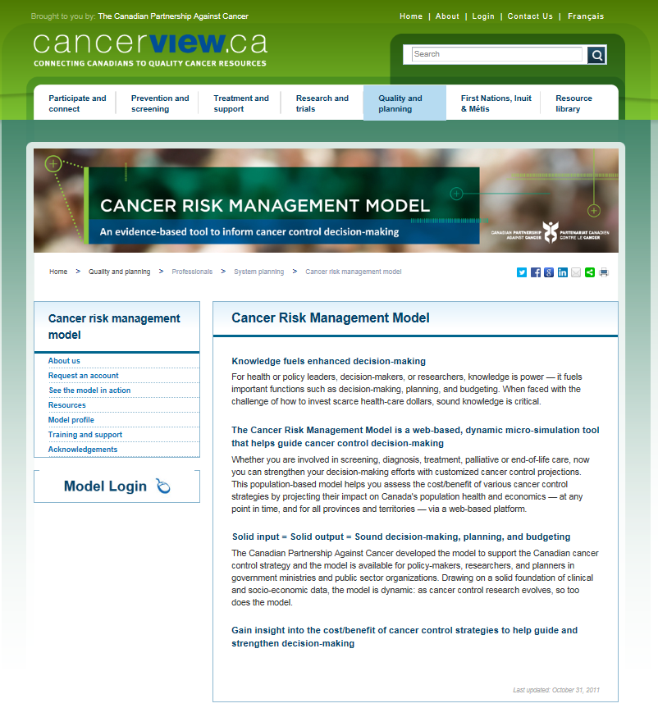
Model Login
www.cancerview.ca/cancerriskmanagement
Request an account
Training and Support

Slide 20
Main Data Sources
Data Type | Source
Mortality, Birth, Population projections | Vital Statistics (1950-2005), Census (2006, 2011)
Incidence, Staging, (Survival) | Canadian Cancer Registry (1992-2010)
Cancer Survival by stage | British Columbia Cancer Registry Data (1992-2012) Chart review (1991-92), Literature (1981, 1990-2000, 2005),
Smoking rates | Canadian Community Health Survey (2000-2007), National Population Health Survey (1994-2004) Canadian Health Survey (1979)
Time use data | General Social Survey (2005)
Earnings, Transfers, and Taxes | Census 2006, SPSD/M v16.1 (2005)
Total health care expenditures | Canadian Institute for Health Information (2006)
Health care costs: diagnosis, treatment, follow-up, palliative and terminal care | Ontario Case Costing Initiative (2007-2008), Provincial formulary (2009), Provincial Ministries of Health (2009)
Current treatment practice | Expert Opinion, Ontario admin data
Screening, Lung cancer risk equation, Radon exposure, sexual network, HPV virus transmission | Canadian Breast Cancer Screening Database, British Columbia admin data, CCHS, Reports, Literature
Health status | Classification and Measurement System, CCHS
Notes:
All Data Sourced and Available

Slide 21
Model Assessment
Consultation (external) Current practice/costs reviewed by experts from across Canada not involved in building model Case study evaluations
Face Validity Inspect simulated individual life trajectories for plausibility
Internal validation Ensure model outputs are consistent with model inputs Example: Do incidence rates generate the expected number of cancer cases?
External validation Ensure model outputs are consistent with other data sources not used to build model Example: Can we replicate outcomes from other studies (RCTs)?
Calibration ( model fitting ) An iterative process of parameter estimation to ensure that the underlying model processes can match a pre-selected set of target data

