Slide 1
Key Cost Estimates on Cancer Treatment and Smoking Cessation in Canada
March 2017

Slide 2
Contents
Overview
Why is this resource important?
What information is contained in this resource?
How can I use this resource?
Methods
Scope + Limitations
Key Costs – Smoking Cessation
Key Costs – Cancer Treatment
Suggested citation
Bibliography

Slide 3
Tobacco use in this document does not refer to use of traditional tobacco for ceremonial and/or spiritual purposes, it refers instead to misuse and cessation of commercial tobacco products

Slide 4
Why is this resource important?

Slide 5
Why is this resource important?
Tobacco use is the world’s leading cause of preventable death
Tobacco use costs Canadians billions of dollars each year in direct health care costs and indirect costs (e.g., lost productivity, long-term disability and death)

Slide 6
Why is this resource important?
Many cancer patients still smoke regularly (Lucchiari et al., 2013; U.S. Department of Health and Human Services (HHS) 2014)
About 20% of current cancer patients in Canada are smokers (Liu et al., 2016)
Cigarette smoking can reduce the effectiveness of cancer treatments and increase the risk of therapy-related side effects (Li et al., 2015)
Given the addictive nature of smoking and the high risk of relapse, the incorporation of smoking cessation efforts into cancer care is needed (HHS 2014; Warren & Ward, 2015)
Notes:
Data sources:
Lucchiari C, Masiero M, Botturi A, Pravettoni G. Helping patients to reduce tobacco consumption in oncology: a narrative review. Springerplus 2016;5:1136.
U.S. Department of Health and Human Services (HHS). The Health Consequences of Smoking: 50 Years of Progress. A Report of the Surgeon General. . Atlanta, GA: U.S. Department of Health and Human Services, Centers for Disease Control and Prevention, National Center for Chronic Disease Prevention and Health Promotion, Office on Smoking and Health., 2014.
Liu J, Chadder J, Fung S, Lockwood G, Rahal R, Halligan M, Mowat D, Bryant H. Smoking behaviours of current cancer patients in Canada. Current Oncology 2016; 23(3):201-203.
Li WHC, Chan SSC, Wang KMP, Lam TH. Helping cancer patients quit smoking by increasing their risk perception: a study protocol of a cluster randomized controlled trial. BMC Cancer 2015;15:490.
Warren GW, Ward KD. Integration of tobacco cessation services into multidisciplinary lung cancer care: rationale, state of the art, and future directions. Transl Lung Cancer Res 2015;4:339-52.

Slide 7
Why is this resource important?
Evidence indicates that tobacco cessation improves the effectiveness of treatment and likelihood of survival amongst all cancer patients, not just those with tobacco-related cancers, yet tobacco use is rarely addressed within oncology practice.
While evidence-based approaches to tobacco cessation exist in Canada, these services are rarely offered in cancer settings.

Slide 8
Why is this resource important?
Treatments for smoking cessation are ‘among the most cost effective of all healthcare interventions’. (NIH, 2002)
Without support around half of all quit attempts fail within the first week of a quit. (Hughes et al, 2004)
Less than five percent of quit attempts result in long-term abstinence. (Hughes et al, 2004)
Notes:
National Institute for Health and Clinical Excellence. Guidance on the Use of Nicotine Replacement Therapy (NRT) and Bupropion for Smoking Cessation. 2002: 1-27. http://www.nice.org.uk/nicemedia/pdf/NiceNRT39GUIDANCE.pdf .
Hughes JR, Keely J, Naud S. Shape of the relapse curve and long-term abstinence among untreated smokers. Addiction 2004;99:29–38.

Slide 9
Why is this resource important?
In 2015, the Centre for Excellence in Economic Analysis Research (CLEAR) completed a rapid literature review on the cost effectiveness of tobacco cessation programs in oncology settings.
This review identified a single full-text article that met the inclusion criteria: a cost-effectiveness analysis of a formal smoking cessation program for patients with early-stage non-small cell lung cancer.
According to this study, at one year post-surgery, the incremental cost-effectiveness ratios (ICERs) were $16,415 per quality-adjusted life year (QALY) gained and $45,629 per life year gained, whereas at five years post-surgery, the ICERs were $2,609 per QALY gained and $2,703 per life year gained.
These results indicate that the cost-effectiveness of smoking cessation became more evident as time increased, due to benefits of the program continuing.
Overall, findings suggest that current and future smoking cessation programs should incorporate an economic evaluation alongside a tobacco cessation intervention to assess its cost-effectiveness.
(CLEAR 2015)
Notes:
Centre for Excellence in Economic Analysis Research (CLEAR). Rapid literature review: Economic evaluation of smoking cessation programs in the oncology setting. April 2015. Available from: https://content.cancerview.ca/download/cv/prevention_and_screening/tobacco_cessation/documents/rapidliteraturereviewecoevalpdf?attachment=0

Slide 10
Why is this resource important?
The cost of smoking cessation is dwarfed in comparison to the cost of cancer treatment
e.g., ~$27,898 for initial-phase colorectal cancer treatment for females versus ~$5314 for “best practice” smoking cessation support including: multiple counselling sessions, NRT + medications (VAR or BUP), and 6.3 quit attempts. (refer to slides 39 + 41 for cost assumptions)
Given that cancer patients who continue to smoke likely require more treatment (e.g., higher dosages of drugs, radiation, longer treatment duration, surgical complications, rehospitalization, etc), offering smoking cessation to cancer patients represents an opportunity to improve quality and efficacy of cancer care and lower costs to the healthcare system

Slide 11
What information is contained in this resource?

Slide 12
What information is contained within this resource?
This resource includes:
Cost estimates associated with various smoking cessation interventions
Costs of commonly treated cancers in Canada, including gender- and phase-specific costs of treatment.
Effectiveness of smoking cessation interventions
Coverage of cessation aids across Canada
Sample smoking cessation intervention scenarios
Notes sections contain complete citation information, as well as detailed costing assumptions, easy to copy + paste

Slide 13
How can I use this resource?

Slide 14
How can I use this resource?
To support cancer agencies and governments in sustaining, spreading and scaling up evidence-based approaches to tobacco cessation within the cancer system, the Canadian Partnership Against Cancer has compiled multiple lines of evidence in a suite of resources.
These slides on key cost estimates are one of several resources available from the Partnership to support evidence-informed decision-making on tobacco cessation for cancer patients.

Slide 15
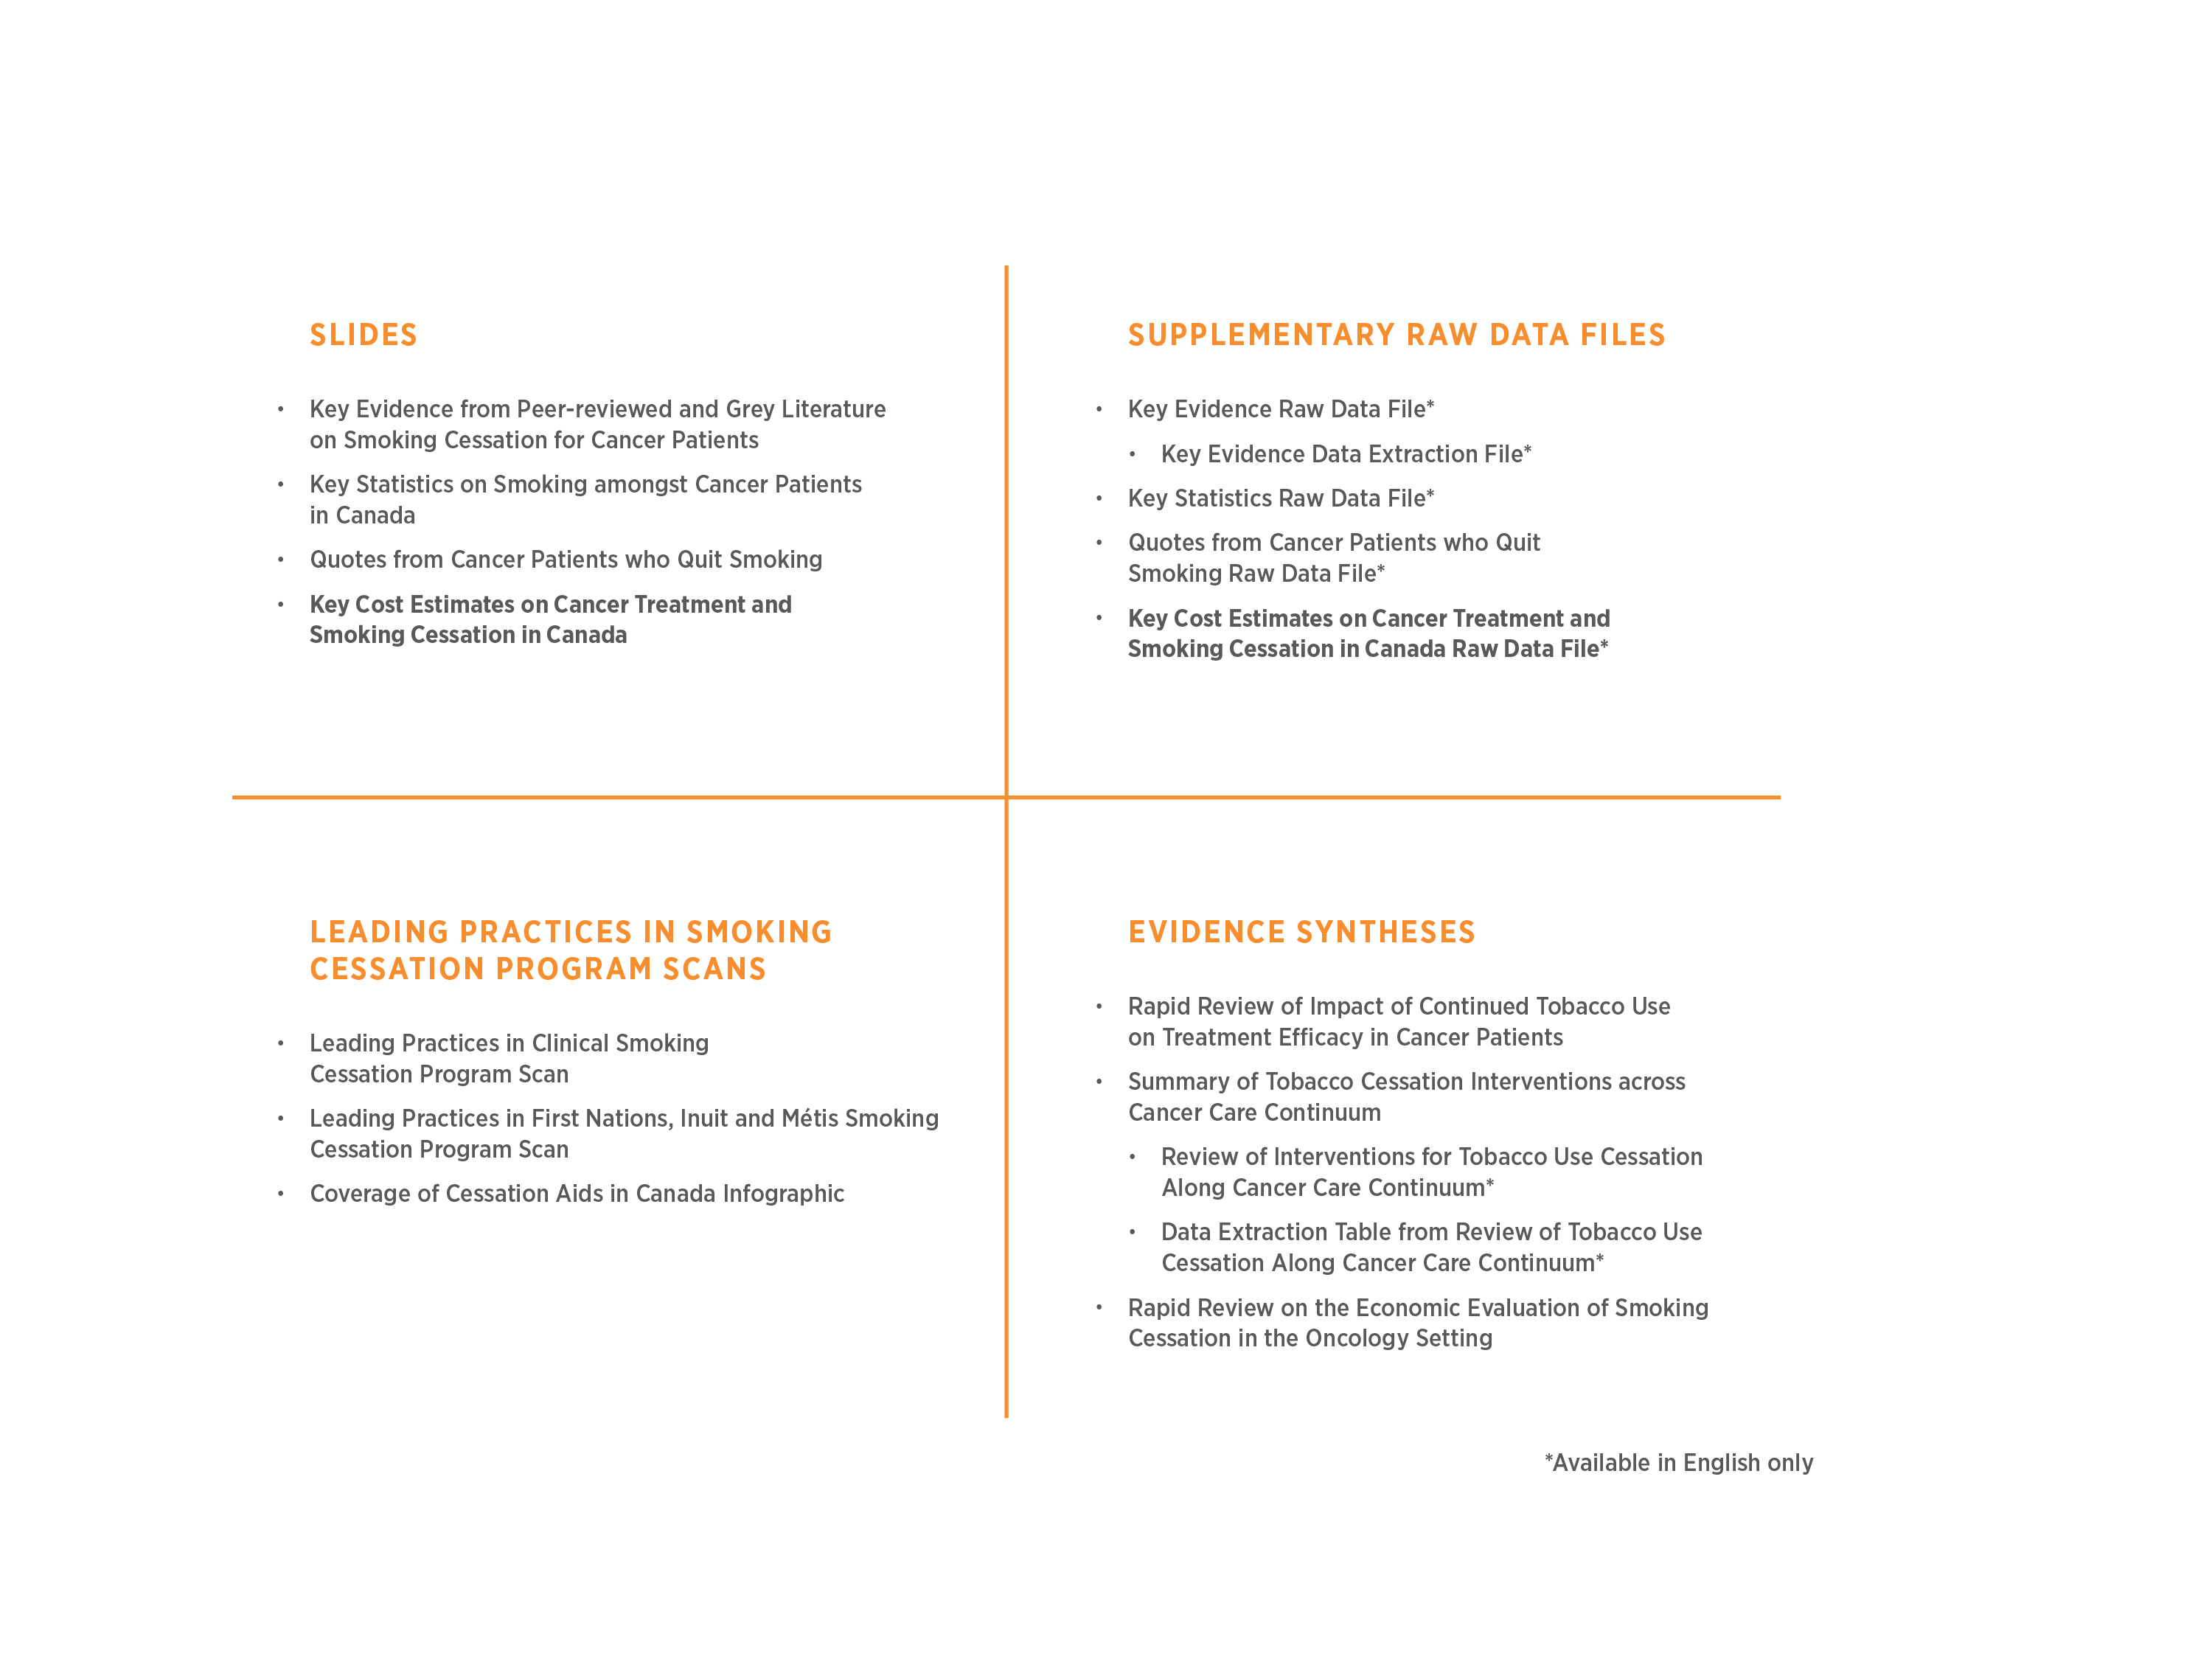
Suite of Tobacco Cessation in Cancer Systems Resources
www.cancerview.ca/tobacco

Slide 16
How can I use this resource?
Copy-and-paste slides or data on cost estimations into presentations, briefing notes, reports, etc
Build your own cost estimates from data presented on slides or within raw data file
Access assumptions from notes sections of slides
Copy-and-paste citations from notes sections of slides, or bibliography section
Cite the resource using the suggested citation in your presentations, briefings, reports, etc

Slide 17
Methods

Slide 18
Methods
Average Costs of Smoking Cessation Interventions (Pharmacotherapy)
Costing data were sourced from the 2016 provincial drug formularies, where available.
These costs excluded drug dispensing fees and markup prices.
Average Canadian unit costs were taken as the average of provincial unit costs, and were multiplied by the number of units required for each smoking cessation intervention.
Minimum, average, and maximum values were used to exemplify the range of average costs across varying dosages (as per expert input)
Data on effectiveness of smoking cessation interventions included
The Number Needed to Treat (NNT) is provided for each intervention, and represents how many are required to treat in order to prevent one early death (Hughes, 2012).
Expert review was completed by the Partnership and external experts in smoking cessation at the Centre for Addiction and Mental Health
Notes:
Hughes JR. A Quantitative Estimate of the Clinical Significance of Treating Tobacco Dependence. 2012;100(2):130–4.
Chaiton M, Diemert L, Cohen JE, et al Estimating the number of quit attempts it takes to quit smoking successfully in a longitudinal cohort of smokers BMJ Open 2016;6:e011045. doi: 10.1136/bmjopen-2016-011045

Slide 19
Methods
Average Costs of Smoking Cessation Interventions (Counselling)
Provider time requirements were determined for each step of these strategies.
Costs were allocated based on the average hourly salaries of three health disciplines: registered nurses, physicians and pharmacists.
Average hourly salaries were sourced from the Government of Alberta Occupations and Educational Programs website and converted to 2016 Canadian Dollars using the Bank of Canada monthly consumer price index.
Notes:
Government of Alberta Occupations and Educational Programs website: http://occinfo.alis.alberta.ca/occinfopreview/info/browse-wages

Slide 20
Methods
Average Costs of Smoking Cessation Interventions (Relapse Prevention + Quit Attempts)
Without support around half of all quit attempts fail within the first week of a quit. (Hughes et al, 2004)
The average number of quit attempts to achieve abstinence is likely significantly higher than what is generally communicated to smokers.
A new Canadian study suggests that a current smoker tries to quit on average 30 times or more before successfully quitting for 1 year or longer (Chaiton et al, 2016)
Extended treatment with varenicline may prevent relapse, studies of extended treatment with NRT are urgently needed (Hajek et al, 2013)
Notes:
Hughes JR, Keely J, Naud S. Shape of the relapse curve and long-term abstinence among untreated smokers. Addiction 2004;99:29–38.
Chaiton M, Diemert L, Cohen JE, et al Estimating the number of quit attempts it takes to quit smoking successfully in a longitudinal cohort of smokers BMJ Open 2016;6:e011045. doi: 10.1136/bmjopen-2016-011045
Hajek P, Stead LF, West R, Jarvis M, Hartmann-Boyce J, Lancaster T. Relapse prevention interventions for smoking cessation. Cochrane Database of Systematic Reviews 2013, Issue 8. Art. No.: CD003999. DOI: 10.1002/14651858.CD003999.pub4.

Slide 21
Methods
Average Costs of Smoking Cessation Interventions (Relapse Prevention + Quit Attempts)
Minimum, average, and maximum values were used to exemplify the range of average costs across varying numbers of quit attempts based on Chaiton et al’s methodologies, but tailored slightly to reflect the cancer patient population, versus general population (Chaiton et al, 2016)
Minimum quit attempts = 6.3 attempts. This scenario comes from a recall of quit attempts over a lifetime amongst successful quitters, may underestimate actual number of quit attempts.
Maximum quit attempts = 29.6 attempts. This scenario comes from a life table approach, whereby the success rate of quit attempts varies by “quit attempt age” as observed during period of the study. This approach is offsetting – it overestimates chance of success, may underestimate subsequent attempts.
Average quit attempts = 19.6 attempts. This scenario comes from a constant rate assumption, whereby every quit attempt has the same chance of success, no matter how many previous quit attempts there have been, may underestimate actual number of quit attempts.
Finally, Chaiton et al’s maximum quit attempts (142) wasn’t used in this analysis, as this represents a lifetime approach, and is less relevant to the cancer patient population, though may be helpful when estimating quit attempts in the general population.
Notes:
Chaiton M, Diemert L, Cohen JE, et al Estimating the number of quit attempts it takes to quit smoking successfully in a longitudinal cohort of smokers BMJ Open 2016;6:e011045. doi: 10.1136/bmjopen-2016-011045
¹Based on modelling and data from Chaiton et al, 2016 study on estimating quit attempts in Canadian population, minimal, maximal, and average scenarios are presented that would likely be relevant to most cancer patient populations. Minimum quit attempts = 6.3 attempts. This scenario comes from a recall of quit attempts over a lifetime amongst successful quitters, may underestimate actual number of quit attempts. Maximum quit attempts = 29.6 attempts. This scenario comes from a life table approach, whereby the success rate of quit attempts varies by “quit attempt age” as observed during period of the study. This approach is offsetting – it overestimates chance of success, may underestimate subsequent attempts. Average quit attempts = 19.6 attempts. This scenario comes from a constant rate assumption, whereby every quit attempt has the same chance of success, no matter how many previous quit attempts there have been, may underestimate actual number of quit attempts. Finally, Chaiton et al’s maximum quit attempts (142) wasn’t used in this analysis, as this represents a lifetime approach, and is less relevant to the cancer patient population, though may be helpful when estimating quit attempts in the general population.
Chaiton M, Diemert L, Cohen JE, et al Estimating the number of quit attempts it takes to quit smoking successfully in a longitudinal cohort of smokers BMJ Open 2016;6:e011045. doi: 10.1136/bmjopen-2016-011045

Slide 22
Scope and Limitations
General + Costs of Smoking Cessation
Multiple assumptions that may not represent all jurisdictions and/or patient populations
No access to the raw data for further analyses or modeling
Changes over time in intervention costs, evidence on effectiveness and healthcare costs may change the estimates
There is no data on average number of quit attempts in cancer patient populations, as such, the data on quit attempts may over- or underestimate actual number of quit attempts required to achieve abstinence in cancer patient populations
Not in scope to determine potential cost-savings nor cost benefits of offering smoking cessation to cancer patients

Slide 23
Methods
Average Costs of Most Commonly Treated Cancers
Top 5 cancers treated in Canada in scope
All costs were obtained from de Oliveira et al., 2016
Estimates of the costs attributable to cancer were obtained by employing the ‘net cost’ method, where the costs incurred by cancer patients were subtracted by the costs incurred by matched controls.
All costs were converted to 2016 Canadian Dollars using the Bank of Canada monthly consumer price index.
Expert review was completed by a health economist expert lead and the Partnership
Notes:
de Oliveira C, Pataky R, Bremner K, Rangrej J, Chan K, Cheung W, Hoch J, Peacock S, Krahn M. Phase-specific and lifetime costs of cancer care in Ontario, Canada. BMC Cancer; 2016;16(1):809.

Slide 24
Methods
Phases of Cancer Treatment: Pre-Diagnosis
For the average costs of cancer treatment, all patients had a pre-diagnosis phase, which is defined as the 3 months before diagnosis.
This phase typically includes diagnostic testing to establish the cancer diagnosis.
(de Oliveira et al., 2016)
Notes:
de Oliveira, C. Pataky, R. Bremner, K. Rangrej, J. Chan, K. Cheung, W. Hoch, J. Peacock, S. and M. Krahn. BMC Cancer; 2016;16(1):809, Phase-specific and lifetime costs of cancer care in Ontario, Canada

Slide 25
Methods
Phases of Cancer Treatment: Initial, Continuing, Terminal
Following the pre-diagnosis phase, the time between diagnosis and death was divided into three clinically relevant phases of care:
Initial: includes the primary course of therapy and any adjuvant therapy (defined as 6 months from date of diagnosis);
Continuing: encompasses ongoing surveillance and active follow-up treatment for cancer recurrence and/or new primary cancers (expressed as an annual estimate); and
Terminal: captures the intensive services, often palliative, provided in the year before death (defined as 12 months including data of death).
(de Oliveira et al., 2016)
Notes:
de Oliveira, C. Pataky, R. Bremner, K. Rangrej, J. Chan, K. Cheung, W. Hoch, J. Peacock, S. and M. Krahn. BMC Cancer; 2016;16(1):809, Phase-specific and lifetime costs of cancer care in Ontario, Canada

Slide 26
Scope and Limitations
Costs of Cancer Treatment
The estimated average net costs for each phase includes:
costs of chemotherapy and radiation therapy
all physician services (primary care physicians, specialists and other physicians) and diagnostic tests and laboratory services
outpatient prescription drugs for patients aged 65+ and/or on social assistance (only)
inpatient hospitalizations (also includes any drugs provided during the hospital stay)
ambulatory care (which includes same-day surgeries/procedures and emergency department visits)
other institution-based care (which includes complex continuing care and long-term care), and home care.
(de Oliveira et al., 2016)
Notes:
de Oliveira, C. Pataky, R. Bremner, K. Rangrej, J. Chan, K. Cheung, W. Hoch, J. Peacock, S. and M. Krahn. BMC Cancer; 2016;16(1):809, Phase-specific and lifetime costs of cancer care in Ontario, Canada

Slide 27
Scope and Limitations
Costs of Cancer Treatment
These cost estimates do not cover:
community service agency costs
costs covered under private health care plans, including outpatient drug costs for those aged <65 years
other health care costs paid out-of-pocket

Slide 28
Key Costs

Slide 29
Smoking Cessation

Slide 30
Effectiveness of Smoking Cessation Interventions – Pharmacotherapy
Varenicline (27.6%) and combination NRT (31.5%) (e.g., patch + inhaler) were most effective for achieving smoking cessation.
Higher rates of smoking cessation were associated with NRT (17.6%) and bupropion (19.1%) compared with placebo (10.6%). (Cahill et al, 2013; Cahill et al, 2014)
Notes:
Cahill K, Stevens S, Perera R, Lancaster T. Pharmacological interventions for smoking cessation: an overview and network meta-analysis. Cochrane Database of Systematic Reviews 2013, Issue 5. Art. No.: CD009329. DOI: 10.1002/14651858.CD009329.pub2.
Cahill K, Stevens S, Lancaster T. Pharmacological Treatments for Smoking Cessation. JAMA. 2014;311(2):193-194. doi:10.1001/jama.2013.283787

Slide 31
Effectiveness of Smoking Cessation Interventions – Behavioural/Counselling
As summarized in Reid et al, 2016:
Brief advice can increase the likelihood of short-term abstinence by 30%. (Fiore et al, 2008)
Intensive cessation advice and counselling has a higher likelihood of getting smokers to quit compared with brief advice (OR 1.37, 95% CI 1.20–1.56). (Stead et al, 2013)
Two approaches to counselling yield significantly higher abstinence rates:
practical counselling for problem-solving skills (e.g., dealing with other smokers, managing cravings, anticipating situations where temptation to smoke will be high [e.g., low mood, alcohol use]);
emotional support (e.g., expressing confidence in the patient’s ability to quit, praising actions taken and successes) (Fiore et al, 2008)
Individual or group counselling increase abstinence rates relative to self-help (1.39 [95% CI 1.24–1.57] and 1.98 [95% CI 1.60–2.46], respectively. (Lancaster + Stead, 2005; Stead + Lancaster, 2005)
Review of telephone counselling found positive effects for interventions involving multiple sessions of proactive counselling compared with self-help or single-session brief counselling (RR 1.41, 95% CI 1.20–1.66). (Stead et al, 2013)
Notes:
Robert D. Reid, Gillian Pritchard, Kathryn Walker, Debbie Aitken, Kerri-Anne Mullen, and Andrew L. Pipe. Managing smoking cessation. CMAJ December 6, 2016 188:E484-E492;
Fiore MC, Jaén CR, Baker TB, et al. Treating tobacco use and dependence: 2008 update. Washington (DC): US Department of Health and Human Services, Public Health Service; 2008.
Stead LF, Buitrago D, Preciado N, et al. Physician advice for smoking cessation. Cochrane Database Syst Rev 2013;(5): CD000165
Lancaster T, Stead LF. Individual behavioural counselling for smoking cessation. Cochrane Database Syst Rev 2005; (2): CD001292.
Stead LF, Lancaster T. Group behaviour therapy programmes for smoking cessation. Cochrane Database Syst Rev 2005;(2): CD001007.
Stead LF, Hartmann-Boyce J, Perera R, et al. Telephone counselling for smoking cessation. Cochrane Database Syst Rev 2013;(8):CD002850.

Slide 32
Effectiveness of Smoking Cessation Interventions – Combination Therapy
High quality evidence indicates that using a combination of behavioural support and pharmacotherapy increases the chances of successfully quitting after at least six months.
Combining interventions suggests that the chance of success is increased by 70 to 100 percent compared to just brief advice or pharmacotherapy. (Stead et al, 2016)
Notes:
Stead LF, Koilpillai P, Fanshawe TR, Lancaster T. Combined pharmacotherapy and behavioural interventions for smoking cessation. Cochrane Database of Systematic Reviews 2016, Issue 3. Art. No.: CD008286. DOI: 10.1002/14651858.CD008286.pub3.

Slide 33
Notes:
Canadian Partnership Against Cancer. Cessation Aids and Coverage in Canada. April 2016. Available from: https://content.cancerview.ca/download/cv/prevention_and_screening/tobacco_cessation/documents/cessationaidcoverage2pdf?attachment=0

Slide 34
Sample Smoking Cessation Scenarios

Slide 35
Sample Smoking Cessation Scenarios
These scenarios are meant to be illustrative examples
Jurisdictions are encouraged to build their own scenarios using the Key Cost Estimates Raw Data File as a starting point, and incorporating local sources of data to improve accuracy of the estimates

Slide 36
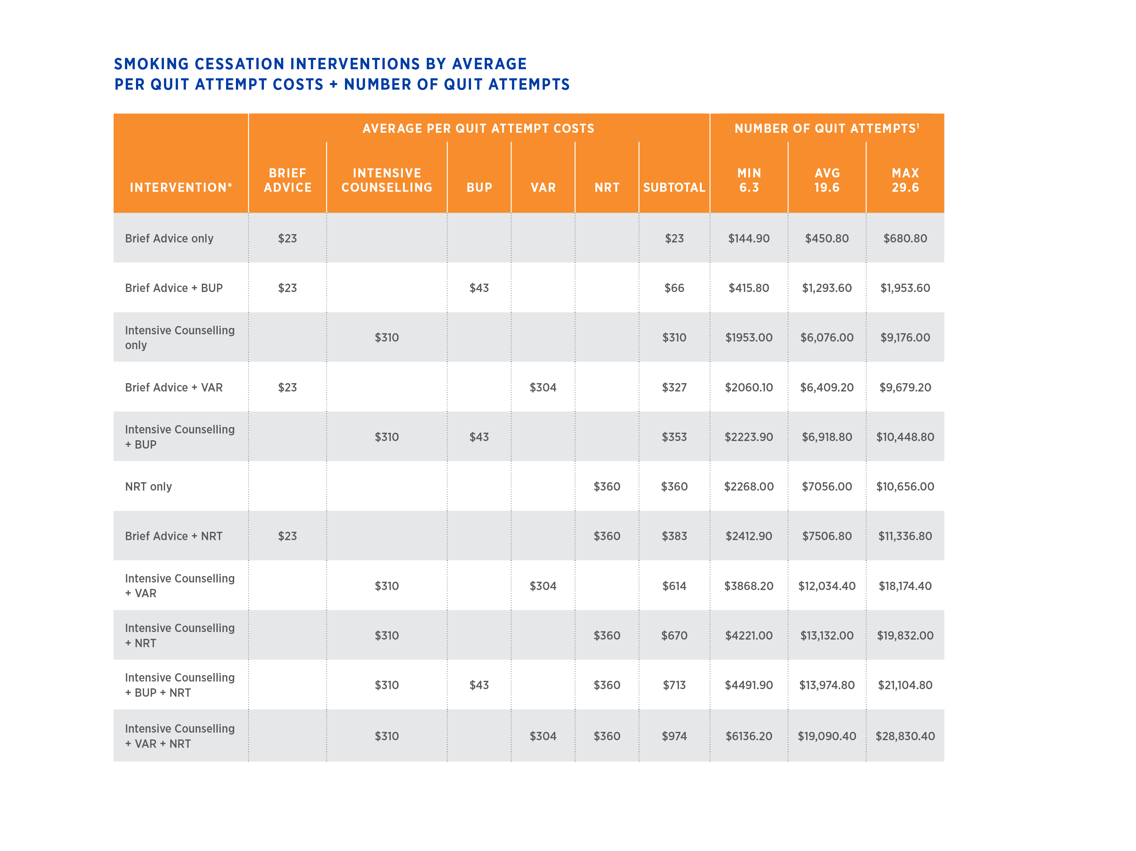
¹Based on modelling and data from Chaiton et al, 2016 study on estimating quit attempts in Canadian population, minimal, maximal, and average scenarios are presented that would likely be relevant to most cancer patient populations. Minimum quit attempts = 6.3 attempts. This scenario comes from a recall of quit attempts over a lifetime amongst successful quitters, may underestimate actual number of quit attempts. Maximum quit attempts = 29.6 attempts. This scenario comes from a life table approach, whereby the success rate of quit attempts varies by “quit attempt age” as observed during period of the study. This approach is offsetting – it overestimates chance of success, may underestimate subsequent attempts. Average quit attempts = 19.6 attempts. This scenario comes from a constant rate assumption, whereby every quit attempt has the same chance of success, no matter how many previous quit attempts there have been, may underestimate actual number of quit attempts.
*Effectiveness of each intervention varies
Estimates are based upon assumptions and costs developed within Raw Data File, please refer to this document for further details on costs and assumptions.
Notes:
Please refer to Key Cost Estimates Raw Data File for full details, assumptions and citations
All costs in 2016 dollars.
¹Based on modelling and data from Chaiton et al, 2016 study on estimating quit attempts in Canadian population, minimal, maximal, and average scenarios are presented that would likely be relevant to most cancer patient populations. Minimum quit attempts = 6.3 attempts. This scenario comes from a recall of quit attempts over a lifetime amongst successful quitters, may underestimate actual number of quit attempts. Maximum quit attempts = 29.6 attempts. This scenario comes from a life table approach, whereby the success rate of quit attempts varies by “quit attempt age” as observed during period of the study. This approach is offsetting – it overestimates chance of success, may underestimate subsequent attempts. Average quit attempts = 19.6 attempts. This scenario comes from a constant rate assumption, whereby every quit attempt has the same chance of success, no matter how many previous quit attempts there have been, may underestimate actual number of quit attempts. Finally, Chaiton et al’s maximum quit attempts (142) wasn’t used in this analysis, as this represents a lifetime approach, and is less relevant to the cancer patient population, though may be helpful when estimating quit attempts in the general population.
Chaiton M, Diemert L, Cohen JE, et al Estimating the number of quit attempts it takes to quit smoking successfully in a longitudinal cohort of smokers BMJ Open 2016;6:e011045. doi: 10.1136/bmjopen-2016-011045
*Effectiveness of each intervention varies
ª Average wage of health care professionals (physicians, registered nurses + pharmacists) used to calculate personnel costs
^{b} NRT could be patch, gum, lozenge, inhaler or spray. Average costs per week, based on average use of each form: $20 patch, $10 lozenge, $29 gum, $45 spray + $46 inhaler

Slide 37
ªAverage wage of health care professionals (physicians, registered nurses + pharmacists) used to calculate personnel costs. Cost per minute is $0.70.
*Referral may be to an external smoking cessation program, quitline, etc
¹Based on modelling and data from Chaiton et al, 2016 study on estimating quit attempts in Canadian population, minimal, maximal, and average scenarios are presented that would likely be relevant to most cancer patient populations. Minimum quit attempts = 6.3 attempts. This scenario comes from a recall of quit attempts over a lifetime amongst successful quitters, may underestimate actual number of quit attempts. Maximum quit attempts = 29.6 attempts. This scenario comes from a life table approach, whereby the success rate of quit attempts varies by “quit attempt age” as observed during period of the study. This approach is offsetting – it overestimates chance of success, may underestimate subsequent attempts. Average quit attempts = 19.6 attempts. This scenario comes from a constant rate assumption, whereby every quit attempt has the same chance of success, no matter how many previous quit attempts there have been, may underestimate actual number of quit attempts.
Notes:
Please refer to Key Cost Estimates Raw Data File for full details, assumptions and citations
All costs in 2016 dollars.
ª Average wage of health care professionals (physicians, registered nurses + pharmacists) used to calculate personnel costs. Cost per minute is $0.70.
¹Based on modelling and data from Chaiton et al, 2016 study on estimating quit attempts in Canadian population, minimal, maximal, and average scenarios are presented that would likely be relevant to most cancer patient populations. Minimum quit attempts = 6.3 attempts. This scenario comes from a recall of quit attempts over a lifetime amongst successful quitters, may underestimate actual number of quit attempts. Maximum quit attempts = 29.6 attempts. This scenario comes from a life table approach, whereby the success rate of quit attempts varies by “quit attempt age” as observed during period of the study. This approach is offsetting – it overestimates chance of success, may underestimate subsequent attempts. Average quit attempts = 19.6 attempts. This scenario comes from a constant rate assumption, whereby every quit attempt has the same chance of success, no matter how many previous quit attempts there have been, may underestimate actual number of quit attempts. Finally, Chaiton et al’s maximum quit attempts (142) wasn’t used in this analysis, as this represents a lifetime approach, and is less relevant to the cancer patient population, though may be helpful when estimating quit attempts in the general population.
Chaiton M, Diemert L, Cohen JE, et al Estimating the number of quit attempts it takes to quit smoking successfully in a longitudinal cohort of smokers BMJ Open 2016;6:e011045. doi: 10.1136/bmjopen-2016-011045

Slide 38
ªAverage wage of health care professionals (physicians, registered nurses + pharmacists) used to calculate personnel costs. Cost per minute is $0.70.
^{b}NRT could be patch, gum, lozenge, inhaler or spray. Average costs per week, based on average use of each form: $20 patch, $10 lozenge, $29 gum, $45 spray + $46 inhaler
¹Based on modelling and data from Chaiton et al, 2016 study on estimating quit attempts in Canadian population, minimal, maximal, and average scenarios are presented that would likely be relevant to most cancer patient populations. Minimum quit attempts = 6.3 attempts. This scenario comes from a recall of quit attempts over a lifetime amongst successful quitters, may underestimate actual number of quit attempts. Maximum quit attempts = 29.6 attempts. This scenario comes from a life table approach, whereby the success rate of quit attempts varies by “quit attempt age” as observed during period of the study. This approach is offsetting – it overestimates chance of success, may underestimate subsequent attempts. Average quit attempts = 19.6 attempts. This scenario comes from a constant rate assumption, whereby every quit attempt has the same chance of success, no matter how many previous quit attempts there have been, may underestimate actual number of quit attempts.
Notes:
Please refer to Key Cost Estimates Raw Data File for full details, assumptions and citations
All costs in 2016 dollars.
ª Average wage of health care professionals (physicians, registered nurses + pharmacists) used to calculate personnel costs. Cost per minute is $0.70.
^{b} NRT could be patch, gum, lozenge, inhaler or spray. Average costs per week, based on average use of each form: $20 patch, $10 lozenge, $29 gum, $45 spray + $46 inhaler
¹Based on modelling and data from Chaiton et al, 2016 study on estimating quit attempts in Canadian population, minimal, maximal, and average scenarios are presented that would likely be relevant to most cancer patient populations. Minimum quit attempts = 6.3 attempts. This scenario comes from a recall of quit attempts over a lifetime amongst successful quitters, may underestimate actual number of quit attempts. Maximum quit attempts = 29.6 attempts. This scenario comes from a life table approach, whereby the success rate of quit attempts varies by “quit attempt age” as observed during period of the study. This approach is offsetting – it overestimates chance of success, may underestimate subsequent attempts. Average quit attempts = 19.6 attempts. This scenario comes from a constant rate assumption, whereby every quit attempt has the same chance of success, no matter how many previous quit attempts there have been, may underestimate actual number of quit attempts. Finally, Chaiton et al’s maximum quit attempts (142) wasn’t used in this analysis, as this represents a lifetime approach, and is less relevant to the cancer patient population, though may be helpful when estimating quit attempts in the general population.
Chaiton M, Diemert L, Cohen JE, et al Estimating the number of quit attempts it takes to quit smoking successfully in a longitudinal cohort of smokers BMJ Open 2016;6:e011045. doi: 10.1136/bmjopen-2016-011045

Slide 39
ªAverage wage of health care professionals (physicians, registered nurses + pharmacists) used to calculate personnel costs. Cost per minute is $0.70.
^{b}NRT could be patch, gum, lozenge, inhaler or spray. Average costs per week, based on average use of each form: $20 patch, $10 lozenge, $29 gum, $45 spray + $46 inhaler
¹Based on modelling and data from Chaiton et al, 2016 study on estimating quit attempts in Canadian population, minimal, maximal, and average scenarios are presented that would likely be relevant to most cancer patient populations.
Notes:
Please refer to Key Cost Estimates Raw Data File for full details, assumptions and citations
All costs in 2016 dollars.
ª Average wage of health care professionals (physicians, registered nurses + pharmacists) used to calculate personnel costs. Cost per minute is $0.70.
^{b} NRT could be patch, gum, lozenge, inhaler or spray. Average costs per week, based on average use of each form: $20 patch, $10 lozenge, $29 gum, $45 spray + $46 inhaler
¹Based on modelling and data from Chaiton et al, 2016 study on estimating quit attempts in Canadian population, minimal, maximal, and average scenarios are presented that would likely be relevant to most cancer patient populations. Minimum quit attempts = 6.3 attempts. This scenario comes from a recall of quit attempts over a lifetime amongst successful quitters, may underestimate actual number of quit attempts. Maximum quit attempts = 29.6 attempts. This scenario comes from a life table approach, whereby the success rate of quit attempts varies by “quit attempt age” as observed during period of the study. This approach is offsetting – it overestimates chance of success, may underestimate subsequent attempts. Average quit attempts = 19.6 attempts. This scenario comes from a constant rate assumption, whereby every quit attempt has the same chance of success, no matter how many previous quit attempts there have been, may underestimate actual number of quit attempts. Finally, Chaiton et al’s maximum quit attempts (142) wasn’t used in this analysis, as this represents a lifetime approach, and is less relevant to the cancer patient population, though may be helpful when estimating quit attempts in the general population.
Chaiton M, Diemert L, Cohen JE, et al Estimating the number of quit attempts it takes to quit smoking successfully in a longitudinal cohort of smokers BMJ Open 2016;6:e011045. doi: 10.1136/bmjopen-2016-011045

Slide 40
Cancer Treatment

Slide 41
(de Oliveira et al., 2016)
Notes:
All costs in 2016 dollars
Among females with colorectal cancer, the highest estimated average net costs are seen in the initial phase, however, these patients also have the lowest estimated average net costs across the pre-diagnosis and continuing phases. Females with breast cancer have the lowest estimated average net costs across the initial and terminal phases of cancer. In general among the top 4 cancers for females, the initial and terminal phases of cancer have higher estimated average net costs compared to the pre-diagnosis and continuing phases of cancer.
de Oliveira, C. Pataky, R. Bremner, K. Rangrej, J. Chan, K. Cheung, W. Hoch, J. Peacock, S. and M. Krahn. BMC Cancer; 2016;16(1):809, Phase-specific and lifetime costs of cancer care in Ontario, Canada

Slide 42
(de Oliveira et al., 2016)
Notes:
All costs in 2016 dollars
Males with prostate cancer have the lowest estimated average net costs across the initial, continuing and terminal phase, whereas males with lung cancer have the highest estimated average net costs across the pre-diagnosis and terminal phases. In general among males with the top 4 cancers, the initial and terminal phases have higher estimated average net costs compared to the pre-diagnosis and continuing phases.
de Oliveira, C. Pataky, R. Bremner, K. Rangrej, J. Chan, K. Cheung, W. Hoch, J. Peacock, S. and M. Krahn. BMC Cancer; 2016;16(1):809, Phase-specific and lifetime costs of cancer care in Ontario, Canada

Slide 43
Suggested citation
Canadian Partnership Against Cancer. (2017). Key Cost Estimates on Cancer Treatment and Smoking Cessation in Canada. Retrieved Month XX, 20XX from: www.cancerview.ca/tobacco

Slide 44
Bibliography
Alberta Health Services (AHS). Tobacco Use Statistics [Available from: https://www.albertaquits.ca/about-us/tobacco-usage/tobacco-use-statistics#costs-of-smoking.
de Oliveira C, Pataky R, Bremner K, Rangrej J, Chan K, Cheung W, Hoch J, Peacock S, Krahn M. Phase-specific and lifetime costs of cancer care in Ontario, Canada. BMC Cancer; 2016;16(1):809.
Government of Alberta Occupations and Educational Programs website: http://occinfo.alis.alberta.ca/occinfopreview/info/browse-wages
Gritz E, Fingeret M, Vidrine D, Lazev A, Mehta N, Reece G. Successes and failures of the teachable moment: Smoking Cessation in Cancer Patients. Cancer. 2006;106(1):17-27.
Hughes JR. A Quantitative Estimate of the Clinical Significance of Treating Tobacco Dependence. 2012;100(2):130–4.
Liu J, Chadder J, Fung S, Lockwood G, Rahal R, Halligan M, Mowat D, Bryant H. Smoking behaviours of current cancer patients in Canada. Current Oncology 2016; 23(3):201-203.
Lucchiari C, Masiero M, Botturi A, Pravettoni G. Helping patients to reduce tobacco consumption in oncology: a narrative review. Springerplus 2016;5:1136.
Reid JL, Hammond D, Rynard VL, R. B. Tobacco Use in Canada: Patterns and Trends, 2015 Edition. . Waterloo, ON: Propel Centre for Population Health Impact, University of Waterloo.
Simmons V, Litvin E, Patel R, Jacobsen P, McCaffrey J, Bepler G et al. Patient–provider communication and perspectives on smoking cessation and relapse in the oncology setting. Patient Education and Counseling. 2009;77(3):398-403.
Warren GW, Ward KD. Integration of tobacco cessation services into multidisciplinary lung cancer care: rationale, state of the art, and future directions. Transl Lung Cancer Res 2015;4:339-52.
Weaver K, Danhauer S, Tooze J, Blackstock A, Spangler J, Thomas L et al. Smoking Cessation Counseling Beliefs and Behaviors of Outpatient Oncology Providers. The Oncologist. 2012;17(3):455- 462.
National Institute for Health and Clinical Excellence. Guidance on the Use of Nicotine Replacement Therapy (NRT) and Bupropion for Smoking Cessation. 2002: 1-27. http://www.nice.org.uk/nicemedia/pdf/NiceNRT39GUIDANCE.pdf .
Hughes JR, Keely J, Naud S. Shape of the relapse curve and long-term abstinence among untreated smokers. Addiction 2004;99:29–38.
Chaiton M, Diemert L, Cohen JE, et al Estimating the number of quit attempts it takes to quit smoking successfully in a longitudinal cohort of smokers BMJ Open 2016;6:e011045. doi: 10.1136/bmjopen-2016-011045
Hajek P, Stead LF, West R, Jarvis M, Hartmann-Boyce J, Lancaster T. Relapse prevention interventions for smoking cessation. Cochrane Database of Systematic Reviews 2013, Issue 8. Art. No.: CD003999. DOI: 10.1002/14651858.CD003999.pub4.
Cahill K, Stevens S, Perera R, Lancaster T. Pharmacological interventions for smoking cessation: an overview and network meta-analysis. Cochrane Database of Systematic Reviews 2013, Issue 5. Art. No.: CD009329. DOI: 10.1002/14651858.CD009329.pub2.
Cahill K, Stevens S, Lancaster T. Pharmacological Treatments for Smoking Cessation. JAMA. 2014;311(2):193-194. doi:10.1001/jama.2013.283787
Robert D. Reid, Gillian Pritchard, Kathryn Walker, Debbie Aitken, Kerri-Anne Mullen, and Andrew L. Pipe. Managing smoking cessation. CMAJ December 6, 2016 188:E484-E492;
Fiore MC, Jaén CR, Baker TB, et al. Treating tobacco use and dependence: 2008 update. Washington (DC): US Department of Health and Human Services, Public Health Service; 2008.
Stead LF, Buitrago D, Preciado N, et al. Physician advice for smoking cessation. Cochrane Database Syst Rev 2013;(5): CD000165
Lancaster T, Stead LF. Individual behavioural counselling for smoking cessation. Cochrane Database Syst Rev 2005; (2): CD001292.
Stead LF, Lancaster T. Group behaviour therapy programmes for smoking cessation. Cochrane Database Syst Rev 2005;(2): CD001007.
Stead LF, Hartmann-Boyce J, Perera R, et al. Telephone counselling for smoking cessation. Cochrane Database Syst Rev 2013;(8):CD002850.
Stead LF, Koilpillai P, Fanshawe TR, Lancaster T. Combined pharmacotherapy and behavioural interventions for smoking cessation. Cochrane Database of Systematic Reviews 2016, Issue 3. Art. No.: CD008286. DOI: 10.1002/14651858.CD008286.pub3.

