Slide 1
The 2018 Cancer System Performance
Tables & Figures
(November 2018)

Slide 2
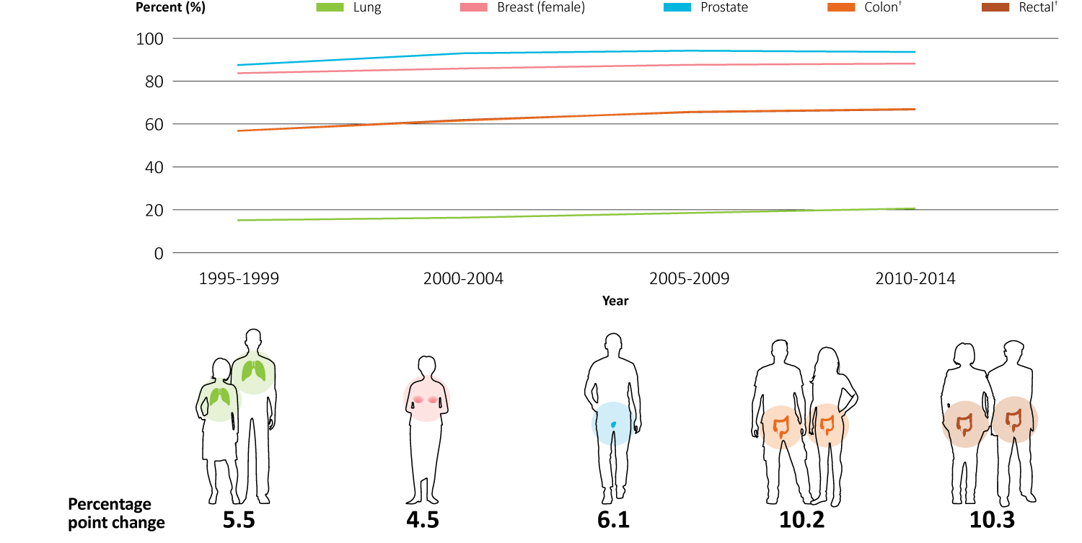
Five-year survival for lung, breast (female), prostate, colon and rectal cancer, by period of diagnosis — from 1995 to 2014
† Only 4 trend lines are visible as colon and rectal cancer had very similar trends in survival over time. 1995-1999 survival data includes all jurisdictions with the following exceptions: no data is available from NT or NU for breast cancer; no data is available from any of the territories for prostate and rectal cancer; no data is available from NT or YK for colon cancer. 2000-2014 survival data includes all provinces except for QC. Data sources: CONCORD-2;15 CONCORD-3;14 Provincial cancer agencies and programs.

Slide 3
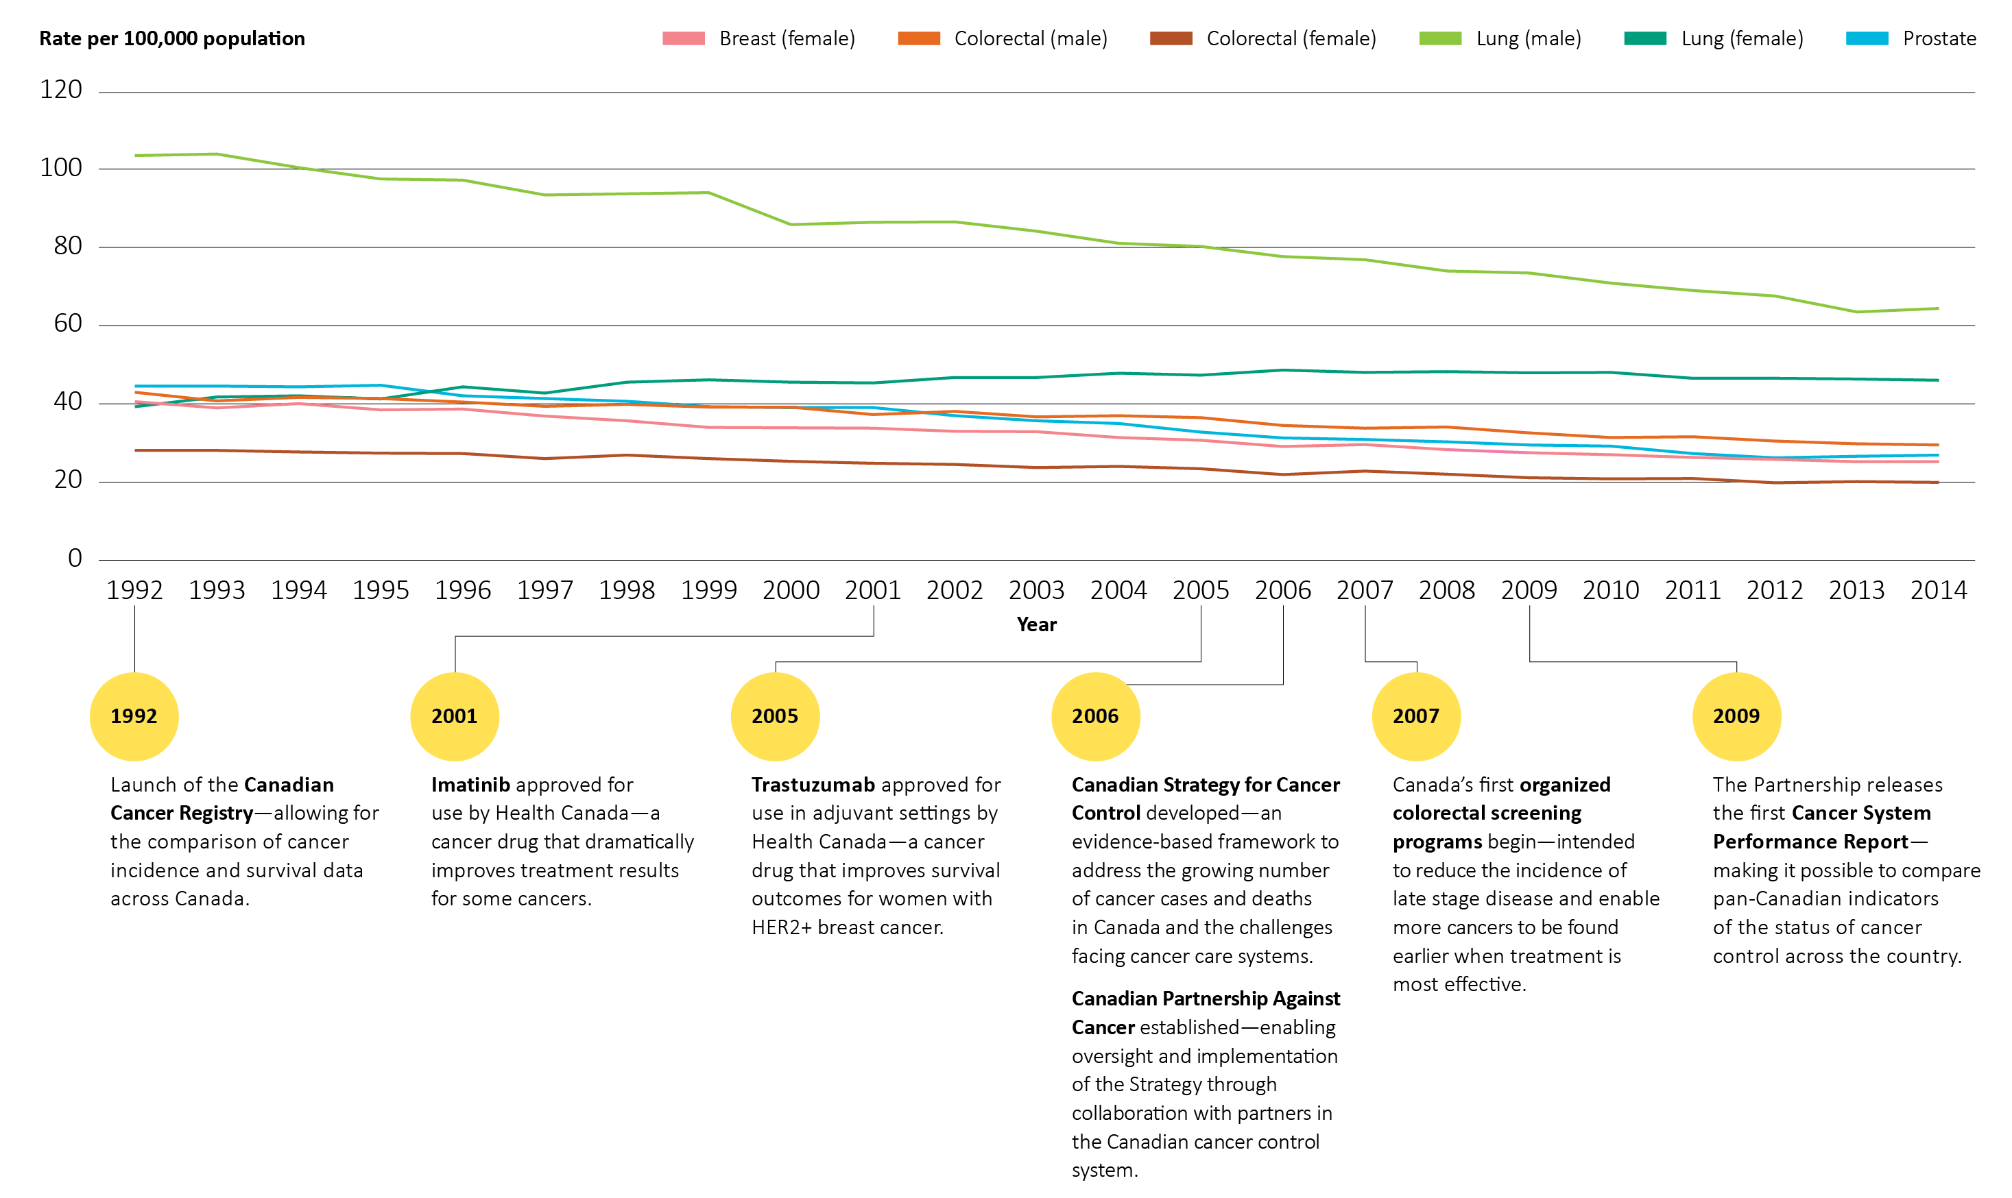
Mortality rates† for breast (female), colorectal, lung and prostate cancer, by sex, Canada — from 1992 to 2014
† Age-standardized to 2011 Canadian population. Data source: Statistics Canada: Vital Statistics Death Database.

Slide 4
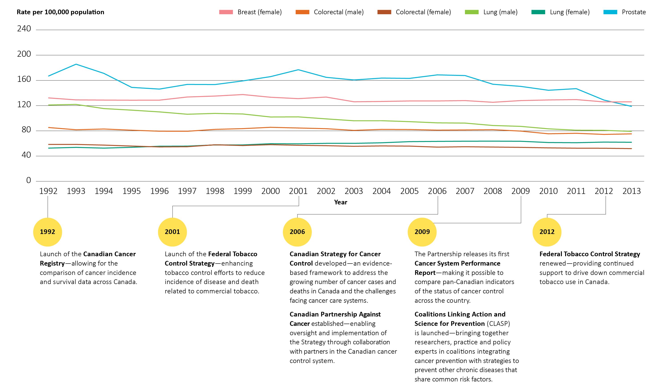
Incidence rates† for breast (female), colorectal, lung and prostate cancer, by sex, Canada — from 1992 to 2013
† Age-standardized to 2011 Canadian population. QC: Cancer incidence data are not available for diagnosis years after 2010. The 2010 Quebec incidence and population data have been copied forward to 2011, 2012 and 2013 for the calculation. Data source: Statistics Canada: Canadian Cancer Registry.

Slide 5
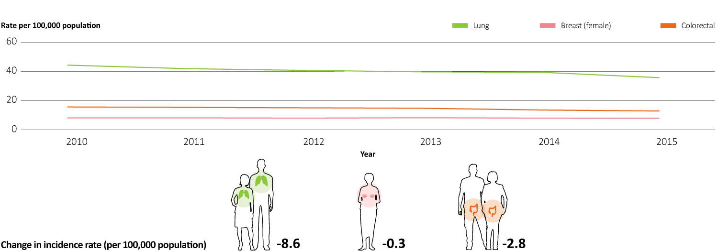
Incidence rates† for Stage IV lung, breast (female) and colorectal cancer – from 2010 to 2015
† Age-standardized to 2011 Canadian population. Includes all provinces and territories except QC. Stage IV incidence data may be underestimated in this figure as all jurisdictions have cases where staging information is unknown or unavailable. Data source: Statistics Canada: Canadian Cancer Registry.

Slide 6
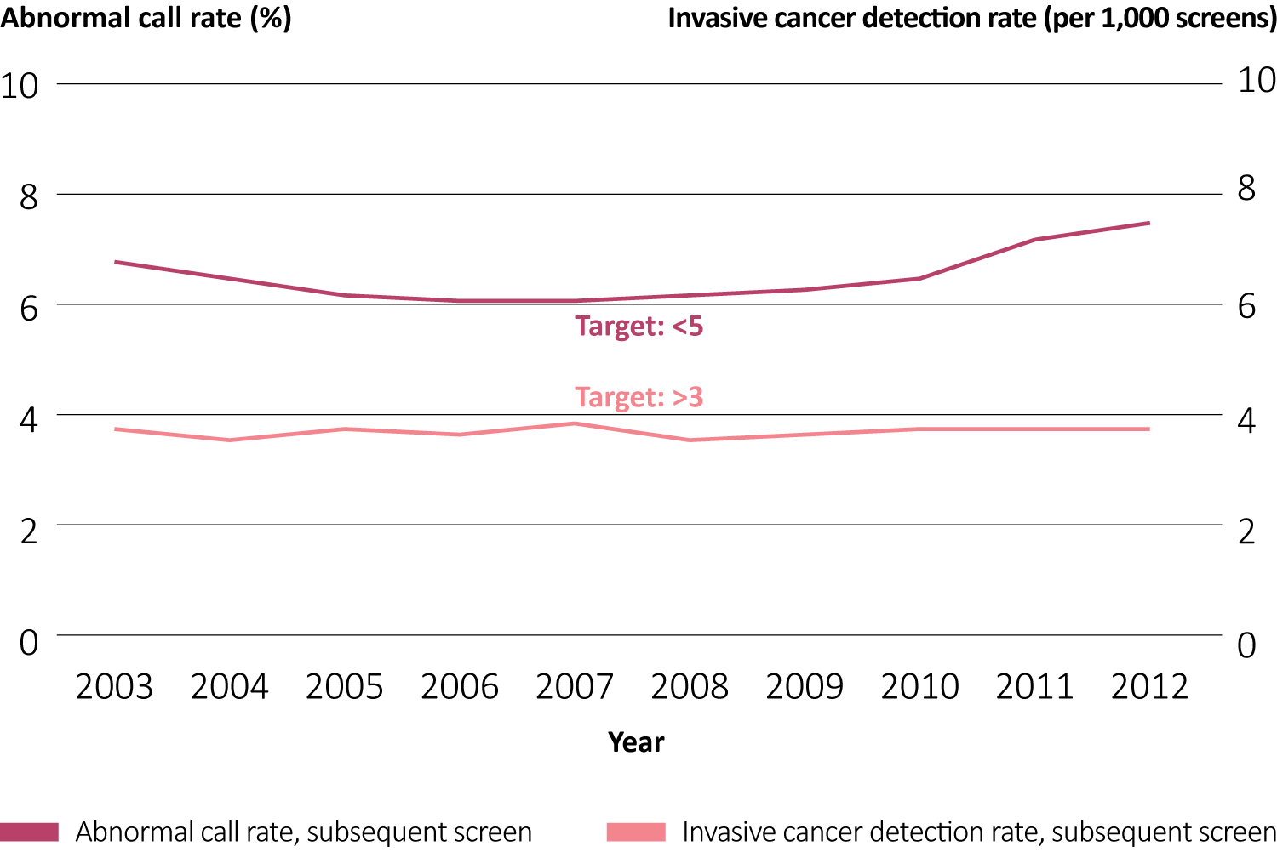
Abnormal call rate and invasive cancer detection rate for subsequent screens,† women aged 50 to 69 years — from 2003 to 2012 screening years
† Subsequent screens includes women who have been screened for breast cancer in the past, and excludes women new to the screening program. AB: Excluded from data prior to 2007 as the Alberta Breast Cancer Screening Program was launched in 2007. QC: Complete diagnostic/cancer information was available to September 30, 2012. Data source: Provincial and territorial breast cancer screening programs.

Slide 7
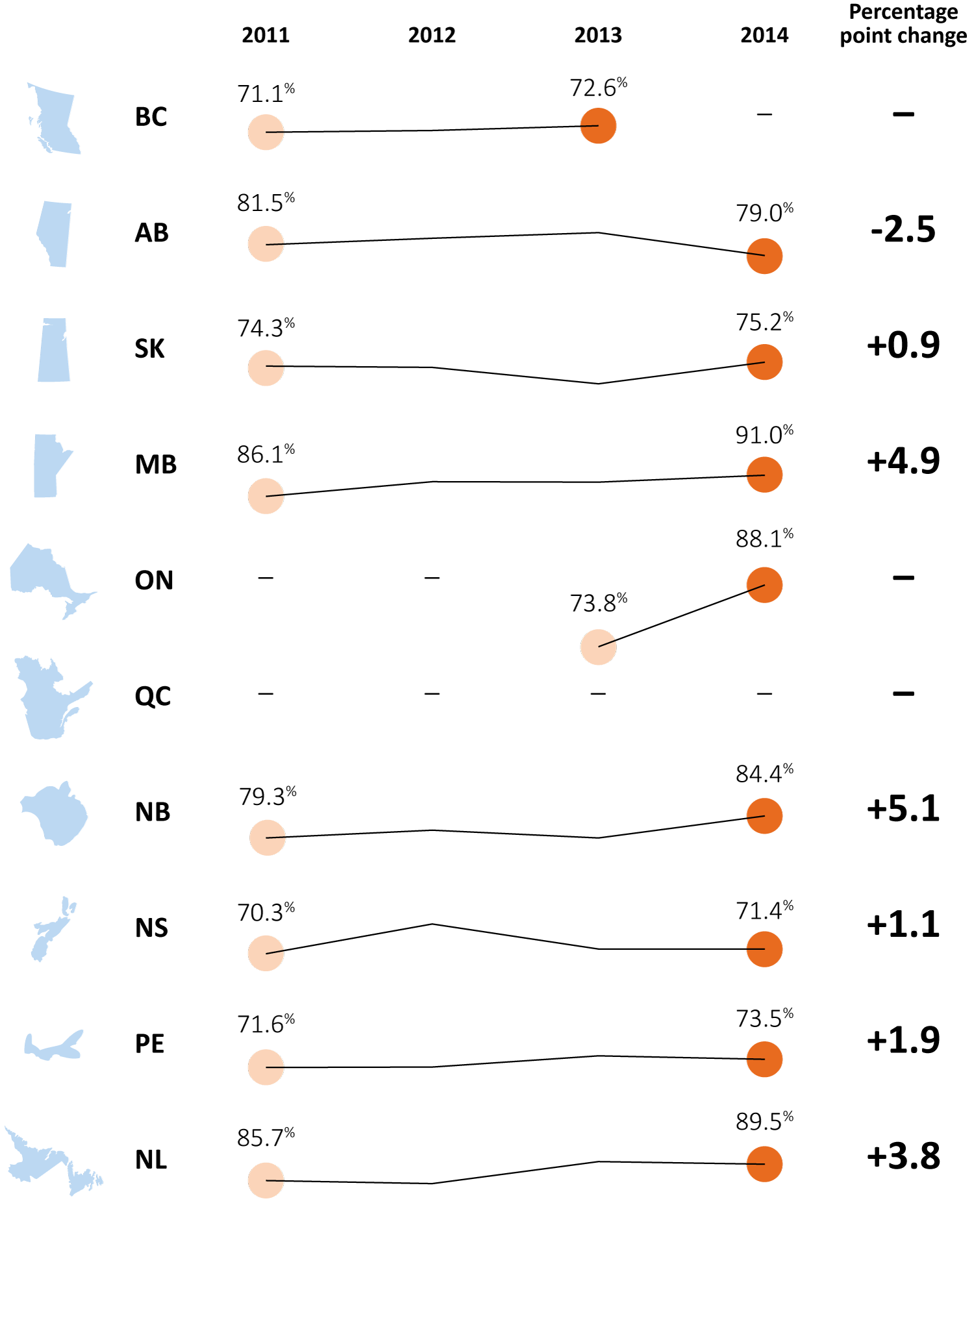
Percentage of colon resections with 12 or more lymph nodes removed and examined, by province — from 2011 to 2014 diagnosis years
“—” Data not available. Data source: Provincial cancer agencies and programs.

Slide 8
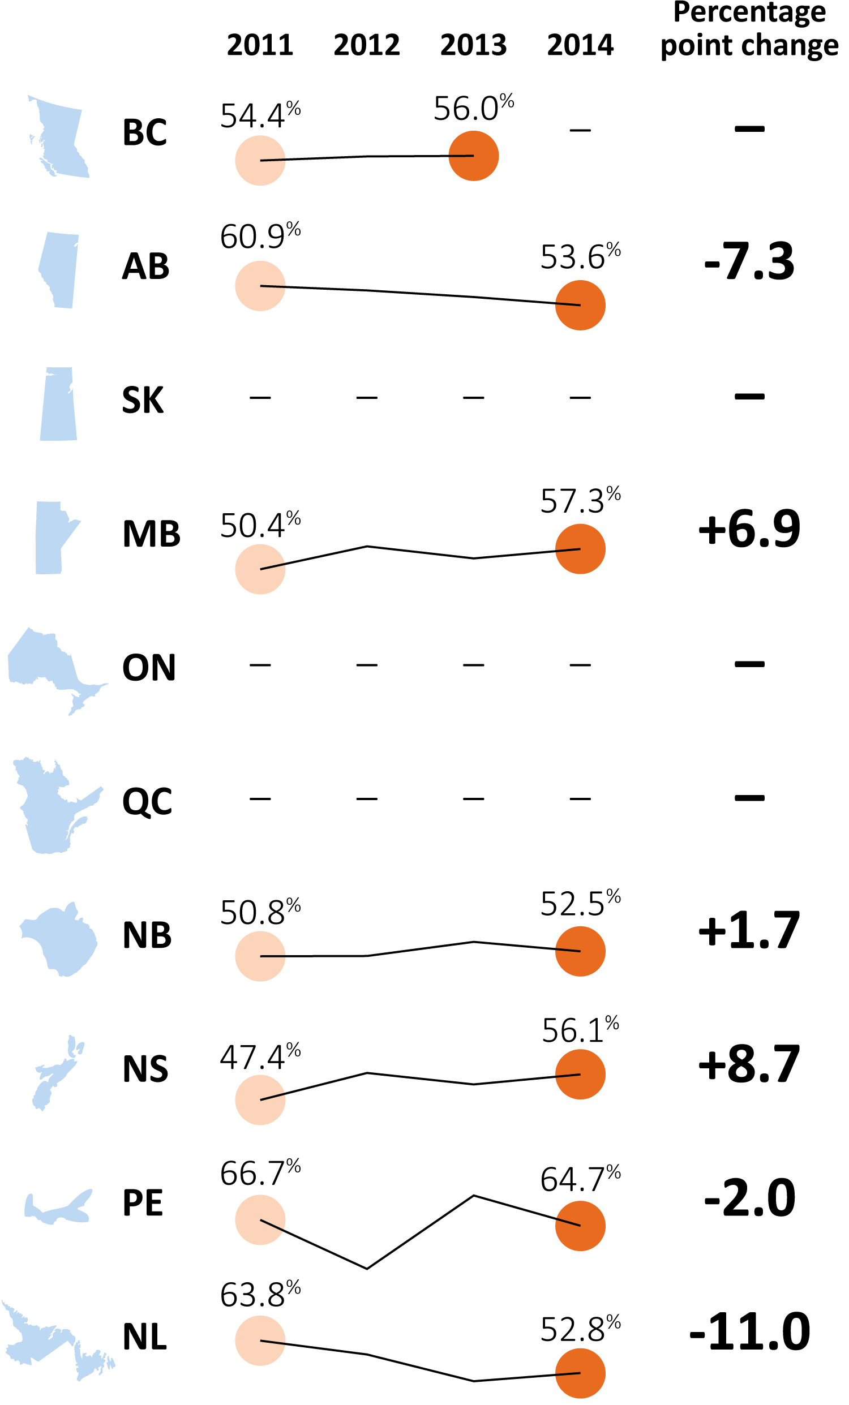
Percentage of Stage II or III rectal cancer patients who received radiation therapy before surgery, by province — from 2011 to 2014 diagnosis years
“—” Data not available. Data source: Provincial cancer agencies and programs.

Slide 9
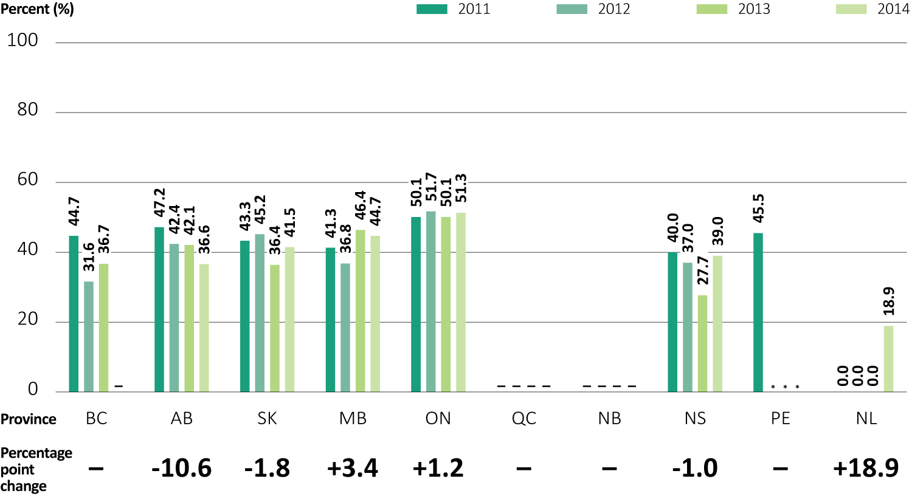
Percentage of Stage II or IIIA non-small cell lung cancer patients who received chemotherapy following surgical resection, by province — from 2011 to 2014 diagnosis years
“—” Data not available. * Suppressed owing to small numbers. NL: The percent increase is due to small counts. Data source: Provincial cancer agencies and programs.

Slide 10
Percentage of patients with Stage II or IIIA non-small cell lung cancer who received chemotherapy following surgical resection, by age group, provinces combined† — from 2011 to 2014 diagnosis years
“—” Data not available. * Suppressed owing to small numbers. NL: The percent increase is due to small counts. Data source: Provincial cancer agencies and programs.

Slide 11
Ratio of adult patients (aged 19+) enrolled in clinical trials to number of incident cases, by province, all cancers — from 2012 to 2015 enrolment years
† Although this indicator is a ratio, as a proxy for the actual clinical trial participation rate, the results (for convenience only) are shown as percentages. “—” Data not available. Denominator: Actual incidence cases were used for 2012 to 2014. Projected incidence cases from Canadian Cancer Registry were used for 2015. ON: Data for age 18+. Data sources: Canadian Cancer Society: Canadian Cancer Statistics; Provincial cancer agencies and programs.

Slide 12
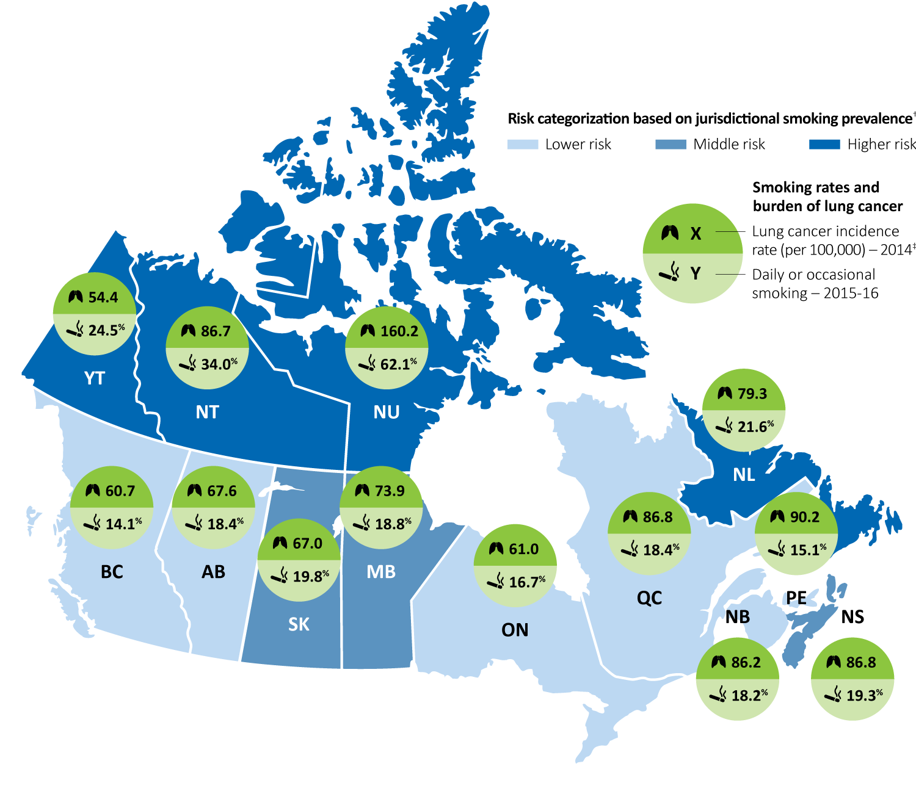
Geographic variation in smoking prevalence and lung cancer incidence – latest reporting years
† Smoking rates from each province and territory were divided into tertiles to generate groups of lower, middle and higher risk. ‡ For incidence rates for territories, years 2012 to 2014 were combined. QC: cancer incidence data are not available for diagnosis years after 2010. The 2010 Quebec incidence and population data have been copied forward to 2014 for the calculation. Data sources: Statistics Canada: Canadian Cancer Registry, Canadian Community Health Survey.

Slide 13
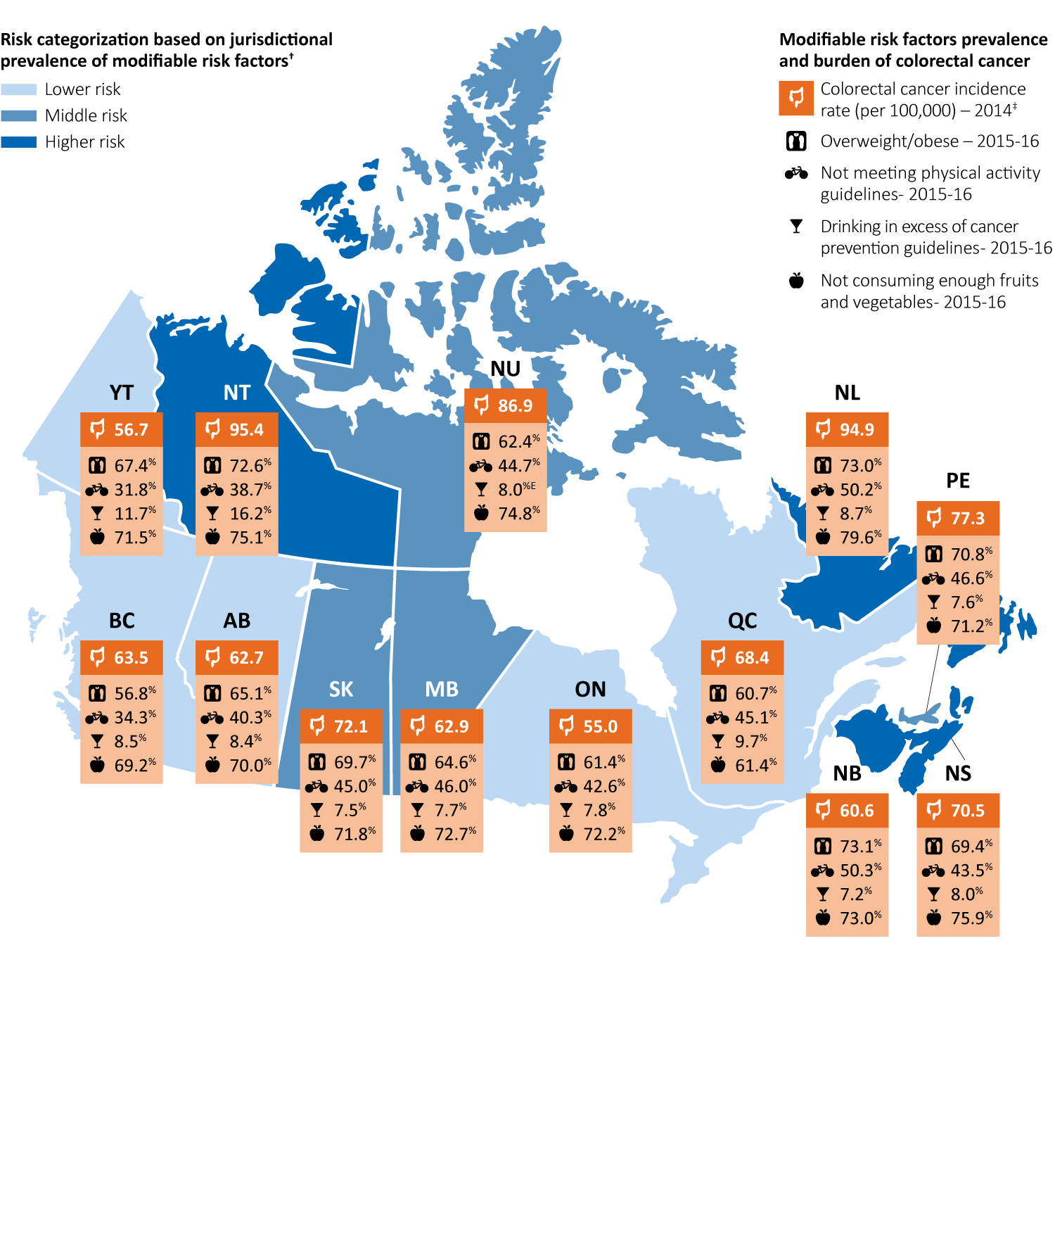
Geographic variation in modifiable risk factors and colorectal cancer incidence – latest reporting years
† Composites were created by summation of jurisdictional cancer risk factors (overweight and obesity, physical inactivity, excessive alcohol consumption and low fruit and vegetables consumption). Derived values were then divided into tertiles to generate groups of lower, middle and higher risk. ‡ For incidence rates for territories, years 2012 to 2014 were combined. E Interpret with caution owing to large variability in the estimate. QC: cancer incidence data are not available for diagnosis years after 2010. The 2010 Quebec incidence and population data have been copied forward to 2014 for the calculation. Data sources: Statistics Canada: Canadian Cancer Registry, Canadian Community Health Survey.

Slide 14
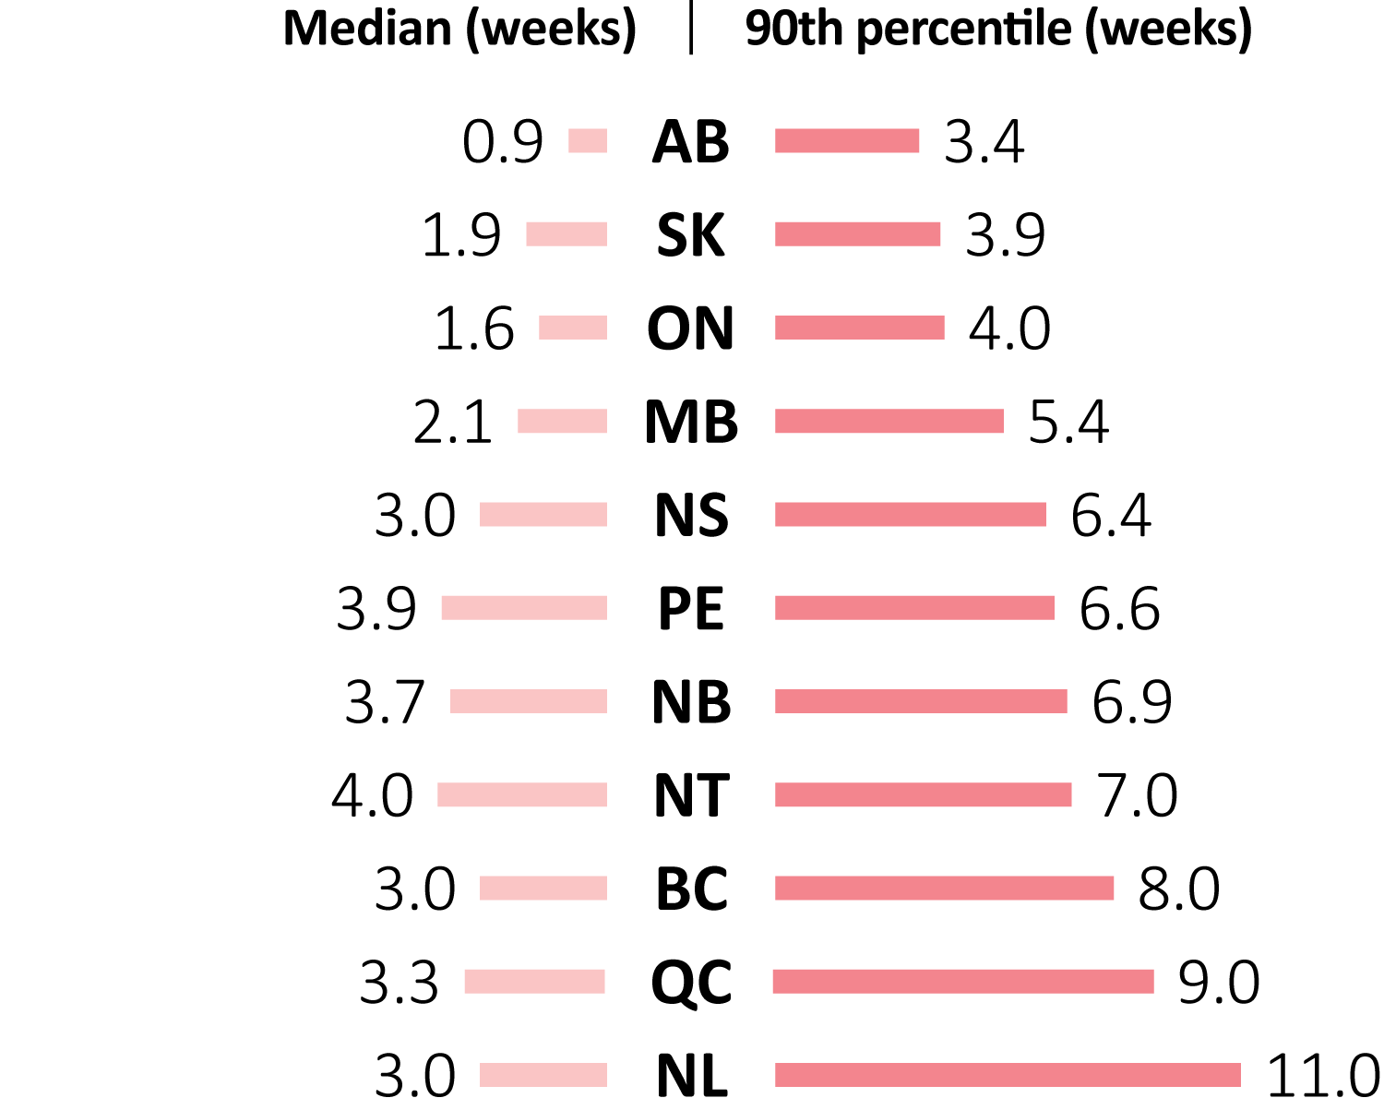
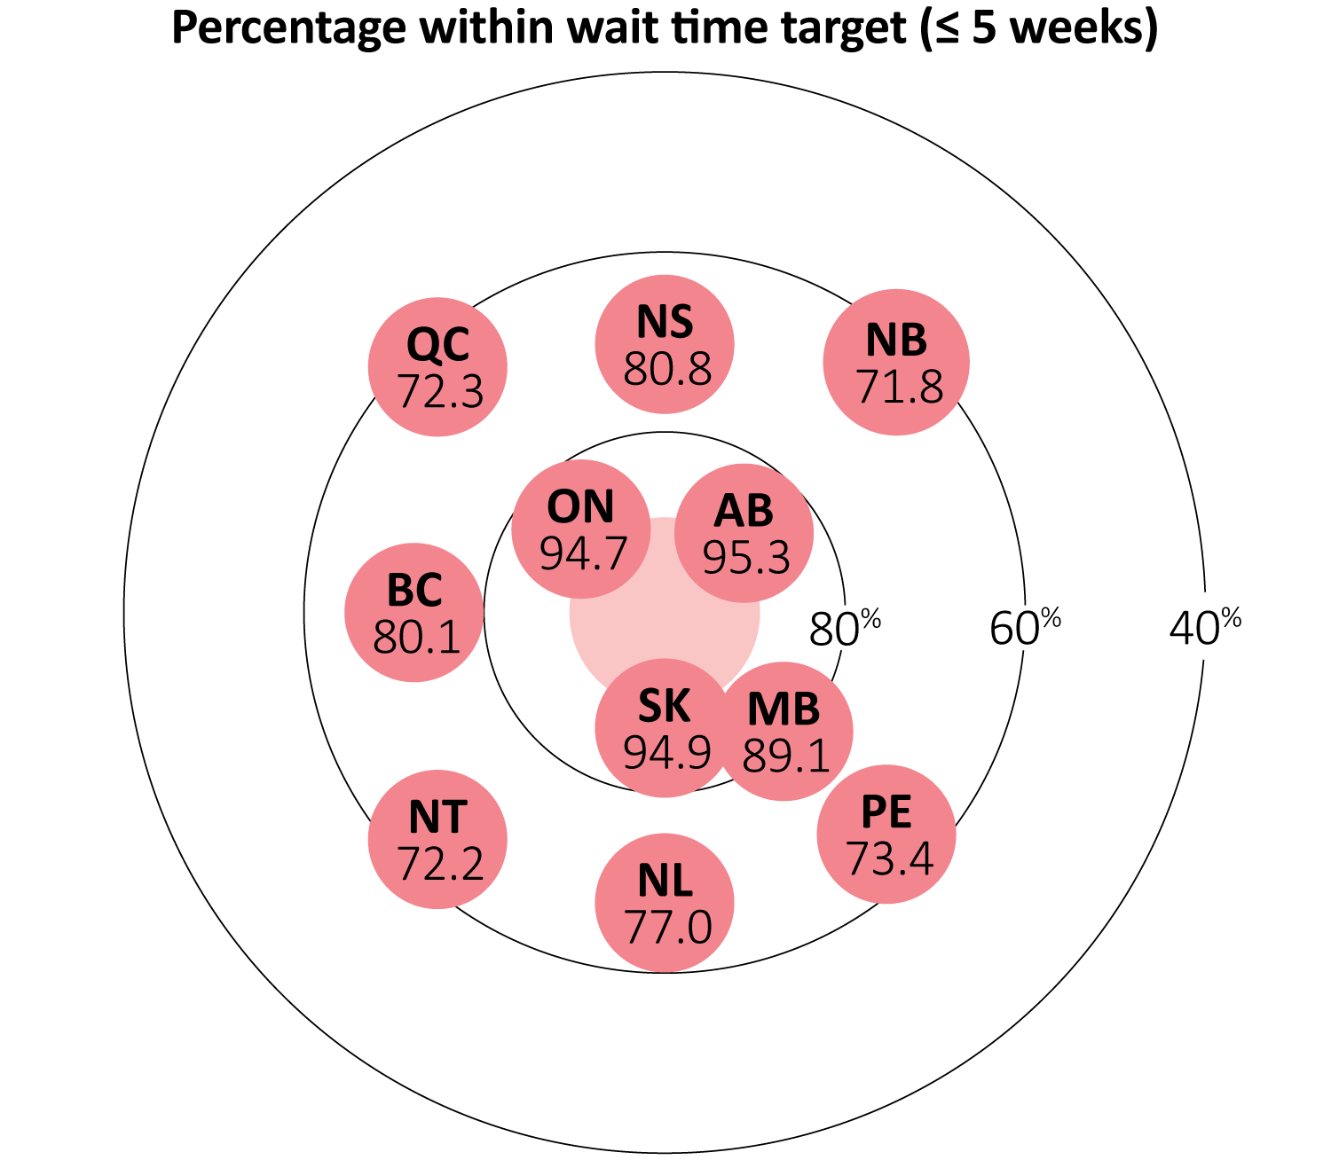
Median and 90th percentile wait times for resolution of abnormal breast screen without tissue biopsy for women aged 50–69, by jurisdiction — 2015 screening year
BC: Screens referred by clinical breast exam (CBE) alone cannot be determined and therefore are not excluded from the data. AB: Data sources are Alberta Breast Cancer Screening Database, Alberta Physician Claim data. SK: Tissue biopsy is defined as a list of investigation types. ON: Women with final result of Unknown/Lost to follow-up and those with a diagnostic resolution date greater than 6 months from abnormal screen were excluded from this measure. QC: Screening data in 2015 were for January to September. NT: All Data were 2013-2015 combined from the BSP database. Data source: Provincial and territorial breast cancer screening programs.

Slide 15
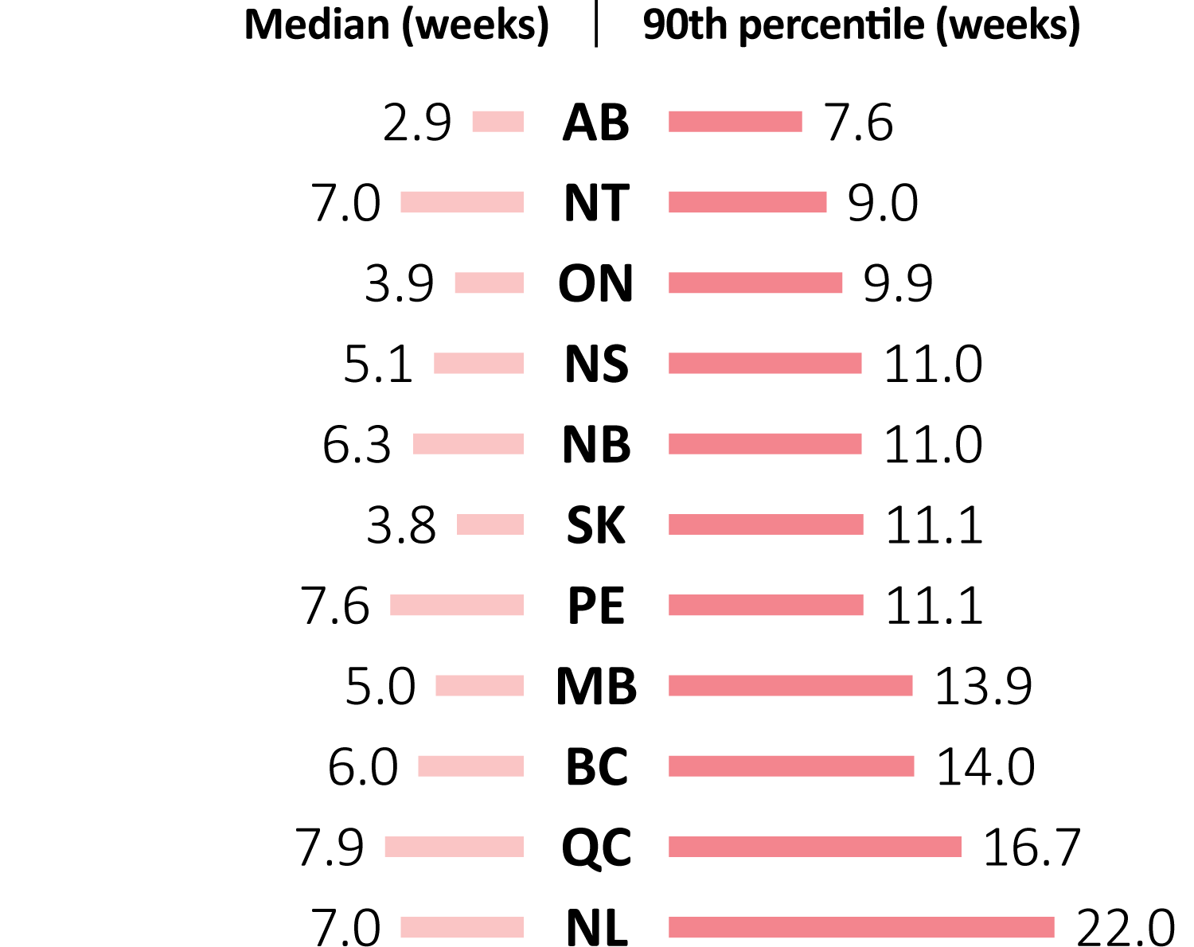
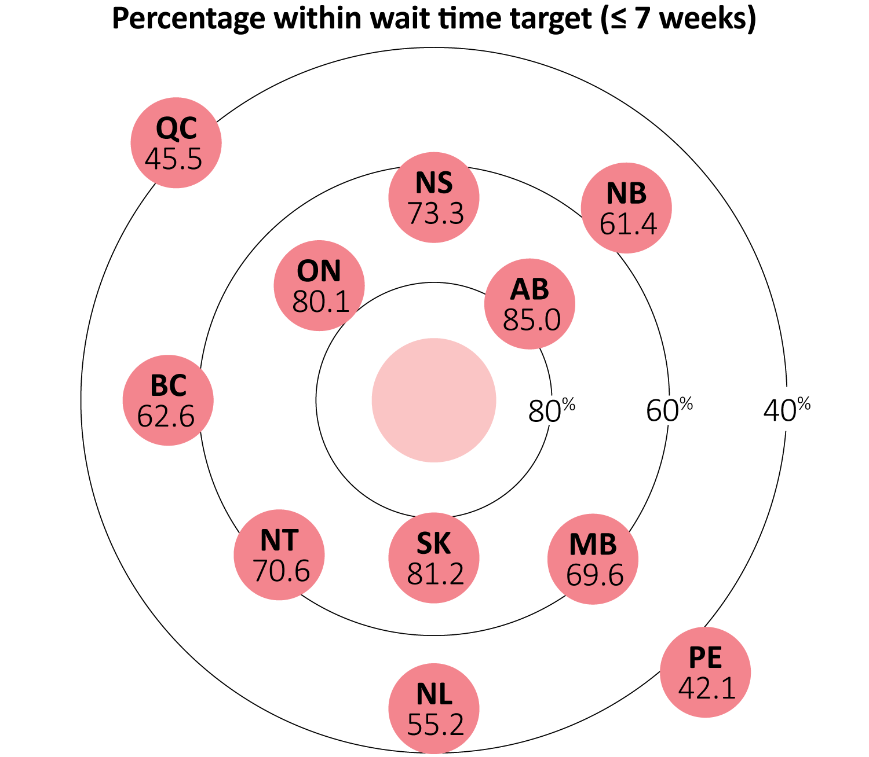
Median and 90th percentile wait times for resolution of abnormal breast screen with tissue biopsy for women aged 50–69, by jurisdiction — 2015 screening year
BC: Screens referred by clinical breast exam (CBE) alone cannot be determined and therefore are not excluded from the data. AB: Data sources are Alberta Breast Cancer Screening Database, Alberta Physician Claim data. SK: Tissue biopsy is defined as a list of investigation types. ON: Women with final result of Unknown/Lost to follow-up and those with a diagnostic resolution date greater than 6 months from abnormal screen were excluded from this measure. QC: Screening data in 2015 were for January to September. NT: All Data were 2013-2015 combined from the BSP database. Data source: Provincial and territorial breast cancer screening programs.

Slide 16
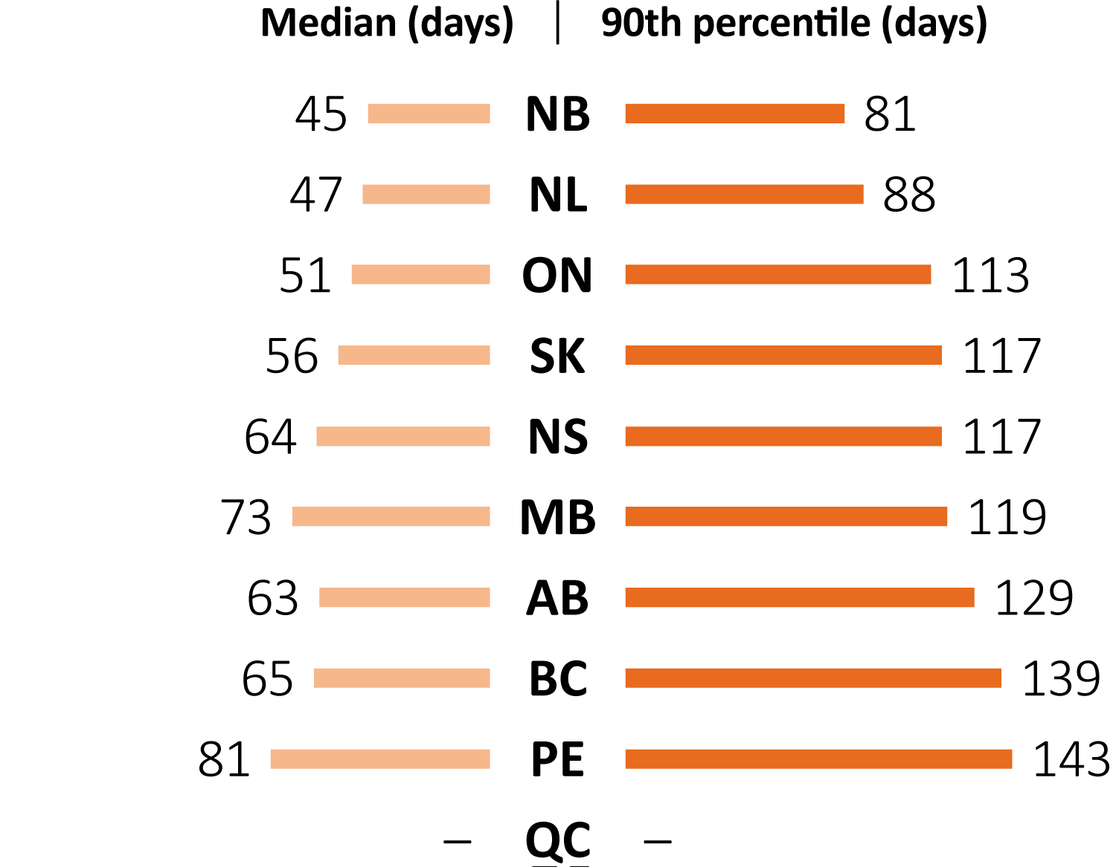
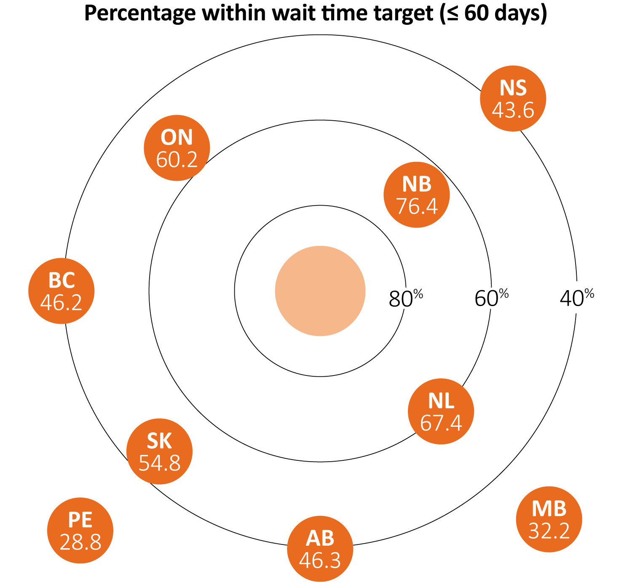
Median and 90th percentile wait times from abnormal fecal test result to follow-up colonoscopy, by province — 2015 screening year
“—” Data not available.
AB: High volumes of positive fecal immunochemical tests may influence wait times for follow-up colonoscopy. In select cases, individuals may choose to postpone follow-up colonoscopy. Depending on the jurisdiction, such cases may or may not be included. See Technical Appendix for more details. Data source: Provincial and territorial colorectal cancer screening programs.

Slide 17
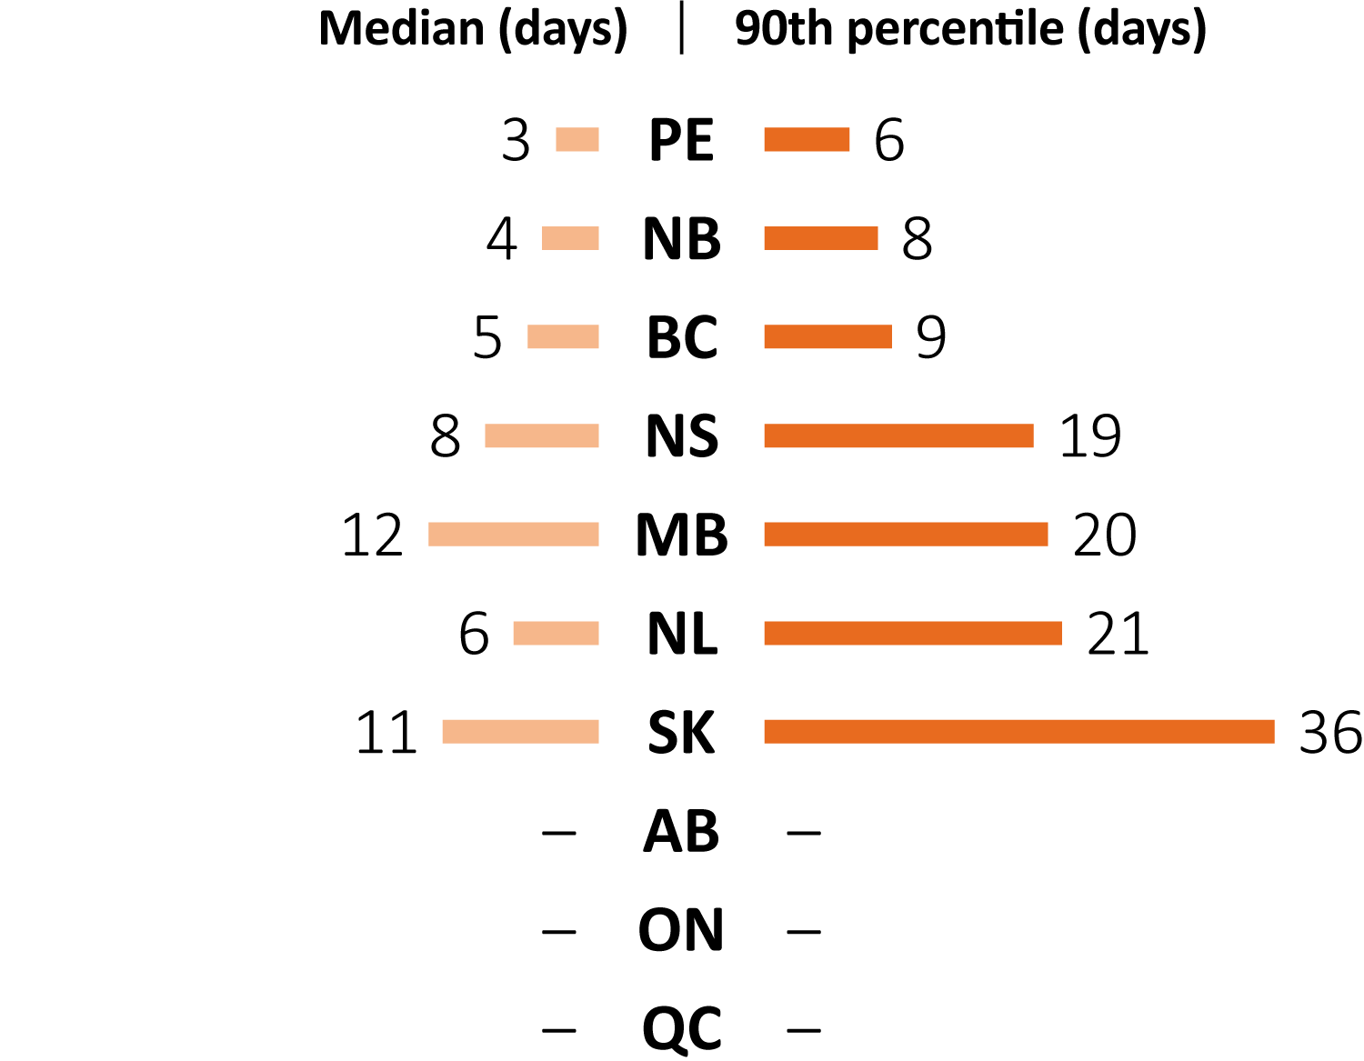
Median and 90th percentile wait times from follow-up colonoscopy to definitive diagnosis, by province — 2015 screening year
“—” Data not available.
In select cases, individuals may choose to postpone follow-up colonoscopy. Depending on jurisdiction, such cases may or may not be included. See Technical Appendix for more details. Data source: Provincial colorectal cancer screening programs.

Slide 18
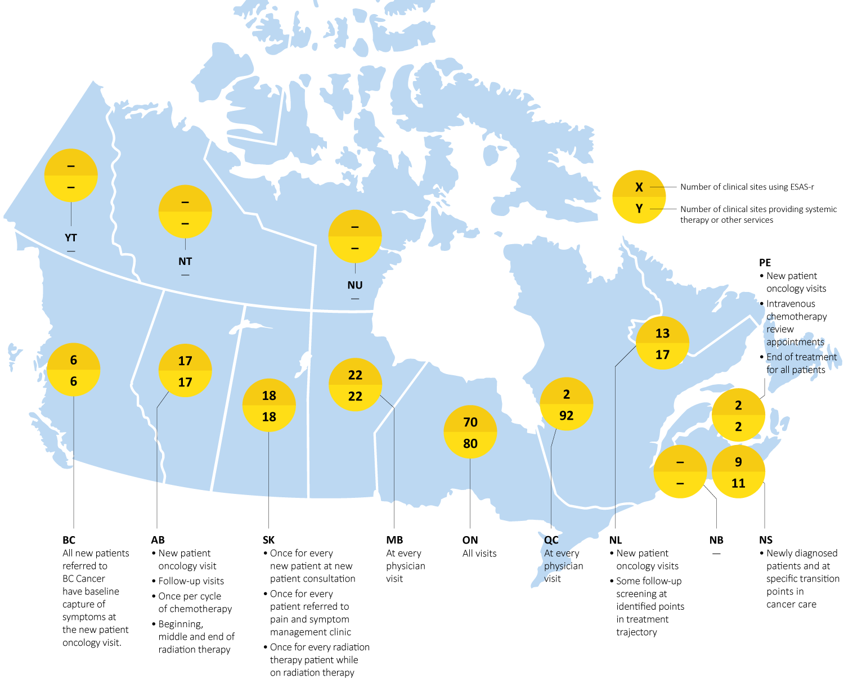
Current state of Patient Reported Outcomes implementation, by province, as of April 2017
“—“ Data not available.
ESAS-r= Edmonton Symptom Assessment System - revised.
Data sources: BC Cancer; Patient-Reported Outcomes Initiative Partners.

Slide 19
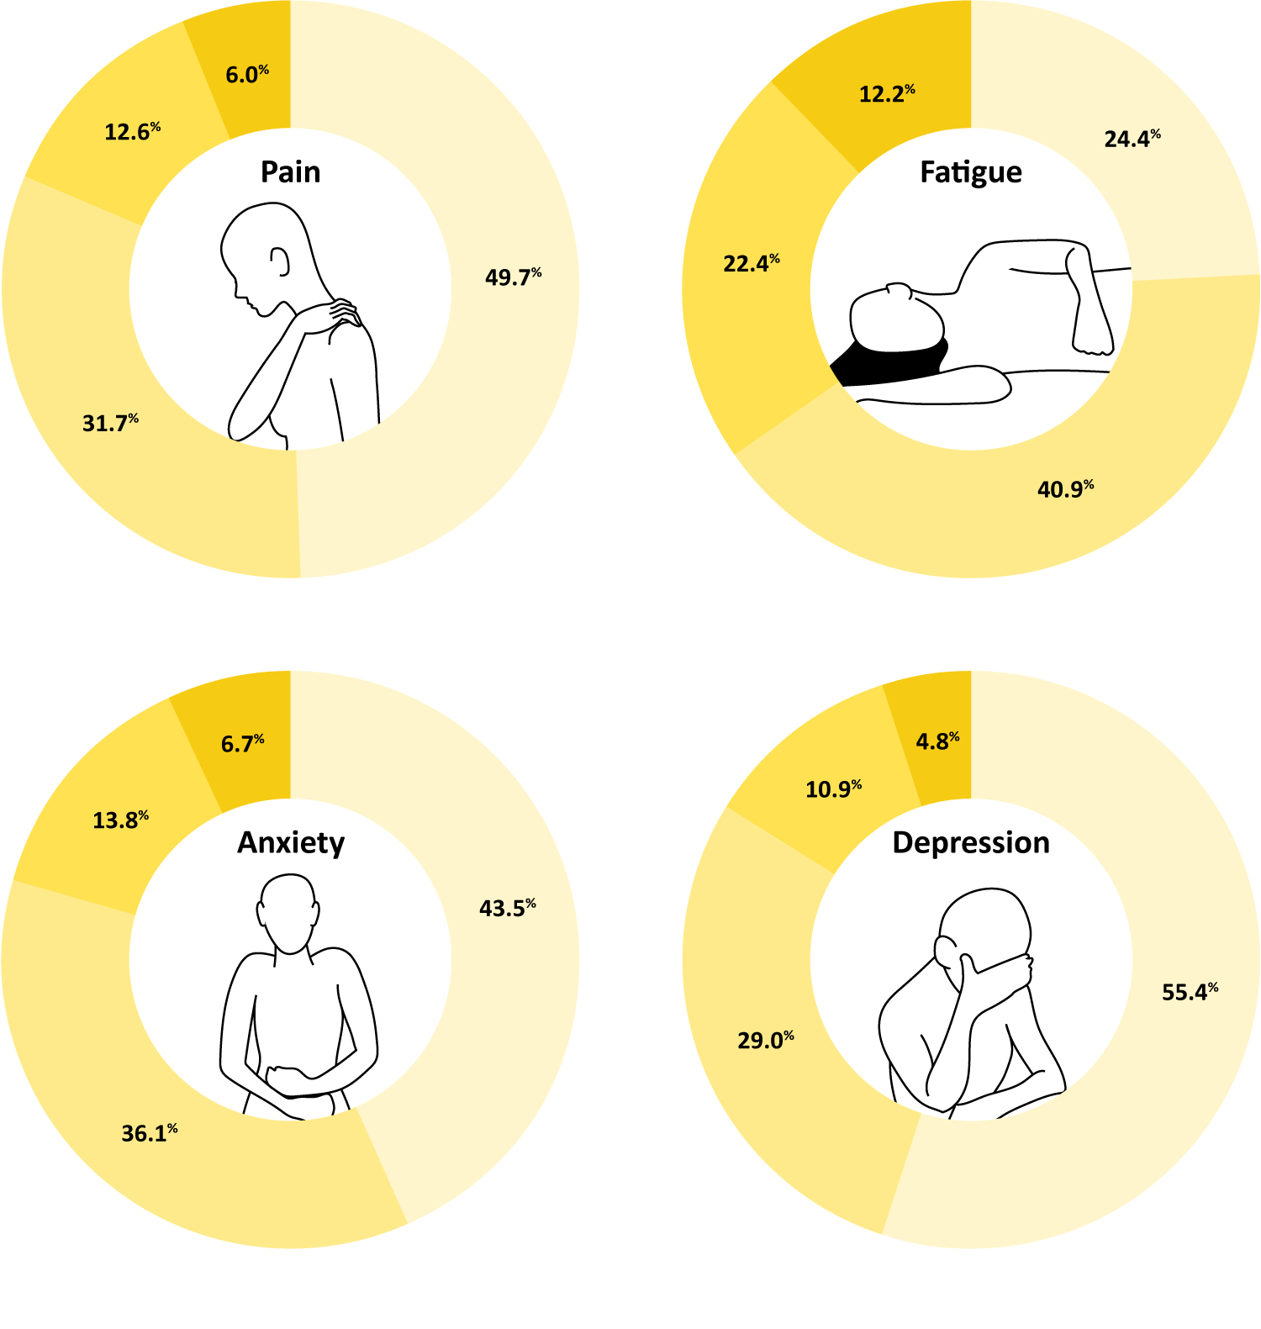
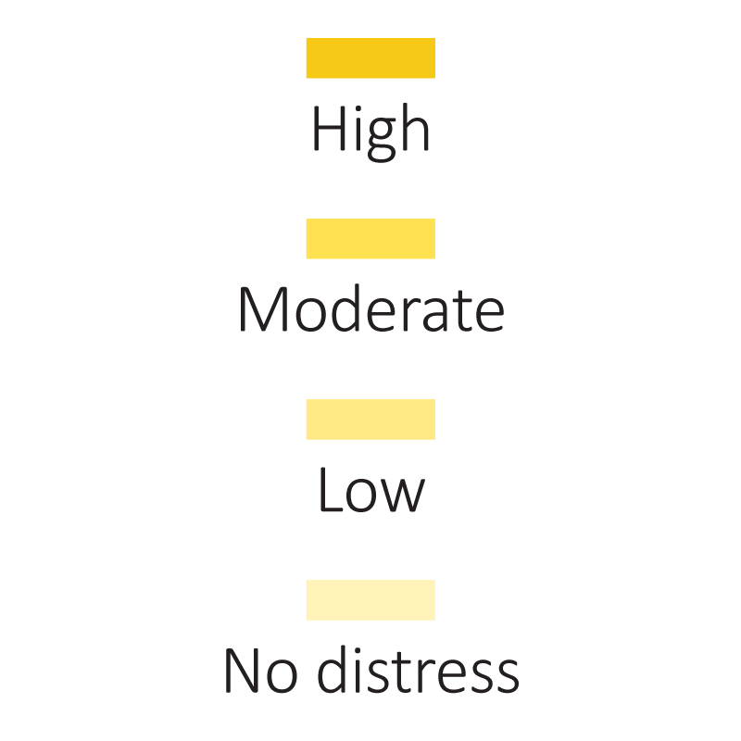
Severity of patient distress, by symptom, jurisdictions combined — From October 2016 to March 2017
The percentage might not sum up to 100% due to rounding. BC, NB and NL were not included.
Data source: Patient-Reported Outcomes Initiative Partners.

Slide 20
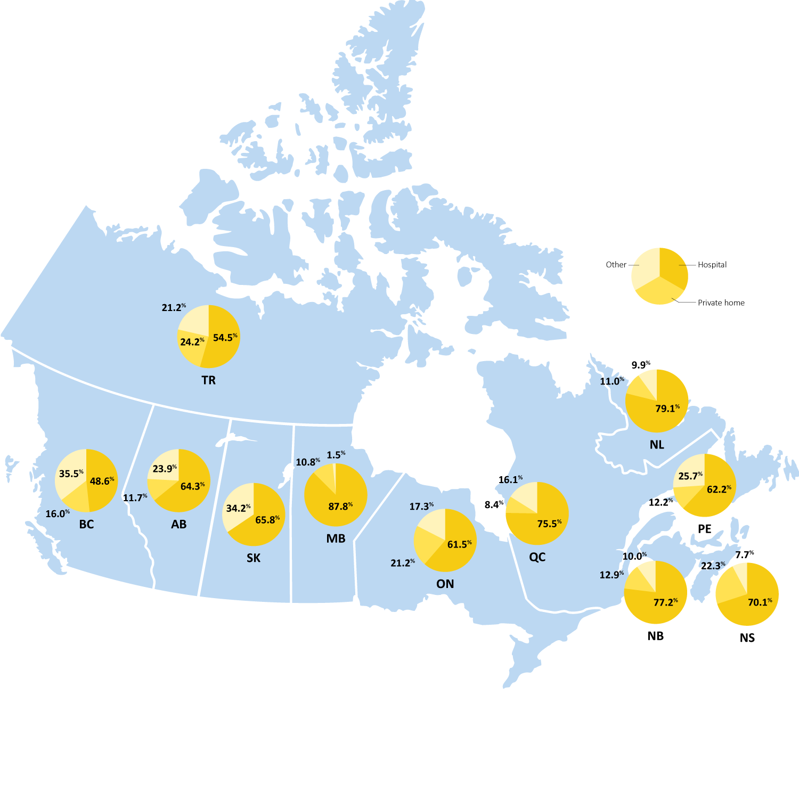
Percentage of cancer patient deaths occurring in hospital, private home or other places, by jurisdiction — 2013 reporting year
The percentage might not sum up to 100% due to rounding. SK: Owing to small numbers, deaths in private homes were combined with Other. TR: Territories combined. Provinces and territories vary in how location of death is categorized and the classification of different settings. In MB, for example, many deaths are categorized as in-hospital occur in palliative care units or hospital-based hospices. Data source: Statistics Canada: Vital Statistics Death Database.

Slide 21
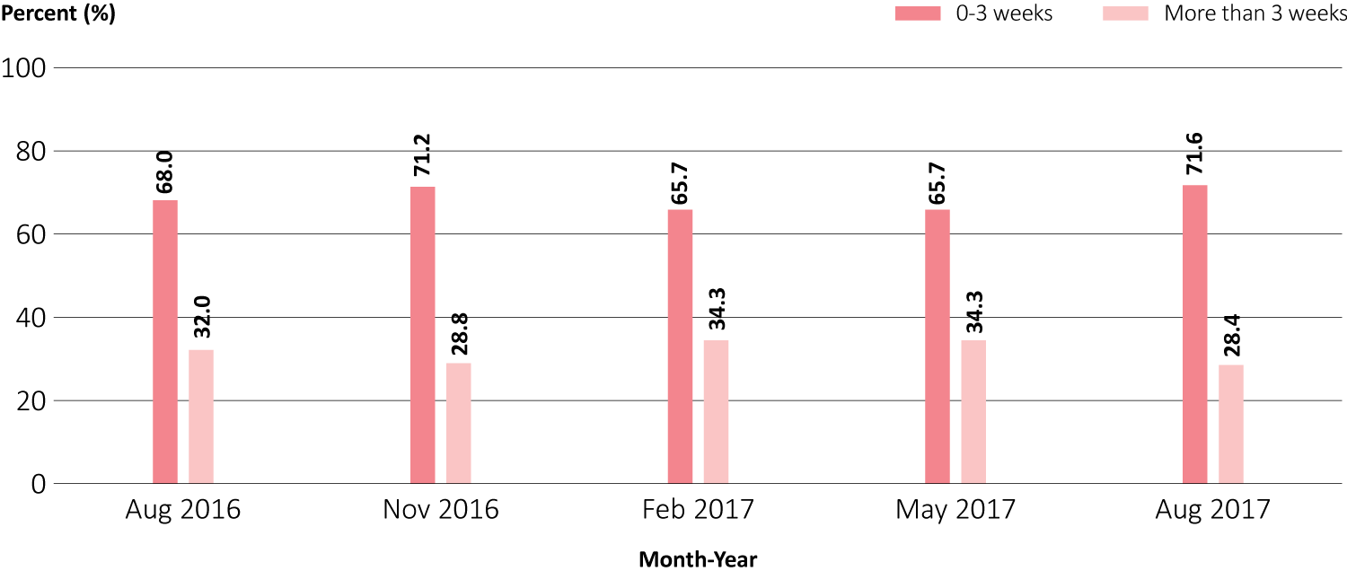
Wait times for follow-up breast ultrasound screening appointments, Quebec — from August 2016 to August 2017
Data source: Gouvernement du Québec: Bulletin national de performance en cancerologie.

Slide 22
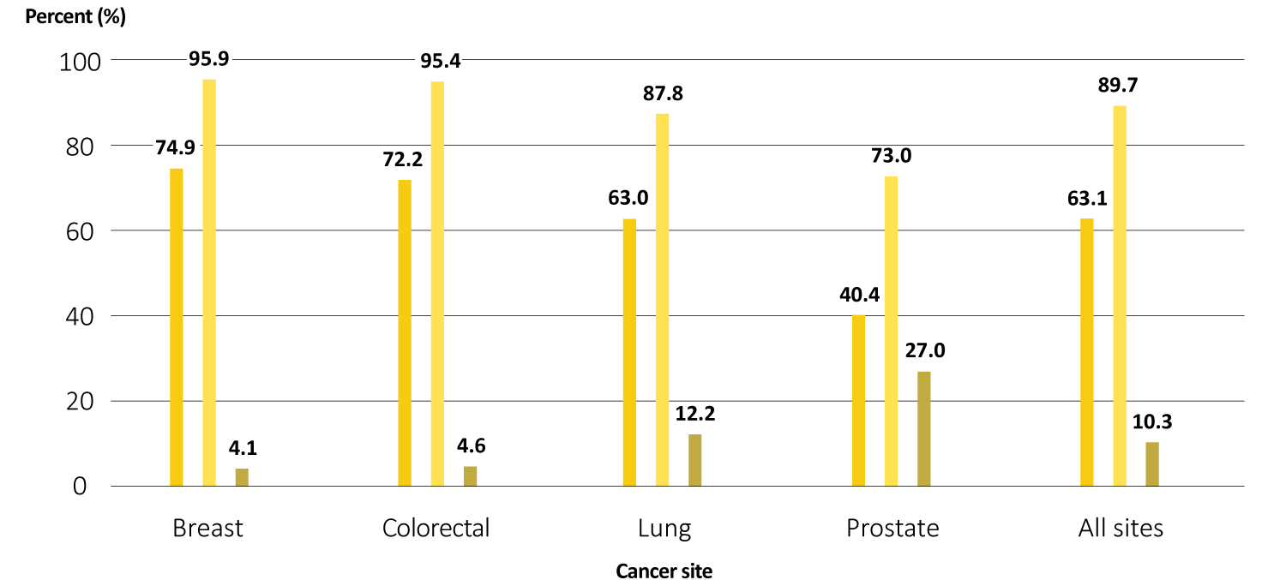
Wait times for cancer surgery for the four most common cancer sites, Quebec – 2016-2017
Data source: Gouvernement du Québec: Bulletin national de performance en cancerologie.

Slide 23
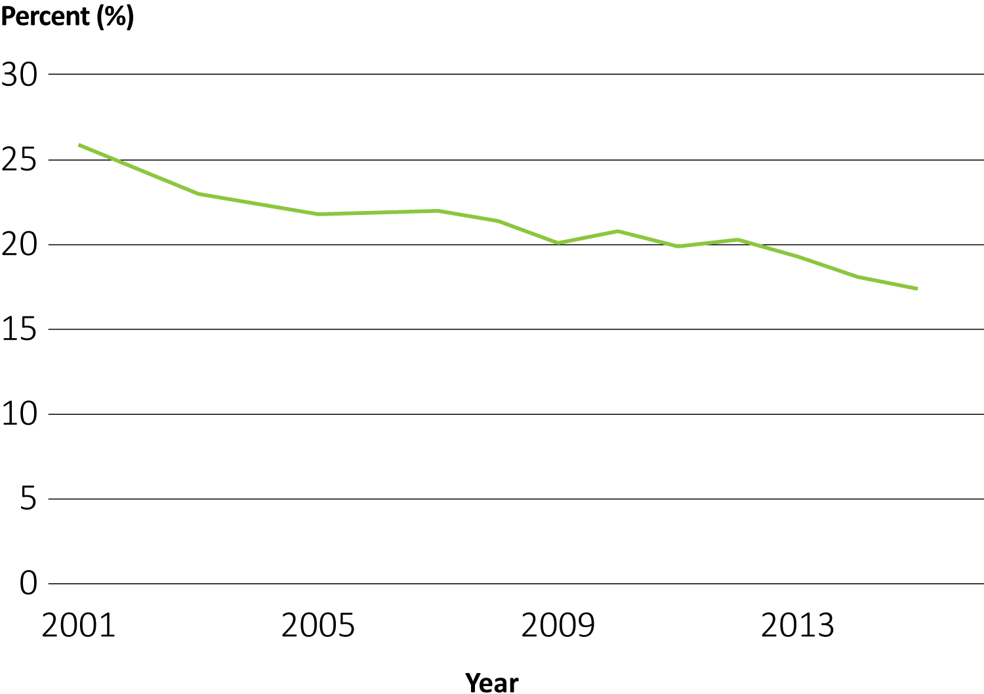
Percentage of Canadians who reported smoking daily or occasionally, Canada — 2001 to 2016 reporting years
Data source: Statistics Canada: Canadian Community Health Survey.

Slide 24
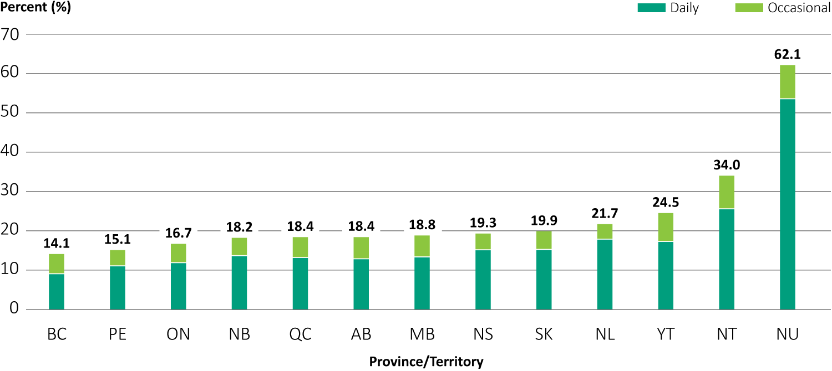
Percentage of Canadians who reported smoking daily or occasionally, by jurisdiction — 2015-16 reporting years
Data source: Statistics Canada: Canadian Community Health Survey.

Slide 25
Percentage of girls who received a full course† of human papillomavirus (HPV) vaccination from school-based HPV immunization programs, by jurisdiction — most recent reported year‡
† As of the 2015/16 school year, the full course of vaccination for school-based HPV vaccination programs is three doses in AB, SK, NT and NU, and two doses in all other provinces and territories. ‡ 2015/16: MB, ON, NS, PE, NL, NT; 2016: SK; 2016/17: BC, AB, QC, NB, YT. “—” Data not available. Data source: Provincial and territorial immunization programs.

Slide 26
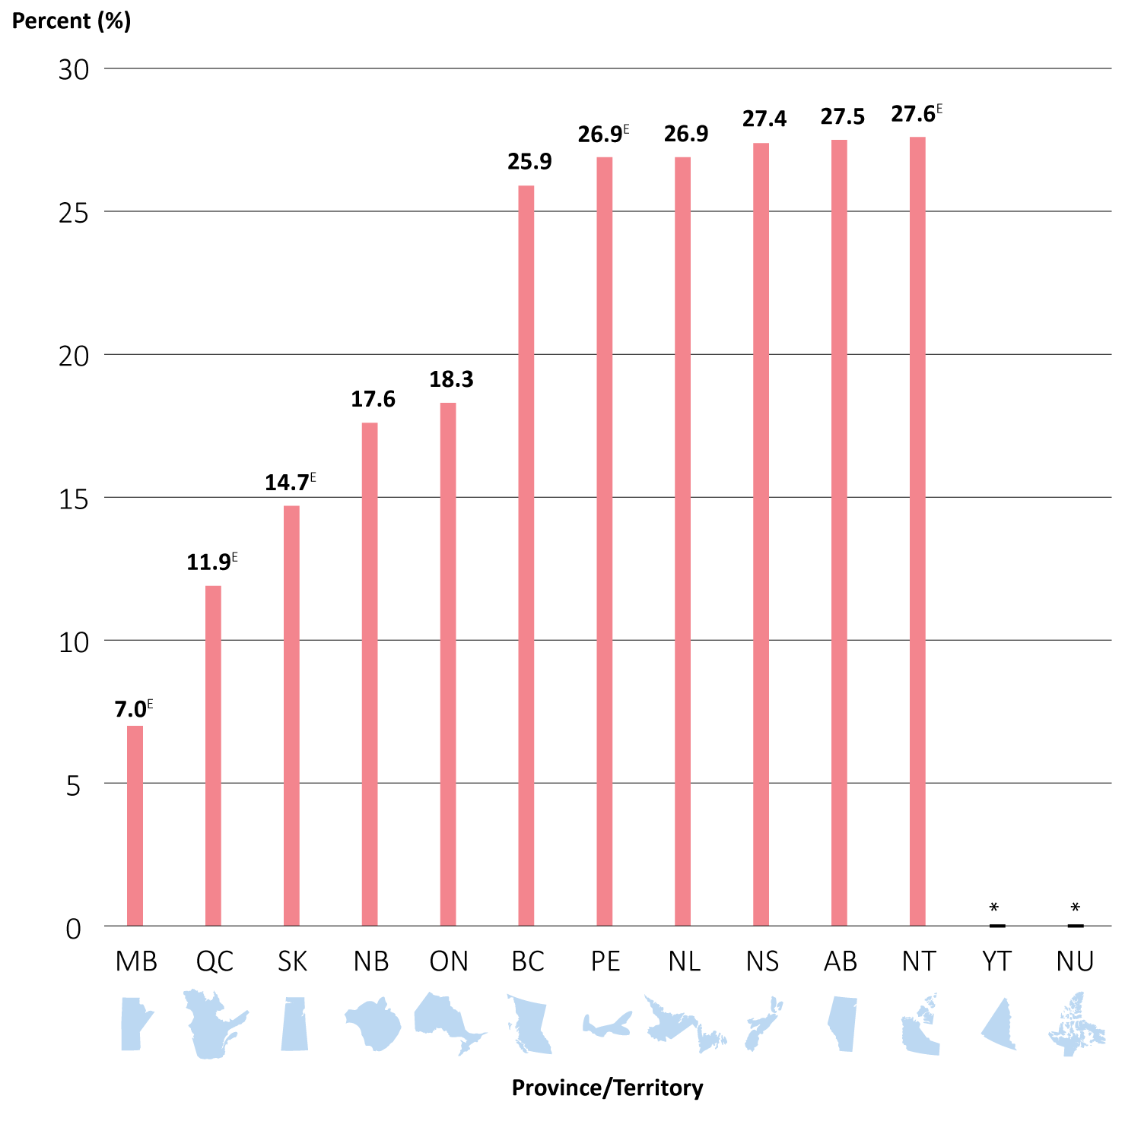
Screening outside of guidelines: percentage of all screening mammograms† in the past year reported by women aged 40–49, by jurisdiction‡ — 2008–12 reporting years combined
† A woman is deemed to have had a screening mammogram if her reason for undergoing a mammogram was one of the following: family history of breast cancer, regular check-up/routine screening, age or current use of hormone replacement therapy. ‡ All jurisdictions provided data in 2008 and 2012. Mammography module was optional from 2009 to 2011; the following jurisdictions provided data in 2009: AB, NB, NS, NL and NT; 2010: AB, NB, NS, NL and NT; 2011: AB, ON, NL and NU. E Interpret with caution owing to large variability in estimates.
* Suppressed owing to small numbers. Data source: Statistics Canada: Canadian Community Health Survey.

Slide 27
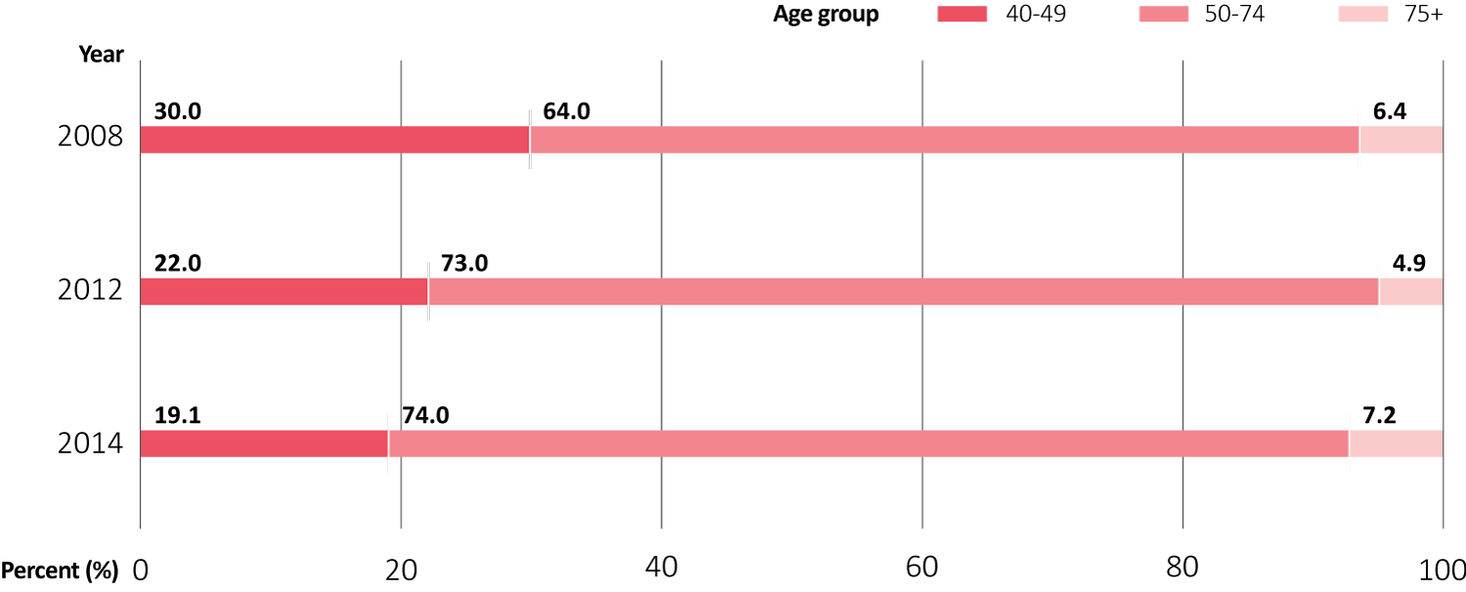
Proportion of self-reported screening mammograms† performed on women within and outside of the target age group in the past year, jurisdictions combined‡ — 2008, 2012 and 2014 reporting years
† A woman is deemed to have had a screening mammogram if her reason for undergoing a mammogram was one of the following: family history of breast cancer, regular check-up/routine screening, age or current use of hormone replacement therapy. ‡ Includes NS, NB, AB and NT. The percentage might not sum up to 100% due to rounding. Data source: Statistics Canada: Canadian Community Health Survey.

Slide 28
Percentage of breast cancer mastectomies done as day surgery, provinces combined† — 2008/09-2015/16 fiscal years
† Includes BC, AB, MB, ON, NB, NS and NL. Data sources: Alberta Health and Wellness: Alberta Ambulatory Care Reporting System; Canadian Institute for Health Information: Hospital Morbidity Database, National Ambulatory Care Reporting System.

Slide 29
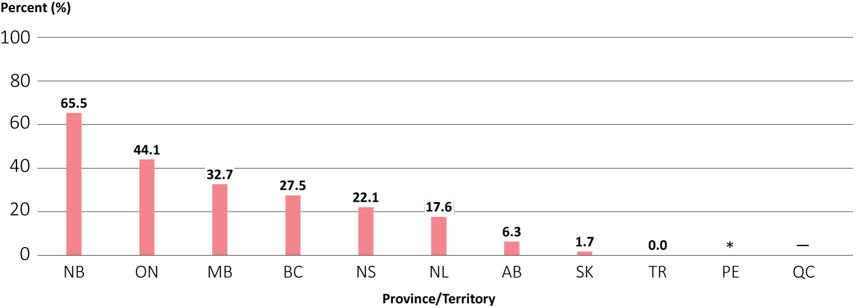
Percentage of mastectomies done as day surgery, by jurisdiction — 2014/15–2015/16 fiscal years combined
* Suppressed owing to small numbers. “—” Data not available. SK, Territories: includes data for 2014. TR: territories combined. Data sources: Alberta Health and Wellness: Alberta Ambulatory Care Reporting System; Canadian Institute for Health Information: Hospital Morbidity Database, National Ambulatory Care Reporting System.

Slide 30
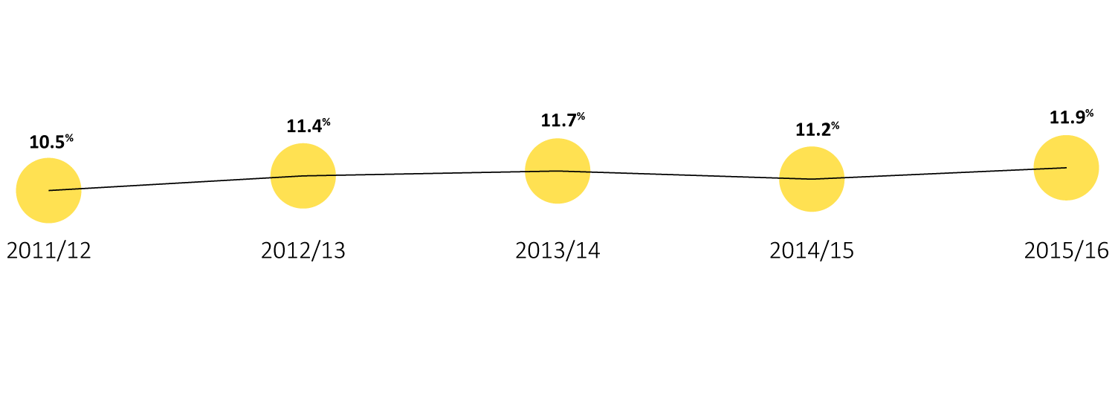
Percentage of cancer patients that died in an acute care hospital and were admitted to an intensive care unit in the last 14 days of life, Canada — 2011/12 to 2015/16 fiscal years
Includes all provinces and territories except QC. Includes only facilities that reported intensive care unit data. Data source: Canadian Institute for Health Information: Discharge Abstract Database.

Slide 31
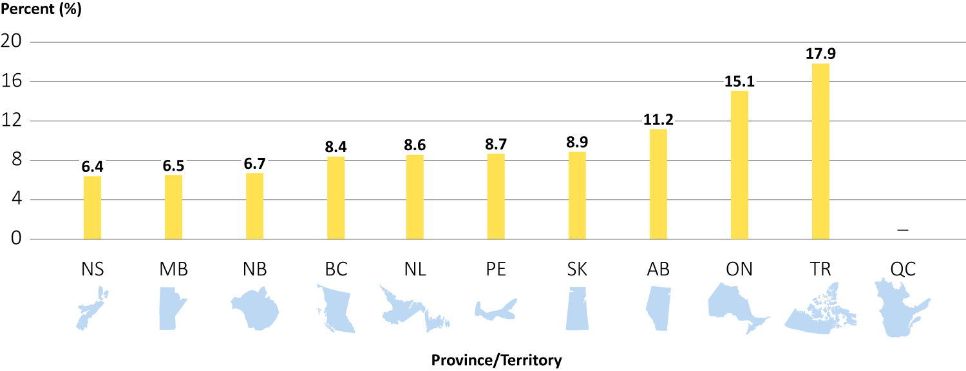
Percentage of cancer patients that died in an acute care hospital and were admitted to intensive care units in the last 14 days of life, by jurisdiction — 2014/15 and 2015/16 fiscal years combined
“—” Data not available. TR: territories combined. Includes only facilities that reported intensive care unit data. Data based on patient’s place of residence. Data source: Canadian Institute for Health Information: Discharge Abstract Database.

