Slide 1
Adolescents & Young Adults with Cancer (April 2017)
To use a hyperlink, right click on it and select ‘Open Hyperlink’, or begin a Slide Show and click on the link.
Figure 1 Most common cancers by age
Figure 2 Percentage change between 1992-96 and 2009-13 in age-standardized incidence rates for different cancers
Figure 3 Five-year relative survival ratios increasing for adolescents and young adults – 1992–96 vs. 2004–08
Figure 4 Estimated increase in the number of fertility clinic patients if all women aged 15–39 years with cancer were referred for fertility consultation – 2016
Figure 5 Employment and income for young adults with cancer – 2007–14 reporting years combined
Figure (Pg. 2) Number of AYAs diagnosed with cancer in 2013
Figure (Pg. 4,5) The challenges of facing cancer for AYAs
Figure (Pg. 7) Increase in the age-standardized incidence rate of cancer for the AYA population
Figure (Pg. 11) Adolescents and young adults are substantially under-represented in cancer research in Canada.
Figure (Pg. 12) AYA-specific data required
Table 1 Five-year relative survival ratio by cancer type and age group, Canada — 2004–08

Slide 3
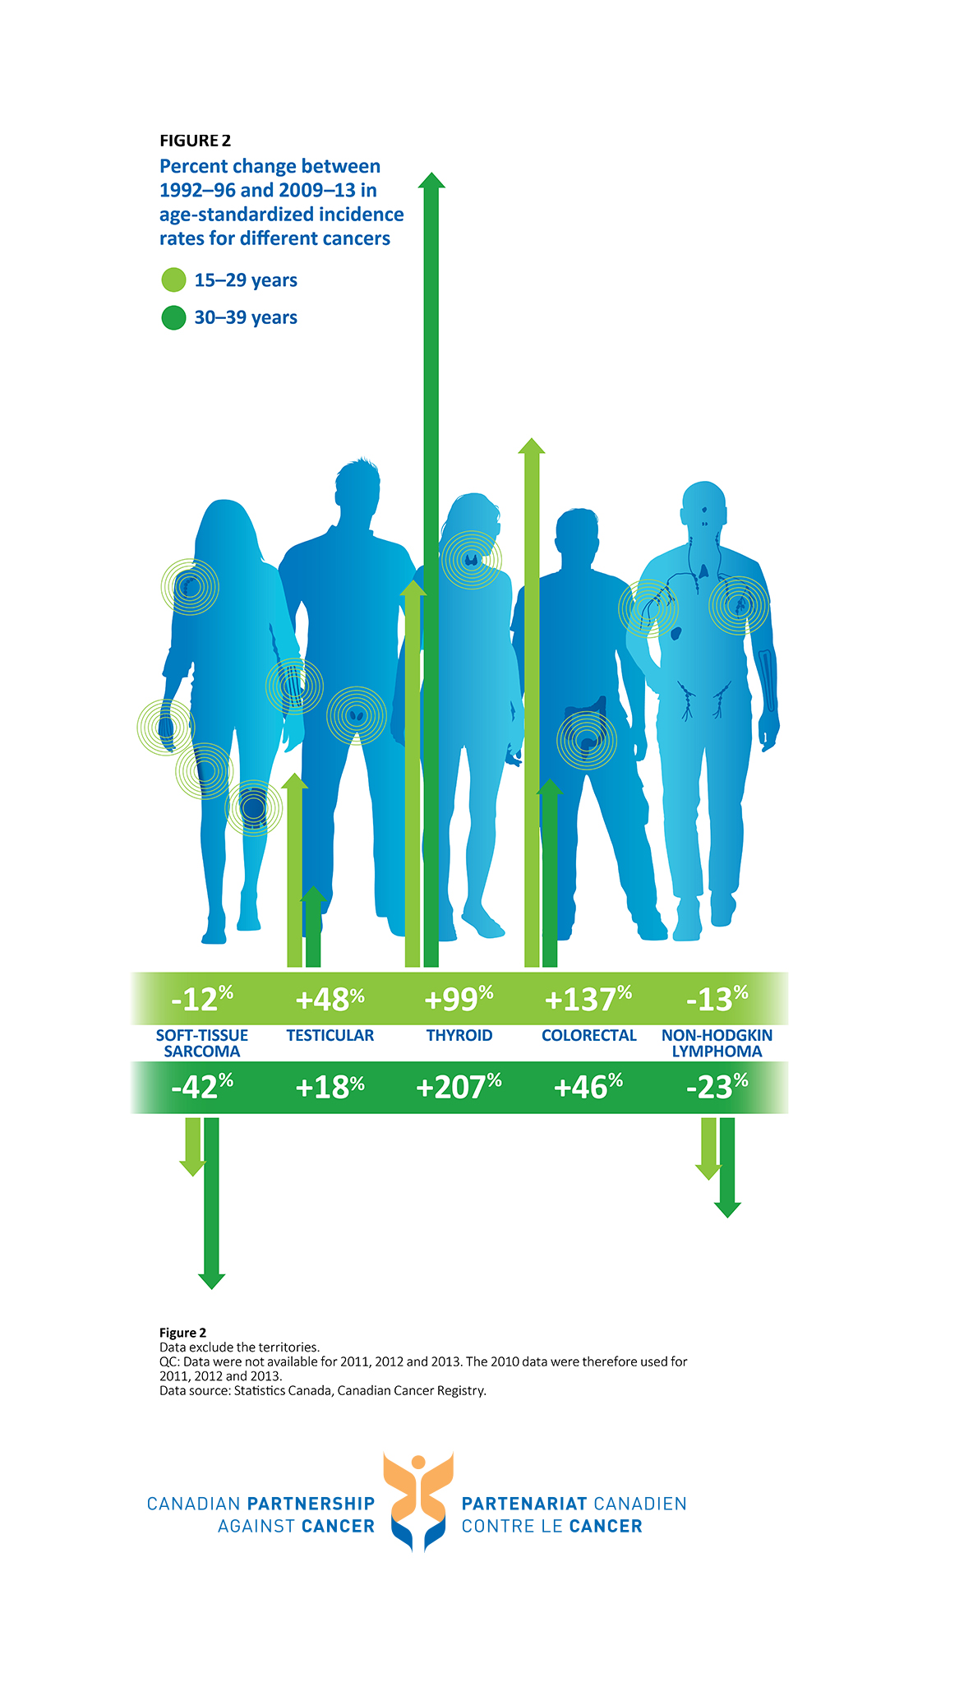

Slide 5
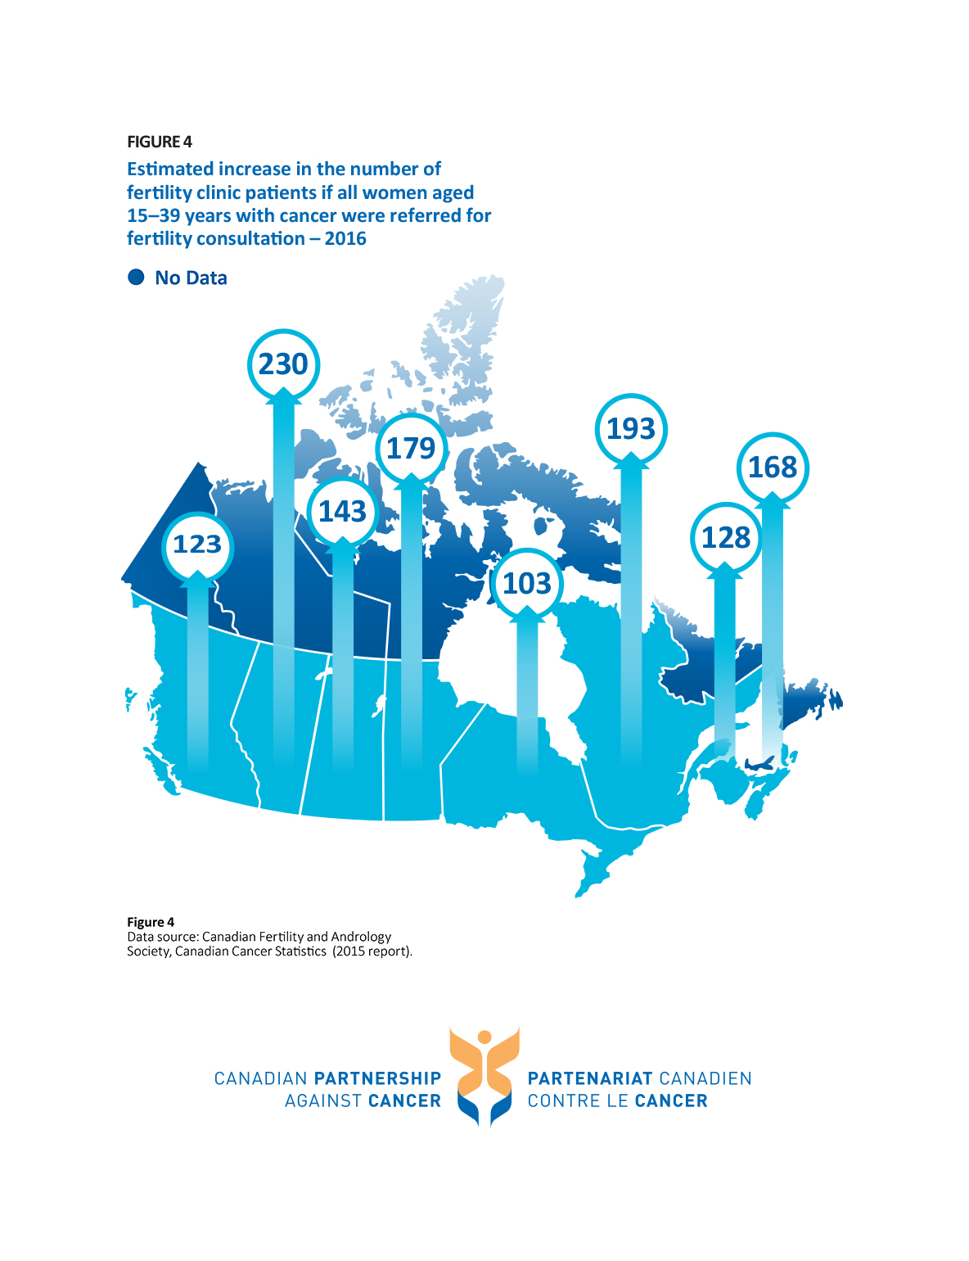

Slide 7
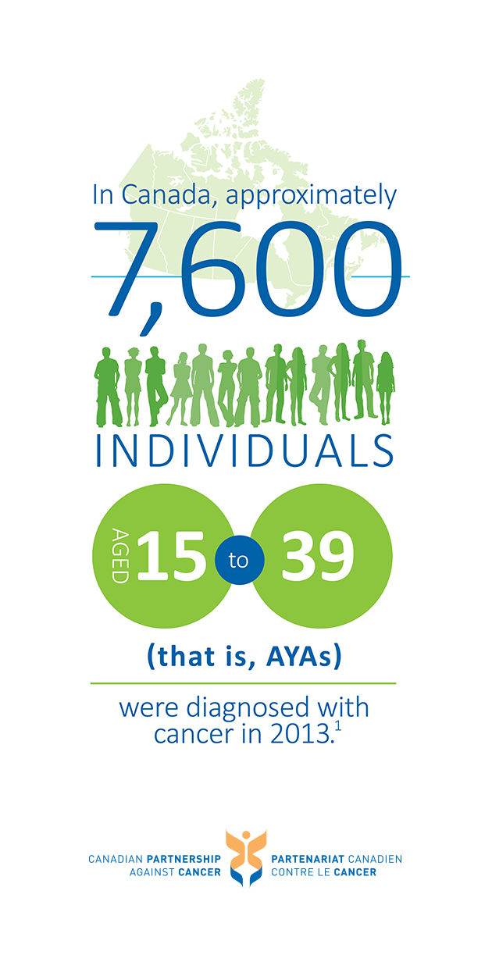

Slide 10
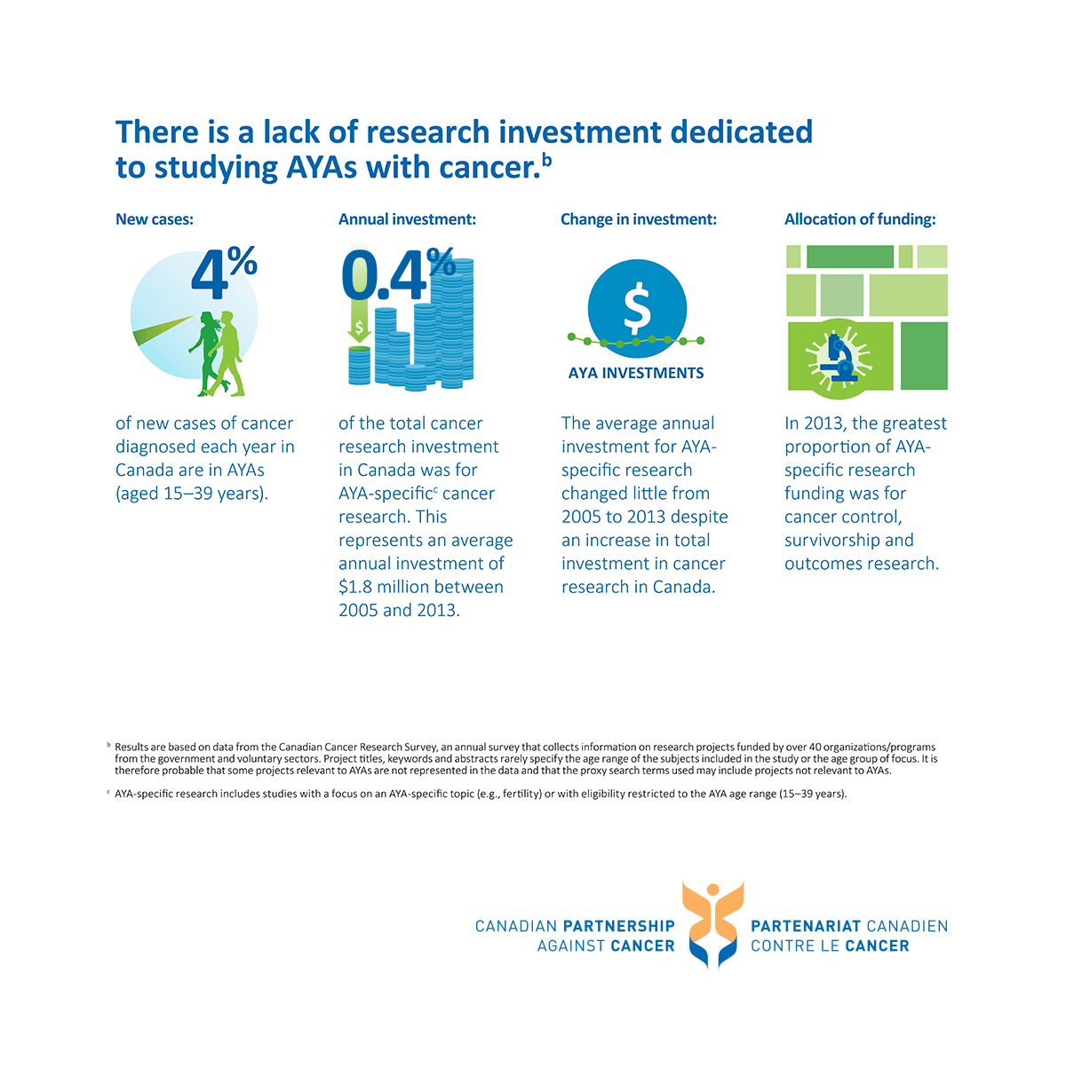

Slide 12
