Slide 1
Toolkit to Improve the Transition to “Life After Cancer”
Implementing a transition process after cancer treatment
July 2023
CISSS de Laval, CIUSSS de la Capitale-Nationale, CIUSSS du Nord-de-l’Île-de-Montréal and the Quebec Cancer Program under the Ministry of Health and Social Services (MSSS)

Slide 2
This guide was made possible through financial support from the Canadian Partnership Against Cancer (CPAC).
This document does not bind the MSSS and is not necessarily representative of its policy guidelines. Its contents are the sole responsibility of its authors and the members of the Transition - Life After Cancer Project Management Committee.
The views expressed in this document are those of the Transition - Life After Cancer Project Management Committee and do not necessarily represent the views of the Quebec Cancer Program (PQC), the Ministry of Health and Social Services (MSSS) or CPAC.
This document is specifically intended for health and social services professionals.
This document is only available electronically.

Slide 3
Project Management Committee
Dr. Marie-Andrée Fortin, Medical Co-manager, Oncology, Radiation Oncologist, CISSS de Laval
Dr. Setareh Samimi, Medical Co-manager, Oncology, Hemato-oncologist, CIUSSS du Nord-de-l’Île-de-Montréal
Sylvie Lambert, Researcher, McGill University
Nicolas Cliquennois, Clinical and Administrative Co-manager, Oncology, CISSS de Laval
Guylaine Veillette, Clinical and Administrative Co-manager, Oncology (replacing Nicolas Cliquennois), CISSS de Laval
Claire Foucher, Clinical and Administrative Co-manager, Oncology, CIUSSS du Nord-de-l’Île-de-Montréal
Myriam Laroche, Clinical and Administrative Co-manager, Oncology, CIUSSS de la Capitale-Nationale
Véronique Blanchette, Project Lead, Community Oncology Nurse Navigator, CIUSSS de la Capitale-Nationale
Céline Samuel, patient partner, Gaspé
Ginette Brousseau, patient partner, member of the PQC’s Comité national des personnes touchées par le cancer (CNPTC) [National committee of persons affected by cancer], Sainte-Thérèse
Marie-José Fillion, patient partner, member of the PQC’s CNPTC, Montréal
Sandie Oberoi, patient partner, member of the PQC’s CNPTC, Montréal
Suzanne Gaudreault, patient partner, member of the PQC’s CNPTC, Pont-Rouge
Denise Page, Director, Regroupement des organisations communautaires en oncologie (ROCO) [Community oncology organizations group]
Christine Arsenault, Clinical and Administrative-Co-manager, Oncology, CISSS de la Gaspésie
Elodie Brochu, Advisor, PQC, MSSS

Slide 4
Lead Authors
Christine Arsenault, Clinical and Administrative-Co-manager, Oncology, CISSS de la Gaspésie
Elodie Brochu, Advisor, PQC, MSSS
Contributors
Dr. Marie-Andrée Fortin, Medical Co-manager, Oncology, Radiation Oncologist, CISSS de Laval
Dr. Setareh Samimi, Medical Co-manager, Oncology, Hemato-oncologist, CIUSSS du Nord-de-l’Île-de-Montréal
Guylaine Veillette, Clinical and Administrative Co-manager, Oncology, CISSS de Laval
Nicolas Cliquennois, Clinical and Administrative Co-manager, Oncology, CISSS de Laval
Claire Foucher, Clinical and Administrative Co-manager, Oncology, CIUSSS du Nord-de-l’Île-de-Montréal
Myriam Laroche, Clinical and Administrative Co-manager, Oncology, CIUSSS de la Capitale-Nationale
Véronique Blanchette, Project Lead, Community Oncology Navigator Nurse, CIUSSS de la Capitale-Nationale
Céline Samuel, patient partner, Gaspé
Acknowledgements
Jacinthe Hovington, Quebec Liaison, CPAC
Neala Lungu, Managing Director, Accreditation Canada, Pan-Canadian Accreditation, Canada
Marie-Pascale Pomey, Co-Director, Centre of Excellence on Partnership with Patients and the Public, Professor in the Department of management, evaluation and health policy, School of Public Health, Université de Montréal
Rachelle Roy, patient partner, member of the PQC’s CNPTC, Abitibi-Témiscamingue
Vincent Dumez, director, community partnerships, Faculty of Medicine, Université de Montréal
Dominique Tremblay, Professor, Faculty of Medicine and Health Sciences, École des sciences infirmières, Université de Sherbrooke.
Astride Bazile, Project Coordinator, Cancer Care Transition of Care Program, McGill University Health Centre

Slide 5
Table of Contents
Life After Cancer: Stories for health care professionals
Successful care transitions
Transition – Life after cancer project
Guide to implementing the transition process
Step 1: Educate your team about implementing a transition process
Step 2: Set up a transition process implementation team
Step 3: Prepare patients and their loved ones for the transition
Step 4: Personalizing follow-up care: Risk stratification and self-care capacity assessment
Step 5: Develop a Support Guide for patients and their loved ones
Step 6: Roll out the medical and pharmaceutical transfer plan
Step 7: Assess patient experience
Appendices
Appendix 1: Accreditation Canada
Appendix 2: Clinical tools
Appendix 3: Transition toolkit satisfaction survey

Slide 6
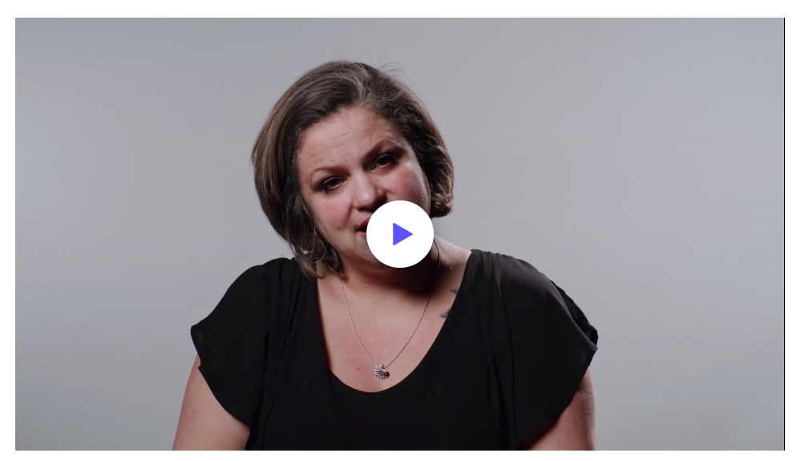
LIFE AFTER CANCER
In this video, Rachelle Roy, Sandie Oberoi and a team of patient partners share their stories to educate patients, loved ones and professionals about the entire cancer journey, from diagnosis to post-treatment.
By sharing their stories, these patient partners give hope to patients and their loved ones, encouraging them to seek out support and services.

Slide 7
With the increase in overall cancer survival, life after cancer has become a distinct phase of the cancer journey (Truant et al. 2017).

Slide 8
What is a successful care transition?
Successful care transitions require multidisciplinary communication and coordination, comprehensive planning (client, patient and caregiver education; caregiver involvement, etc.) and shared accountability during all points of the patient’s transition. When gaps occur in care transitions, individuals are susceptible to fragmentation in care, delayed care, poor quality of care, unfavorable experiences, compromised patient safety, and adverse medical events. (Canadian Institutes of Health Research, 2018).
Follow-up services may include primary care, home and community services, community-based rehabilitation, psychological support services and recommendations for ongoing care. Working together to establish proper placement for the client helps ensure the client receives the most appropriate services in the most appropriate setting and minimizes temporary solutions or unnecessary transfers (Accreditation Canada 2019).

Slide 9
A model for transitioning to “Life After Cancer”
After cancer treatment, patients and their loved ones will enter the necessary phase of recovering and improving their health. Every cancer patient experiences this transition differently and faces a number of challenges, but they all share one thing: Patients and their loved ones need continuity of information, services and support to overcome the physical, psychosocial, practical and financial challenges that come with a cancer diagnosis and treatment, and its impacts.
Successful transitions involve:
Coordinated services with primary care providers: Personalized and determined by risk stratification and patient self-care capacity
Co-development of a support guide with the patient and their loved ones
Self-care support, starting at diagnosis and continuing throughout the entire care pathway
A medical and pharmaceutical transfer plan that ensures medical care is shared with primary care providers
Guidance from community organizations, support groups and patient partner teams
A successful, structured transition process serves as a bridge between the intensive cancer treatment period and a gradual return to daily life, allowing patients and their loved ones to adapt to their new normal.
72% of patients report experiencing difficulties during their first year post‑treatment (Brochu and Arsenault 2022).
Only 18% of patients feel that the organization of their care included a referral to their family physician (Brochu and Arsenault 2022).
54% of responding patients said they did not receive a follow-up treatment care plan (Brochu and Arsenault 2022).

Slide 10
Data supporting why the cancer treatment transition process is so important
Many survivors say they felt unprepared for the period following primary treatment and required a significant amount of information during this phase of their care. Their information needs cover a wide range of issues, including the risk of recurrence and the onset of new cancers, prevention and management of comorbid conditions, evidence-based monitoring practices, and late and long-term effects of treatment (Urquhart 2017).
Side effects of treatment (fatigue, lymphedema, pain, cognitive changes, gastrointestinal changes, etc.) may affect the individual after completion of treatment, in the short and long term.
More and more studies are being conducted to describe the impact of these late and long-term effects on quality of life and vitality after a cancer diagnosis.
Dealing with side effects can affect relationships, returning to work, and self-perception.
For some, these challenges resolve quickly, while for others, the burden of this impact is felt for years (Truant et al. 2017).
Many survivors report often feeling guilty during this period, which influences their decision not to seek care when suffering from late and long-term effects because they do not want to burden healthcare providers caring for active cancer patients (Urquhart 2017).

Slide 11
From the Report on Transition – Life After Cancer (Brochu and Arsenault 2022)
PHYSICAL CHALLENGES
93%
Fatigue was the main physical challenge reported, followed by sleep, intestinal, and cognitive problems.
According to the survey, patients are worried and discouraged about the onset or persistence of physical or emotional symptoms and symptoms that disrupt daily life.
EMOTIONAL CHALLENGES
71%
Fear about cancer recurrence, anxiety, and stress are the most reported emotional challenges.
DAILY LIFE CHALLENGES
39%
Returning to work or school is the main challenge reported.
CHALLENGES
63% of patients experienced difficulties after completing treatment, including 72% in the first year.
Patients do not know where to seek information or who to reach out to ask questions and find solutions to their problems.
These symptoms have direct negative repercussions and compromise the return to day-to-day life (return to work, daily activities, autonomy, social integration, self-esteem).

Slide 12
Transition – Life After Cancer project
The purpose of the 2020–2023 “Transition – Life After Cancer” project was to develop and test out tools and strategies to improve the patient experience by implementing a process to transition patients into life after cancer treatment.
This project was the result of a collaboration between oncology care teams at CISSS de Laval, CIUSSS de la Capitale-Nationale and CIUSSS du Nord-de-l’Île-de-Montréal, physicians, oncology and community pharmacists, researchers, patient partners and community organization representatives. Together, they developed an implementation toolkit for a model aimed at providing personalized and coordinated care and services for a smoother post-treatment transition. This toolkit meets transition-of-care standards.
The Quebec Cancer Program under the Quebec Ministry of Health and Social Services (MSSS) provided support for this project. Funding was also provided by the Canadian Partnership Against Cancer.

Slide 13
TRANSITION TO LIFE AFTER CANCER
PERSONALIZED AND COORDINATED CARE AND SERVICES MODEL
INTERVENTIONS BASED ON STRATIFICATION AND SELF-CARE CAPACITY
OUTCOMES
Complex follow-up care:
Management by oncology team
Shared follow-up care between primary care providers and oncology, primarily through oncology
Support for symptom self-management
High-quality, accessible, safe and personalized care and services
Early detection of declining health
Improved continuity of services with primary care providers
Better integration of services with community organizations
Information and resources available to patients and their loved ones and adapted to meet their needs
Enhanced capacity for self-care among patients and their caregivers
Better overall experience and perceived quality of life among patients and their loved ones
Complex
follow-up care
5% of patients
with low to moderate self-care capacity
Follow-up care coordinated by oncology:
Increased support for self-care
Medical follow-up by oncology team for fixed period
Telemedicine appointments, systematic follow-up care
Services delivered by community organizations
Shared follow-up with primary care providers
Follow-up care
coordinated by oncology
30% of patients with health problems needing specialized follow-up care for a fixed period and/or with low to moderate self‑care ability
Changing needs and capacity for self-care
Increasing in complexity
Standard transition organization:
Medical and pharmaceutical transfer plan, personalized support guide
Service delivery coordinated with primary care providers based on needs
Various strategies and resources for self‑care support
Referrals to community organizations and groups
Transition organization for all
Inspired by: NHS England 2020
13

Slide 14
Care and services pathway after cancer treatment
OBJECTIVES:
High-quality, accessible, coordinated and personalized services
Continuity of primary care and community organization services
Access to available information and resources, tailored to patient needs
Service delivery to support self-care;
Improved overall experience and perceived quality of life
Diagnosis and treatment
Completion of treatment
Personalized planning based on risk stratification and patient’s self-care capacity
Coordination to ensure continuity of services based on risk stratification with a focus on self-care
1
2
3
4
High self-care capacity
Shared follow-up care, mainly with primary care providers
Self-care
Shared medical follow-up care Family physicians, SNPs, community pharmacists, oncology team
Preparing for the transition
Support guide
Medical and pharmaceutical transfer guide
Follow-up care offered based on risk stratification and patient’s self-care capacity
Educational tools
Moderate self-care capacity
Shared follow-up care, tailored to needs
Education about self-care
Patients without a family physician
Support and coordination of services
Oncology/Telehealth
Investigation
Treatment and follow-up care
Coordination of services
Informational support Informational resources: websites, professionals, CLSCs, community organizations, educational tools
Low self-care capacity
Shared follow-up care, mainly with oncology
Interdisciplinary team services
Management by oncology specialists
Peer-to-peer community support Community organizations, peer support, support groups, CLSCs
Inspired by: NHS England 2020
Transition to end-of-life services
PATIENT SUPPORT GUIDE:
Personalized document addressing patient concerns
Content: resources, follow-up care plan, symptom management and prevention, access to educational tools
MEDICAL TRANSFER PLAN:
Clinical training for primary care professionals
Content: oncology follow-up care plan, symptoms to watch for
RISK STRATIFICATION AND SELF-CARE CAPACITY:
Planning is determined in partnership with the patient and professional
Risk stratification includes: 1) health status, 2) cancer type, 3) treatment and 4) specific patient needs
Self-care capacity encompasses: 1) self-concept, 2) initiative and responsibility, 3) knowledge and information seeking and 4) active participation vs. passivity (Kearney and Fleischer, 1979)
EDUCATIONAL TOOLS:
Needs assessment tool
Follow-up care plan (electronic)
Directory of services offered (information and support)
Educational website / Referral pathway / Telehealth tools
JOINT MEDICAL FOLLOW‑UP CARE:
Medical follow-ups shared between primary care and oncology based on risk stratification and self-care capacity patient
14

Slide 15
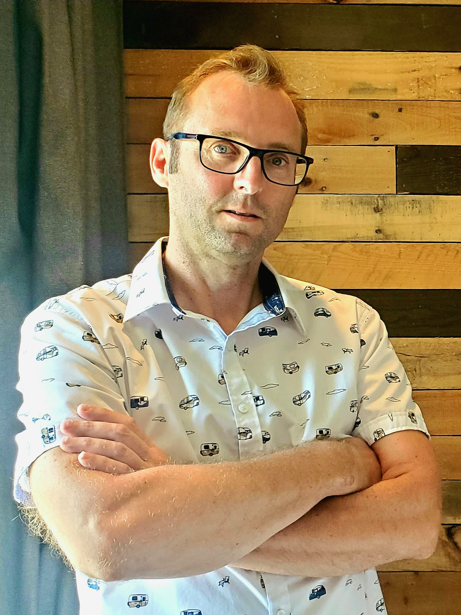
Before you begin
The goal of this implementation toolkit is not to provide a step-by-step guide, but a space to learn.
In this toolkit, you will find tools from the Accreditation Canada required organizational practice (ROP) for “Information transfer at care transitions” to help you meet the standards for transitions.
A post-treatment transition model should be designed as a collaborative learning process. To get the ball rolling, we recommend working with your institution’s Quality, Evaluation, Performance and Ethics Department (QEPED), partnership offices, patient partners, community organizations, clinical advisors and providers.
Begin where your teams currently stand and capitalize on what you do best. Experiment with implementing one or more tools and adapt them to your needs.
The goal is to constantly improve with an eye to provide high-quality, accessible, personalized services that will ensure patients and their loved ones have a positive experience as they transition to life after cancer.
What folks often forget is that “life after cancer” comes with a cancer diagnosis. When you start working with a patient, it is essential to inform them of what will happen and what services are available to them throughout the entire pathway. I am so proud to have been a patient partner on the team that developed the “Life after cancer” project.
Danny Wade, patient partner, Montréal
15

Slide 16
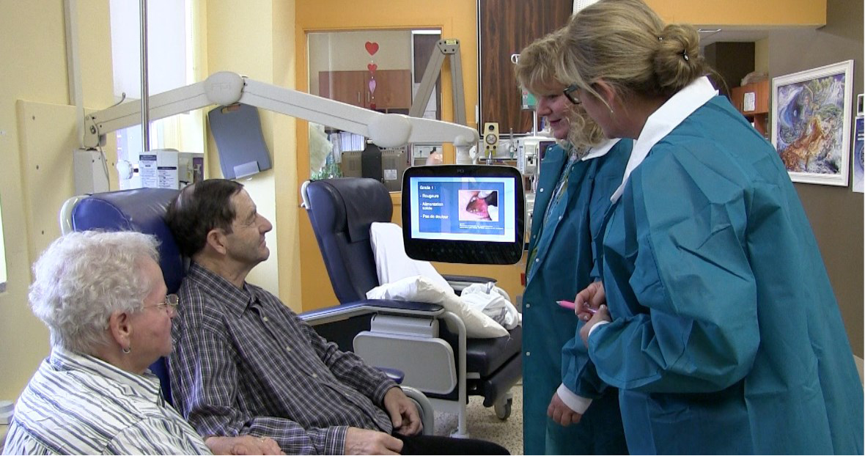
Key steps to transition implementation
4. Personalize follow-up care: risk stratification
1. Educate your oncology team
2. Set up a project team
5. Develop the support guide
6. Roll out the medical and pharmaceutical transfer plan
3. Prepare patients for self‑care
7. Assess patient experience
16

Slide 17
Educate your team about the transition process
Step 1
17

Slide 18
Did you know?
We know that cancer and the treatments that come along with it can have substantial and long-term impacts on a survivor’s health and quality of life, and that following treatment, many survivors have continued medical and supportive care needs similar to those they had during active treatment (Urquhart 2017).
The main challenges associated with service delivery stem from the fact that cancer survivors have an array of complex needs. Their needs are often overlooked because cancer treatment systems and primary care and community sectors are poorly integrated across Canada, with poor coordination among providers and little effort made to find ways to collaborate (Mattison et al. 2018).
18

Slide 19
Strategies and tools to educate your team
Goal of Step 1: Provide support to teams so they can address transition-related issues. For your team’s education to be a success, it is best to offer multiple informational, consulting and communication opportunities. This way, teams can gain insight into how changes will be made. | Available tools (click to download)
Proposed strategies
1. Create a shared vision Educate your team and partners about the realities of the post-treatment transition by sharing: The Report on Transition – Life After Cancer The Accreditation Canada required organizational practice standards - Information transfer at care transitions The Life after cancer treatment video (French only) Sandie Oberoi’s "The first year post-treatment was even harder..." video (French only) The training on the importance of transitions in care, led in tandem with Healthcare Excellence Canada (HEC) (first part of three training sessions) Patient stories (French only)
Report: Transition 2021
Video: Life after treatment
Accreditation Canada standards
Video: The first year post-treatment
Training on the importance of transitions in care
Patient transition stories
19

Slide 20
Proposed strategies | Available tools (click to download)
2. Discuss the project with your team Present the Report on Transition – Life After Cancer Share the training on the importance of transitions in care, led in tandem with Healthcare Excellence Canada (HEC) (first part of three training sessions) Add the transition optimization process to your quality improvement plan 3. Organize an experience-sharing event with patient partners Plan a meeting with the oncology team and patient partners where patient partners can share their experiences relating to the post-treatment transition 4. Share information with your team members Identify leaders, champions and inspiring professionals to be involved in the changes Invite team members to review tools and find solutions for optimization Set up consultations or surveys
Report: Transition 2021
Training on the importance of transitions in care
20

Slide 21
Set up a transition process implementation team
Step 2
21

Slide 22
Did you know?
Patients can also get involved at the organizational level, organizing programs and services or getting involved in governance. Integrating patient experiences at the organizational level represents a valuable source of information that can improve integration and continuity of care and services in order to make the care pathway as smooth as possible for patients (Pomey et al. 2015).
Oncology professionals want to learn more about the post-treatment transition so they can optimize what they are already doing (Brochu and Arsenault 2022).
22

Slide 23
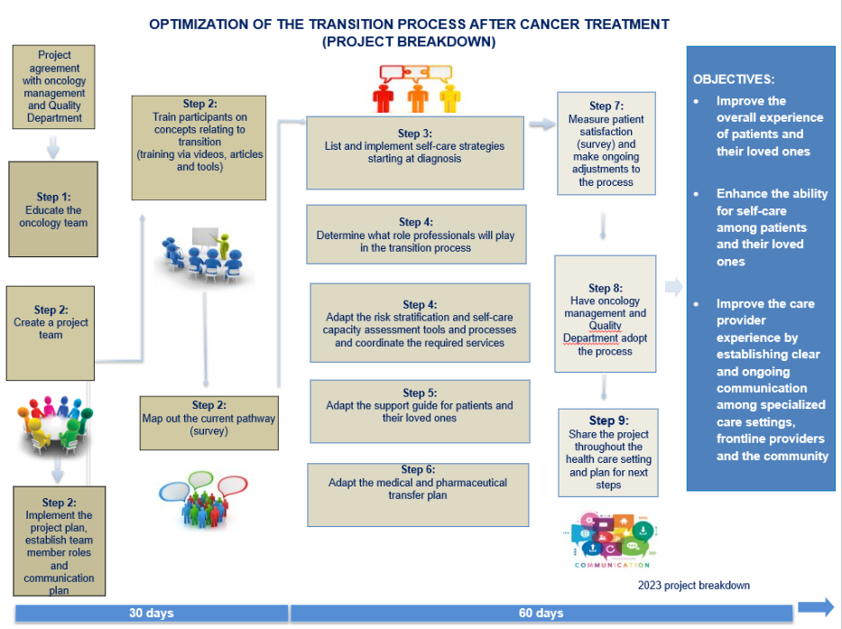
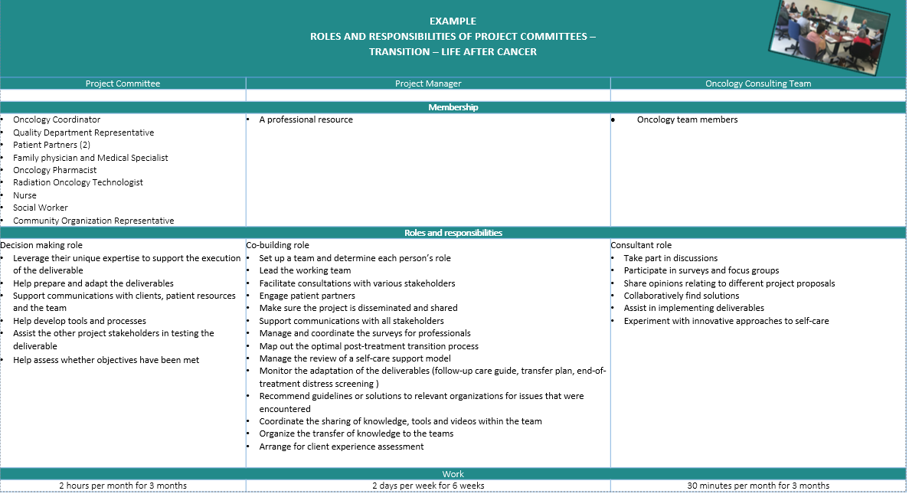
Strategies and tools to set up your project team
Goal of Step 2: Form a project team mandated to review and implement the best tools and conditions to optimize patients’ post-treatment transitions. | Available tools (click to download)
Proposed strategies
Set up your project team Proposal for implementing the entire pathway, but you can implement one tool at a time. Set up a project management committee. We suggest including a nurse, a radiation oncology technologist, a pharmacist, a physician, a social worker, a QEPED advisor, a community organization representative and two patient partners. (Plan on meeting for 1 hour every 15 days for 6 weeks.) Assign a professional to oversee the project plan in order to validate and ensure clinical tool implementation (plan on approximately 2 days of work per week, for about 6 weeks using this toolkit’s strategies) Draft a project plan and prepare a template for your terms of reference (objectives, breakdown of roles, timeline, means and support) Devise a communication plan with the oncology team and your partners
Example of project breakdown
Model action plan (French only)
Example of roles
23

Slide 24
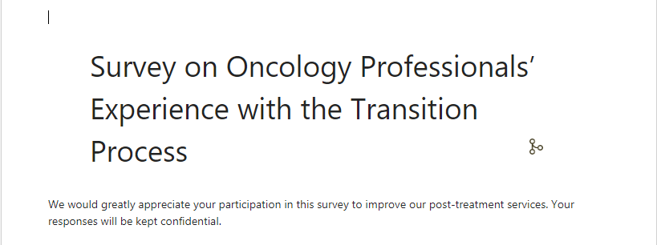
Proposed strategies | Available tools (click to download)
2. Train the team on transitions Set up a shared space (e.g., Teams or SharePoint) for disseminating and uploading tools, videos, surveys and best practice guides As a team, watch the Training on the importance of transitions in care, led in tandem with Healthcare Excellence Canada (HEC) (first part of three training sessions) Lead a vision-sharing activity
3. Prepare patient partners for their role Propose specific tasks and provide regular feedback Find ways to make it easier for them to take part Share learning tools (data, articles on the topic) Offer ways for patient partners to take part that meet their needs and support the partnership (meeting in person or on Teams)
4. Identify the ideal post-treatment transition pathway for your care setting Present the pathway model on slide 14 and the PQC-related project objectives Get feedback from team members about the current pathway via a short internal survey or assessment matrix Map out the desired transition process that follows best practices and works within the constraints of your institution Devise an improvement plan based on your desired outcomes
Training on the importance of transitions in care
(NHS England 2016)
(Healthcare Excellence Canada 2021)
(Berkesse et al. 2022)
Survey on oncology professionals’ experience
(Web version: Copy this form to make your own version. No one else will have access to your responses.)
24

Slide 25
Proposed strategies | Available tools (click to download)
5. Adapt the Risk Stratification and Self-Care Capacity Assessment, Patient Support Guide and Medical Transfer Plan Prioritize your actions based on your project plan Adapt the proposed tools to meet your needs Check in with your team and partners regularly | Next steps: Step 3 - Prepare patients and their loved ones for the transition by offering self-care support from the get-go Step 4 - Personalizing follow-up care: Risk Stratification and Self-Care Capacity Assessment Step 5 - Develop a Support Guide with the patient and their loved ones Step 6 - Roll out the Medical and Pharmaceutical Transfer Plan
6. Organize project follow-up within the team Share the project plan with your team and with management Work together with the QEPED team to ensure consistency across the quality improvement process and the Accreditation Canada process Keep your team in the loop about project progress with project newsletters or email updates Organize follow-up meetings to keep the team informed about how the project is going, keep them engaged and hear their concerns
Other documents on the post-treatment transition (click to download)
Example of a project newsletter template
(French only)
25

Slide 26
Prepare patients and their loved ones for the transition by offering self-care support from the get‑go
Step 3
26

Slide 27
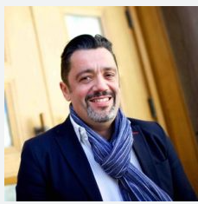
Self-Care Support: Involving Patients in Their Health and Care
Video of Vincent Dumez, Director of Community Partnerships, University of Montréal
27

Slide 28
Did you know?
Patients and their families need more than just access to reliable, scientifically proven information to feel empowered. Patients facing a long‑term diagnosis must be able to figure out their own priorities and preferences to take an active role in their own care. This requires skills to be transferred to patients (Bourmaud et al. 2022).
The client's physical and psychosocial readiness for transition, including their capacity to self-manage their health, is assessed. This assessment happens as early as possible within the care process (Accreditation Canada standard 7.1.126) (Accreditation Canada, 2019).
Studies show that empowerment improves health status among populations. Passiveness has been shown to lead to feelings of incompetence, which can result in depression, or even stopping treatment. Conversely, feelings of competence improve health (Gross 2017).
Learning is a social activity that involves discussions with professionals and peers, social media interactions and online research to find accurate health-related information (NHS England 2016).
28

Slide 29
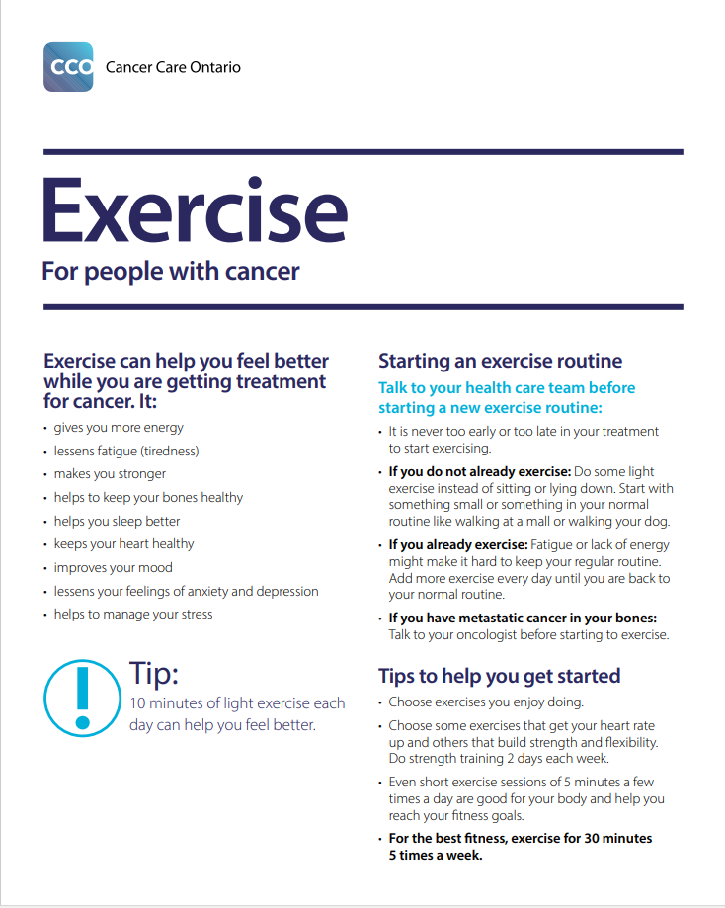
Strategies to implement patient self-care support
Goal of Step 3: Propose a self-care learning model that meets the needs and capacity of patients and their loved ones. This model should be presented to patients upon diagnosis and followed throughout the entire care and service pathway, empowering them to take action. | Available tools (click to download)
Proposed strategies
Make a list of learning tools that offer self-care support upon diagnosis Test out a combination of strategies that provide self-care support (paper documents, educational videos, meetings with professionals and peers) in partnership with team members (see slides 30 to 32) Involve patient partners (if you can, based on your care setting) when selecting self-care support strategies Inform your team and partners of the self-care support offered Provide access to ongoing training for team members
Website: “Life After Cancer” (coming soon)
Websites:
Other documents:
(Macmillan Cancer Support 2020)
(Cancer Care Ontario 2022)
29

Slide 30
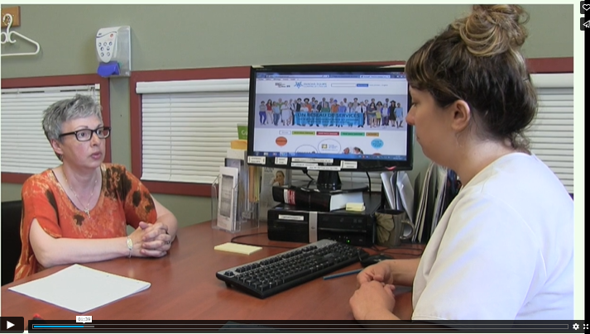
Example timeline for progressively involving patients in self-care and improving the transition experience Professional team
ONN / Nurse Pharmacist / Physician / SNP
Social worker
Nurse
Radiation oncology technologist
Administrative staff member
Social worker
ONN / Nurse
Radiation oncology technologist
Social worker
Physician / Pharmacist / SNP
Start
¾ through treatment
End of treatment
Evaluate capacity and learning need at initial assessment
Begin the self-care support process
Present the DIT as a progressive self-care learning tool
Introduce the informational patient website
Draft and share the pharmaceutical plan and family physician note to optimize collaboration
Ask patients to fill out the End-of-Treatment Preparation Tool (helps envision future)
Complete the Risk Stratification and Self-Care Capacity Assessment and start the Support Guide (nurse, social worker)
Continue offering self-care support online and in videos and documents
Lend out multimedia tools to support patients with trouble accessing the Internet
Review concerns and needs identified in the End-of-Treatment Preparation Tool to coordinate any necessary follow-up care
Complete the Patient Support Guide with the patient and their loved ones and review the educational tools
Refer the patient to the services they need (community and professional) to ensure continuity of services
Fill out and send the Medical and Pharmaceutical Transfer Plan to primary care professionals
Initial assessment
During treatment
End of treatment
30

Slide 31
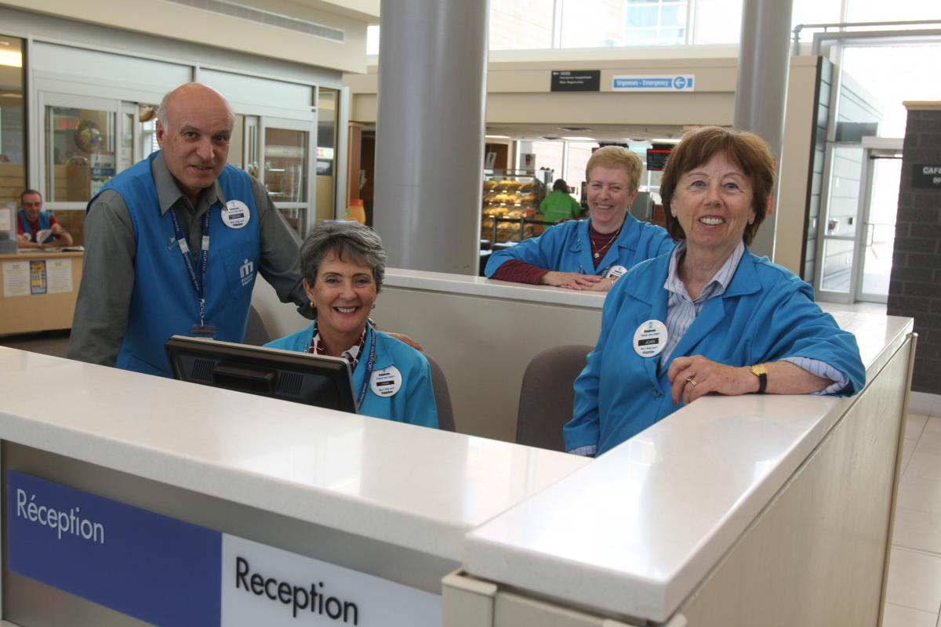
Example timeline for progressively involving patients in self-care and improving the transition experience Patient navigator partners
Patient navigator partner
¾ through treatment
Patient navigator partner
End of treatment
Patient navigator partner
Start
Set up a meeting with a patient partner, to help share experiences and hope
Offer a sympathetic ear through over-the-phone support with someone who can share their own experience
Provide a bookmark listing websites with information and self-care support
Share tips for healthy habits during treatment
Offer sessions about tools to help patients prepare for the transition: the End-of-Treatment Preparation Tool to identify their needs and concerns, experience sharing, screenings of self-care educational videos
Call patients to support them as they prepare for the transition
Offer an end-of-treatment meeting to tell patients about community services
Offer to give patients a call a few weeks post-treatment so they can talk about their experience (refer to ONN if there’s an issue)
Offer to give patients a call three to six months post-treatment to discuss their experiences (refer to ONN or community organization if there’s an issue)
Initial assessment
During treatment
End of treatment
31

Slide 32
Example timeline for progressively involving patients in self-care and improving the transition experience Community organizations
Start
Community
organizations
¾ through treatment
Community
organizations
End of treatment
Community
organizations
Accompany patients to their treatments (transportation)
Offer psychosocial guidance and support
Offer peer support
Ensure patients have access to information and referrals
Offer psychological and spiritual wellness services (massage therapy, yoga, meditation, art therapy, etc.)
Offer physical wellness services (physical activities, massage therapy, kinesiotherapy, etc.)
Offer peer support
Suggest support groups
Offer health education support (healthy habits, smoking cessation, personalized nutrition, alcohol reduction, etc.)
Share general information and offer referrals
Offer psychological and spiritual wellness services
Offer over-the-phone support after a referral
Offer physical wellness services
Provide peer support
Provide group support
Offer health education support (about healthy habits, smoking cessation, personalized nutrition, alcohol reduction, etc.)
Share general information and references
Offer psychological and spiritual wellness services
Offer over-the-phone support after a referral
Offer physical wellness services
Suggest ways to manage stress
Suggest ways to manage pain
Initial assessment
During treatment
End of treatment
32

Slide 33
Personalizing follow-up care: Risk stratification and self-care capacity assessment
Step 4
33

Slide 34
Did you know?
According to NHS Improvement Cancer, an estimated
75% of breast cancer patients, 45% of colorectal cancer patients and 30% of prostate cancer patients have a high capacity for self‑care (NHS England 2016).
Regardless of the type of survivorship care model, a risk-stratified approach to care is a critical component in ensuring that follow-up services are based on the risk of long-term and late effects as well as cancer recurrence (McCabe et al. 2013).
34

Slide 35
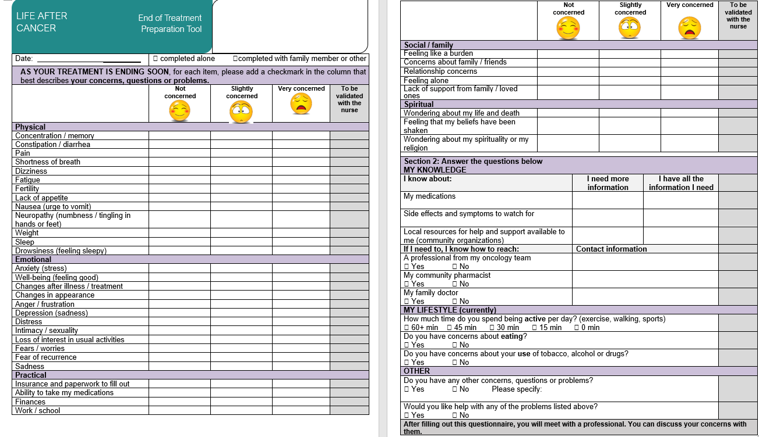
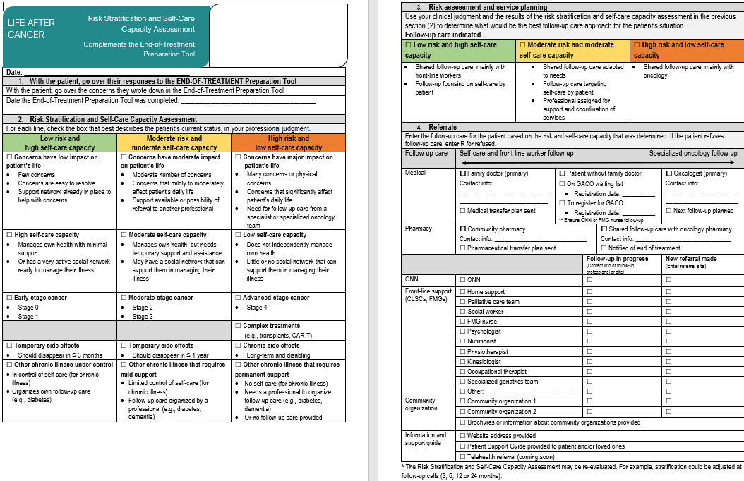
Outil pour préparer le patient à la fin des traitements
Tools for stratifying risk and assessing self-care capacity
Personalizing follow-up care: Tools for stratifying risk and assessing self-care capacity
1
Tools developed by CIUSSS de la Capitale-Nationale:
Myriam Laroche, Clinical and Administrative Co-manager, Oncology
Véronique Blanchette, Community Oncology Nurse Navigator
Suzanne Gaudreault, patient partner
2
35

Slide 36
Strategies to implement risk stratification and self-care capacity assessment tools
Goal of Step 4: Set up a structured process to coordinate continuity of services, personalized based on the patient’s needs, concerns, self-care capacity and health condition. | Available tools (click to download)
Proposed strategies
Propose a clinical process to understand the concerns and needs of patients and their loved ones Review the End-of-Treatment Preparation Tool to adapt it to your institution Work with patient partners to ensure the tool uses accessible language Identify the roles and responsibilities of the stakeholders involved in identifying patients who will be completing treatment in the weeks to come (it helps to include other team members and patient partners) Determine the best time for patients and their loved ones to fill out the tool (see example timelines on slides 30 and 31) and create a reminder (such as the ones used with scheduled exams) Brainstorm a way to inform the team that a patient has started the transition preparation process (note in chart, sticker on passport) Consult with the team to get them involved and give them a better understanding of the challenges
End-of-Treatment Preparation Tool
36

Slide 37
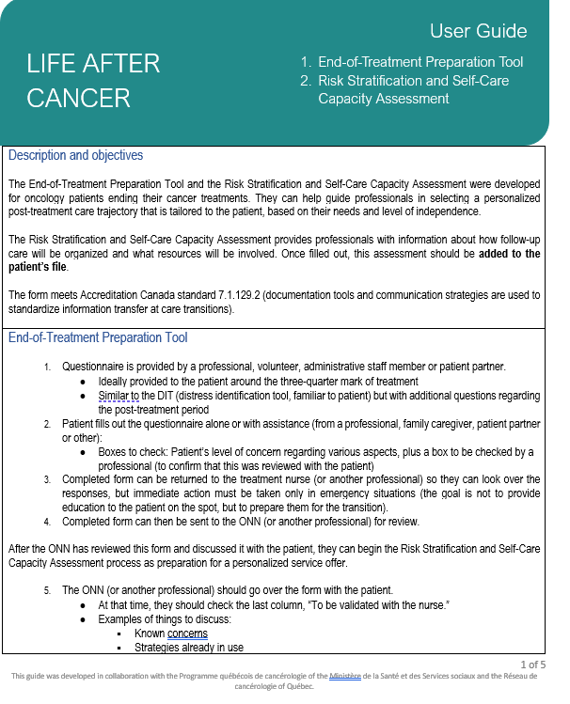
Proposed strategies | Available tools (click to download)
2. Propose a clinical process to personalize follow-up care by stratifying risk and assessing self-care capacity Review the Risk Stratification and Self-Care Capacity Assessment to adapt it to your care setting Establish a process and identify each person’s role in stratifying risk and assessing self-care capacity (who, when, how) Assess the capacity of professionals (workload) based on expected changes and adapt their responsibilities based on the roles of others Make a list of the services available in your community (listing of points of transition) Formalize your pathway (service corridors and points of transition) Develop service agreements with different partners Present the process to the oncology team to ensure interdisciplinary collaboration Speak with health record administrators about saving the assessment in patient charts Train professionals on the process
Risk Stratification and Self-Care Capacity Assessment
User Guide
37

Slide 38
Proposed strategies | Available tools (click to download)
3. Develop a referral template Modify the proposed referral section Work with community organizations to establish a standardized referral template to make it easier to refer patients Set up a referral request follow-up system to ensure patients receive support from professionals and partners during every step of the transition Ensure the clinical tools are adopted by the Form Standardization Committee so tools can be kept in patient charts 4. Train professionals on best practices for stratifying risk and assessing self-care capacity Share information about best practices Teach the team how to use the questionnaire to personalize follow-up care by stratifying risk and assessing self-care capacity Request that your care setting’s oncology program adopt the health care professional roles and responsibilities in the transition pathway
User Guide
38

Slide 39
Proposed strategies | Available tools (click to download)
Examples of how to use the End-of-Treatment Preparation Tool to analyze patient needs and concerns (who does what, how and when): Preparatory phase: Identify needs and concerns Plan a time (¾ into the treatment, before the last cycle, etc.) to provide the patient and their loved ones with the End-of-Treatment Preparation Tool Provide the patient and their loved ones with the tool and explain that it will prepare them for the transition and help them understand their post-treatment service needs (can be done by a professional, volunteer, administrative staff member or patient partner) Collect the completed form; a health care professional will review the responses and address any critical issues (the goal is not to provide on-the-spot education but to be a transition preparation tool) Send the completed from to the ONN (or to another professional) to begin the risk stratification and self-care capacity assessment process (slide 40) to prepare for personalized service delivery Make a note in the patient’s chart that they have begun the process of preparing for transition (a sticker that reads “Transition in progress” may also be placed on their oncology passport)
End-of-Treatment Preparation Tool
39

Slide 40
Proposed strategies | Available tools (click to download)
Examples of how to use the Risk Stratification and Self-Care Capacity Assessment (who does what, how and when): Personalized organization of services and analysis phase Review and analyze the End-of-Treatment Preparation Tool completed by the patient and their loved ones Review the patient’s chart (comorbidities) Speak with the attending physician or medical specialist to confirm the risk stratification level (comorbidities) Have the ONN or another professional fill out sections 1 and 2 of the Risk Stratification and Self-Care Capacity Assessment, an analysis of which will inform section 3 and the personalized service delivery Select the category of risk and self-care capacity under “Follow-up care indications” in section 3 that best fits the patient and their environment: Low risk and high self-care capacity; Moderate risk and moderate self-care capacity; or High risk and low self-care capacity Offer follow-up care services and resources and direct patients as appropriate according to their needs, self-care capacity and risk level (see follow-up care examples on next slide) Plan a meeting with the patient and their loved ones to share your observations and suggest personalized end-of-treatment service delivery (this planning meeting can be held over the phone shortly before treatment completion) Set up a meeting at the patient’s last treatment for the ONN or another professional to review service delivery aimed at ensuring continuity of services and give the patient their Support Guide (see next step)
Risk Stratification and Self-Care Capacity Assessment
User Guide
40

Slide 41
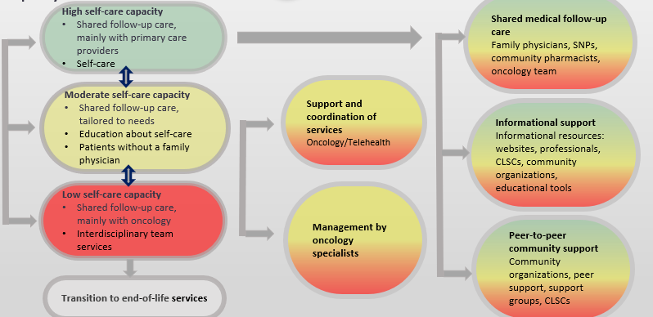
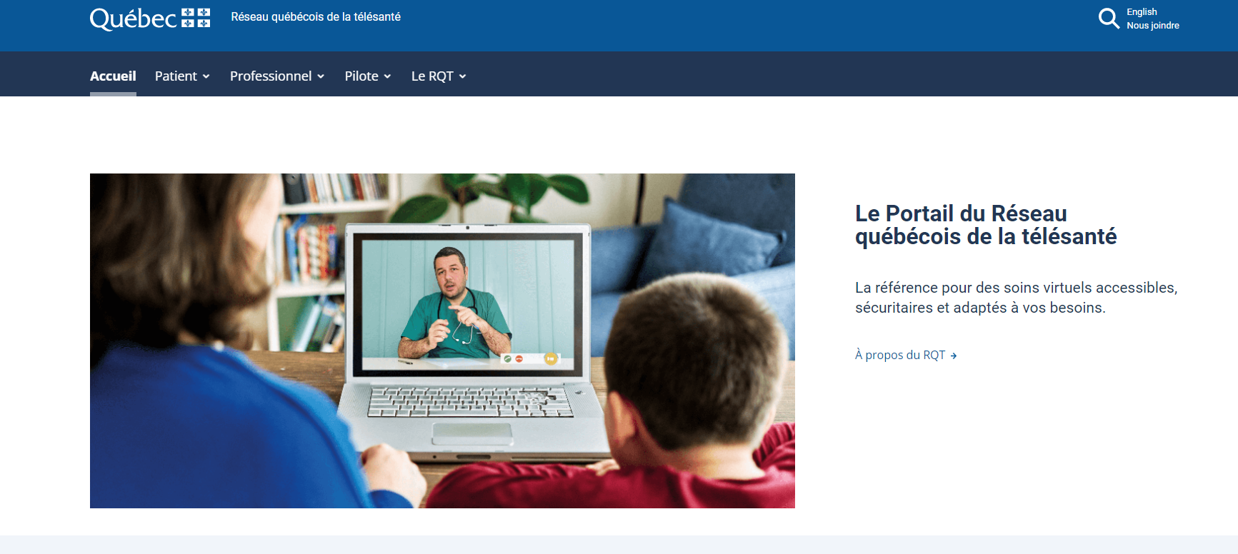
Proposed strategies | Available tools (click to download)
Examples of services based on follow-up care indications: Ensure continuity of services for patients with high self-care capacities Referral to family physician or Primary Health Care Nurse Practitioner Referral to and share transfer plan with community pharmacist Referral to primary care follow-up care resources (shared care) Systematic referral to a community organization Continuity of service with ONN or any other oncology professional, if needed, for the next six months Ensure continuity of services for patients with moderate self-care capacities Over-the-phone follow-up care with ONN for three to six months following treatment (or longer if needed) Follow-up care with a community organization Follow-up care, shared between oncology team and primary care Telehealth follow-up care for three to six months after treatment completion (or more, as needed) Optimize communications between specialized centres (referral centres) and affiliated centres that support the follow-up care transition Reassess risk stratification after six months and redirect as needed Maintain continuity of services for patients with low self-care capacities Ensure continuity of services with oncology team Transfer to end-of-life care setting (if applicable) Reassess risk stratification after six months and transfer as needed
41

Slide 42
Develop a Support Guide with the patient and their loved ones
Step 5
42

Slide 43
Did you know?
One of the primary recommendations of the Institute of Medicine (IOM) is that every cancer survivor should receive a care plan containing a personal treatment summary, any potential late and long-term effects, signs of recurrence, follow-up care directives, a list of care providers, lifestyle recommendations and support resources (Hewitt et al. 2006).
According to the study’s data, oncology staff felt that the optimal time for patients to review their support plan was three to six months after their treatment ended (Dulko et al. 2013).
The pathway for post-treatment personalized service stems from a joint decision between the individual, their loved ones and the clinician (NHS England 2016).
43

Slide 44
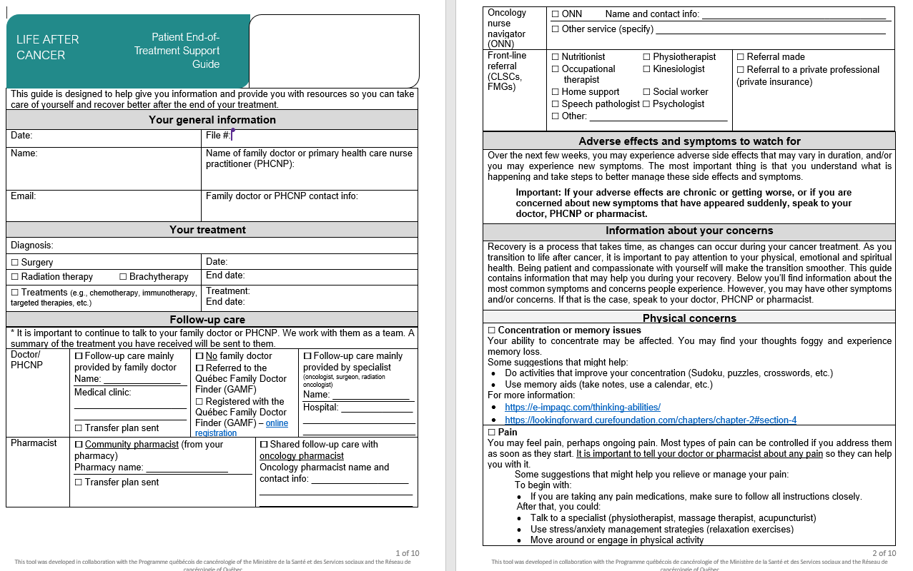
End-of-Treatment Support Guide for Patients and Their Loved Ones
End-of-Treatment Support Guide for Patients and Their Loved Ones
Tool developed by CISSS de Laval:
Dr. Marie-Andrée Fortin, Medical Co-manager
Nicolas Cliquennois, Clinical and Administrative Co-manager
Guylaine Veillette, Clinical and Administrative Co-manager
Marie-José Fillion, patient partner
Ginette Brousseau, patient partner
3
44

Slide 45
Strategies to implement the Support Guide
Goal of Step 5: Provide a personalized support guide that addresses the patient’s and their loved ones’ main concerns, is adapted to their capacities and includes all necessary resources for follow-up care, health advice for symptom management and prevention and information about accessing educational tools. | Available tools (click to download)
Proposed strategies
1. Propose a Patient Support Guide template Review the Patient Support Guide to adapt it to your care setting Work with patient partners to ensure the tool uses accessible language Identify the essential information that should be shared with patients and their loved ones 2. Establish a process for completing a support guide for each patient Come up with a process for sharing the Patient Support Guide after completing risk stratification. (The End-of-Treatment Preparation Tool and Risk Stratification and Self-Care Capacity Assessment will determine what information should be shared in the support guide.) Create a template to facilitate meetings involving healthcare professionals, patients, and their loved ones, aimed at efficiently completing the support guide. The guide should address the needs and objectives of the patient and their loved ones.
Patient Support Guide
45

Slide 46
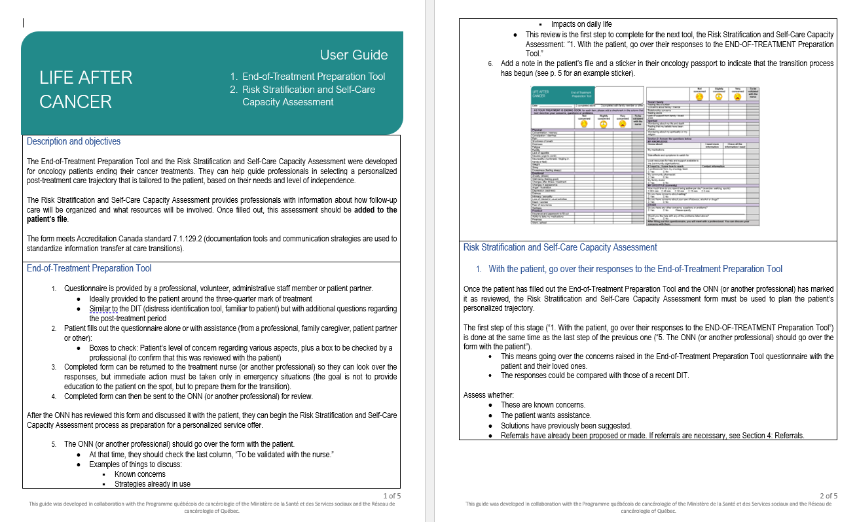
Proposed strategies | Available tools (click to download)
Determine the best time for the professional to fill out the support guide for patients and their loved ones (see example timelines on slides 30 and 31) Assess the capacity of professionals (workload) based on expected changes and adapt their responsibilities based on other participants’ roles Decide which professionals on the team can meet with the patient and their loved ones. This can be a relatively short discussion for patients who received self-care education throughout the care pathway. Come up with a follow-up care mechanism for one or two months after treatment to make sure that all patients receive follow-up care (see slides 30 to 32) Create an information sheet explaining the best-case scenario Involve patient partners in adopting the process Document the roles and responsibilities of the professionals involved in the transition preparation process Share the support guide with the patient: Without MosaiQ: Print and fill out a paper guide Fill out the guide on a computer, save it as a PDF and print or email it to the patient With MosaiQ: Implement as suggested by CISSS de Laval
General User Guide
46

Slide 47
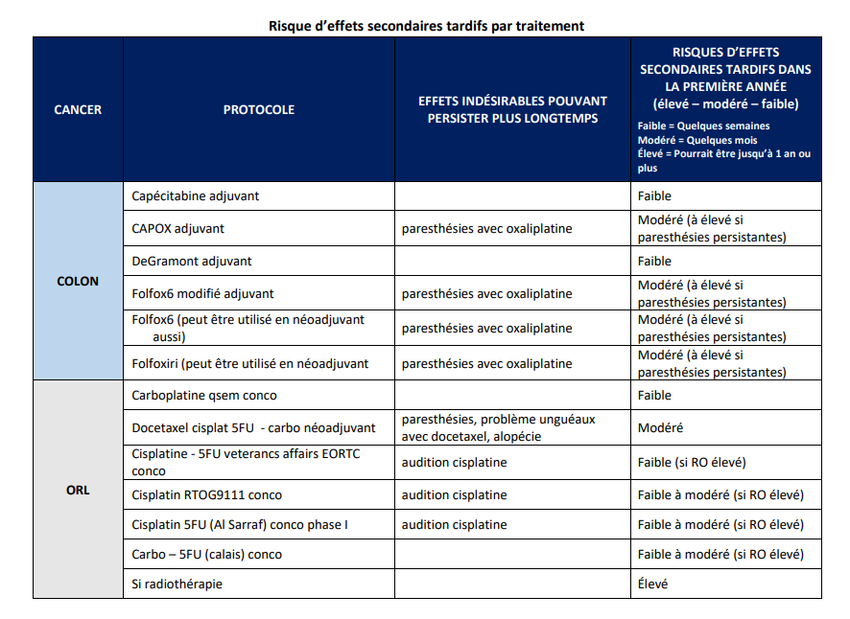
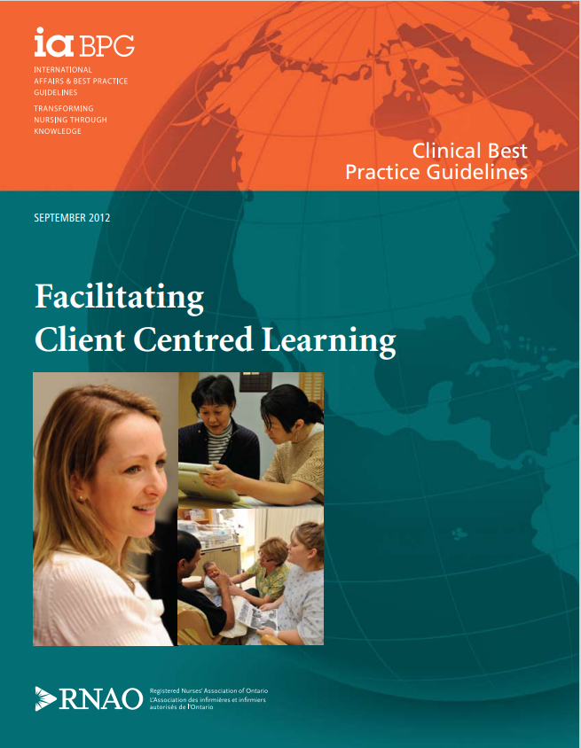
Proposed strategies | Available tools (click to download)
Examples of what to do to fill out the Patient Support Guide Gather all completed forms (Step 4: End-of-Treatment Preparation Tool and Risk Stratification and Self-Care Capacity Assessment) Start completing the support guide by filling out the sections: “Your general information,” “Your treatment,” and “Upcoming follow-ups” (final section) Plan a meeting with the patient and their loved ones. Check with the oncology pharmacist to see if they need to meet with the patient and their loved ones. Present the personalized follow-up care service delivery plan to the patient and their loved ones and adjust the community service referrals to meet their needs Fill out the Patient Support Guide with the patient and their loved ones Ask the patient about their priorities and any strategies they might use to prevent or respond to the onset of symptoms Give the patient and their loved ones the support guide Inform the patient and their loved ones that a Medical Transfer Plan (next step, slide 49) will be sent to their family physician. Tell them what to do if they don’t have a family physician. Make sure that the patient and their loved ones know which resources they can contact with any questions or issues
Information sheet about late symptoms (produced by CISSS de Laval, French only)
(Registered Nurses’ Association of Ontario 2012)
47

Slide 48
Proposed strategies | Available tools (click to download)
3. Equip the team with “Life After Cancer” and late symptom management tools Provide the team with information sheets about common late symptoms Train the team on “Life After Cancer” Support skill development in the learning facilitation approach focused on patient needs and self-care concepts
Late symptom information sheet (produced by CISSS de Laval, French only)
(Registered Nurses’ Association of Ontario 2012)
(National Comprehensive Cancer Network 2023) (FREE. Sign up for an account to access their very useful comprehensive guide.)
Websites:
48

Slide 49
Roll out the Medical and Pharmaceutical Transfer Plan
Step 6
49

Slide 50
Did you know?
Increased communication between oncologists, cancer survivors and other healthcare providers through a follow-up care plan that addresses not only what was done, but also what should be done in the future, can help establish clear roles among providers and help primary care providers better perform their roles in survivor care. (Dulko et al. 2013).
Only 27% of primary care professionals feel that the information they receive is complete and supports the medical and pharmaceutical follow-up care of their patients (Brochu and Arsenault 2022).
50

Slide 51
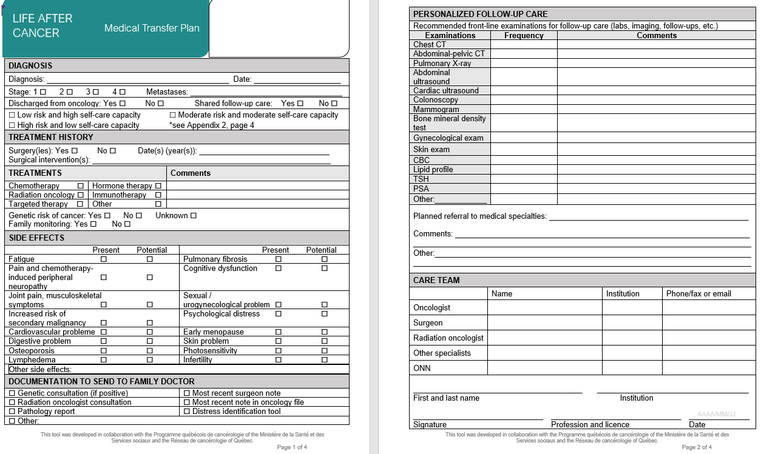
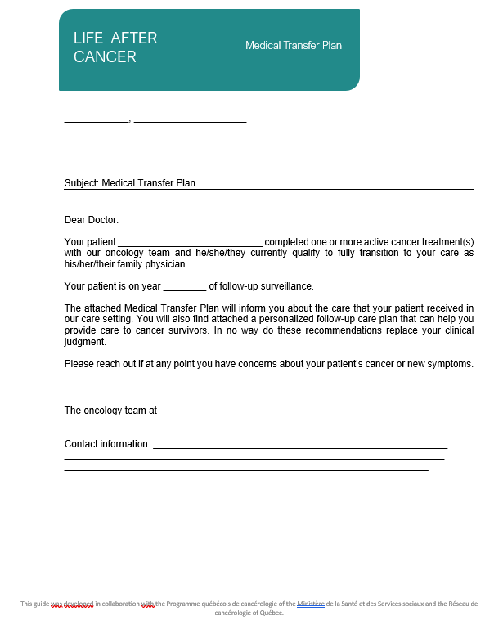
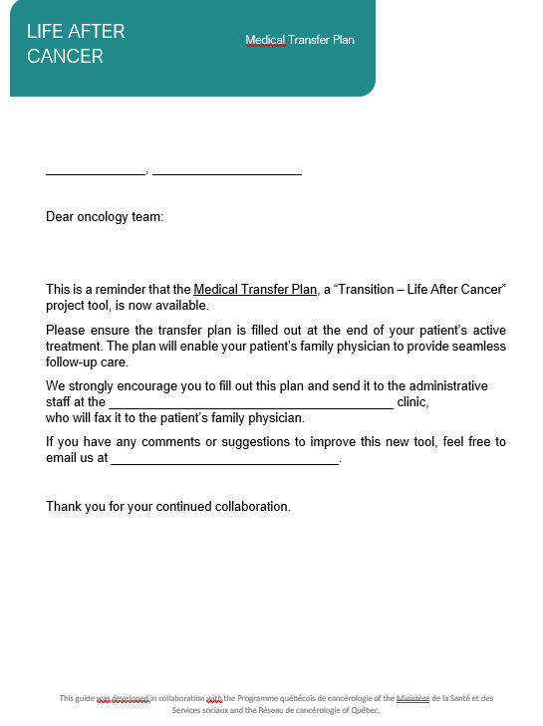
Tools to implement the Medical Transfer Plan
Medical Transfer Plan
Tools developed by CIUSSS du Nord-de-l’Île-de-Montréal:
Dr. Setareh Samimi, Oncologist
Claire Foucher, Clinical and Administrative Co-manager
3
3
Family physician letter of explanation
Example of oncology team reminder
51

Slide 52
Strategies to implement the Medical Transfer Plan
Goal of Step 6: Provide family physicians, Primary Health Care Nurse Practitioners (PHCNP) and community pharmacists with a transfer plan to ensure safe, effective shared care. | Available tools (click to download)
Proposed strategies
1. Set up a process for cancer specialists to fill out the Medical Transfer Plan Review the Medical Transfer Plan to adapt it to your care setting Speak with family physicians and PHCNPs to confirm what clinical information they need transferred Establish a method and process for oncology team physicians to fill out the form Decide how to send the plan to primary care teams Create agreements with administrative staff at family medicine groups, university family medicine groups and physicians’ offices to ensure continuity of medical information Inform family physicians in your region (or nearby) about the Medical Transfer Plan being sent to primary care
Medical Transfer Plan
(National Comprehensive Cancer Network 2023) (FREE. Sign up for an account to access their very useful comprehensive guide.)
52

Slide 53
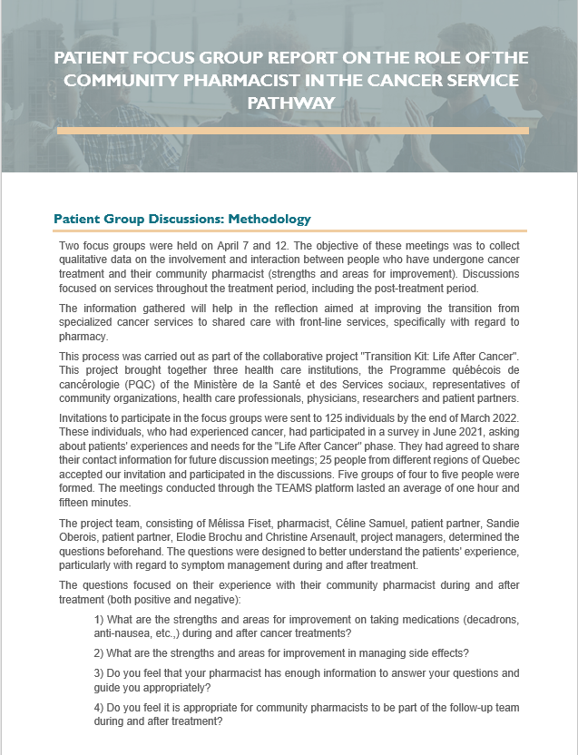
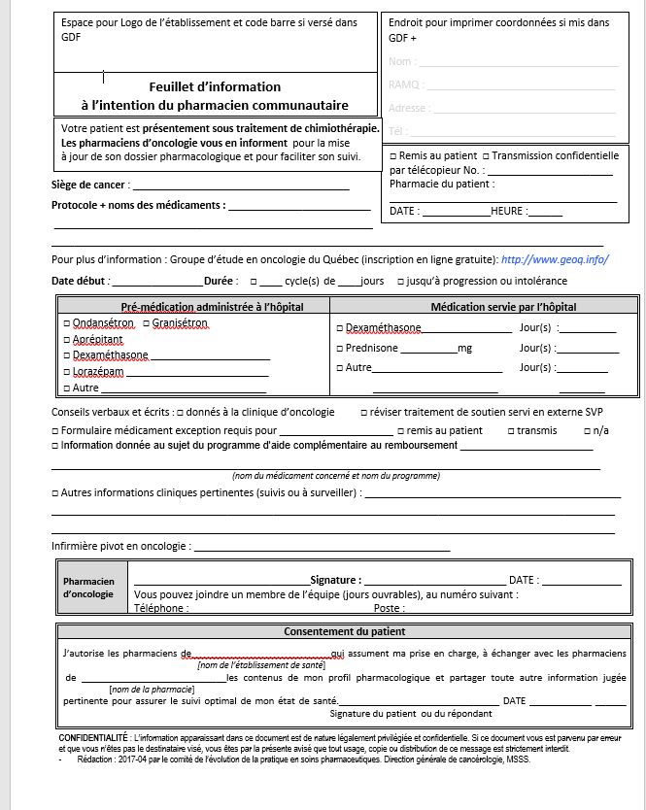
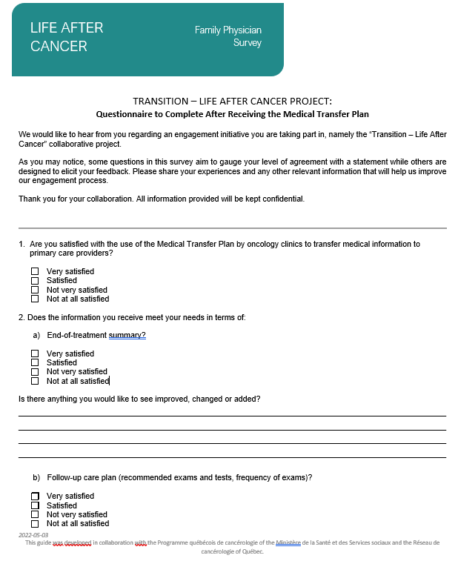
Proposed strategies | Available tools (click to download)
2. Establish a process for completing the Pharmaceutical Transfer Plan Share the “Patient Focus Groups About the Role of Community Pharmacists in the Cancer Care Pathway” report with oncology pharmacists in your organization Work with the oncology pharmacist to approve the information transfer process established in the Pharmaceutical Transfer Plan for IV therapy as soon as treatment starts Set up an end-of-treatment meeting (over the phone or in person) with the oncology pharmacist, the patient and their loved ones (if needed) to go over the Pharmaceutical Transfer Plan and answer any questions Send the community pharmacist a Best Possible Medication History (BPMH) at the end of the treatment 3. Evaluate how satisfied primary care professionals are with the information transfer process Meet with or send surveys to physicians, SNPs and community pharmacists to evaluate how satisfied they are with the new transition process Adjust or change the process based on their feedback
Pharmaceutical transfer plan for IV therapy (FREE after signing up on GEOQ; French only)
Focus group report
Example of family physician satisfaction survey
(paper version)
(Web version: Copy this form to make your own version. No one else will have access to your responses.)
53

Slide 54
Assess patient experience
Step 7
54

Slide 55
Did you know?
Information about patient experience can be used in different ways: to improve specific interventions, change professional practices or even influence the development of public policies (Russell 2013). That said, the end goal is always to use this information to improve the experience of the patients themselves (Dubé-Linteau 2017).
A number of studies have found that a positive care experience is correlated with greater adherence to treatment and prevention recommendations, better clinical results, improved patient safety and less use of services (Dubé-Linteau 2017).
55

Slide 56
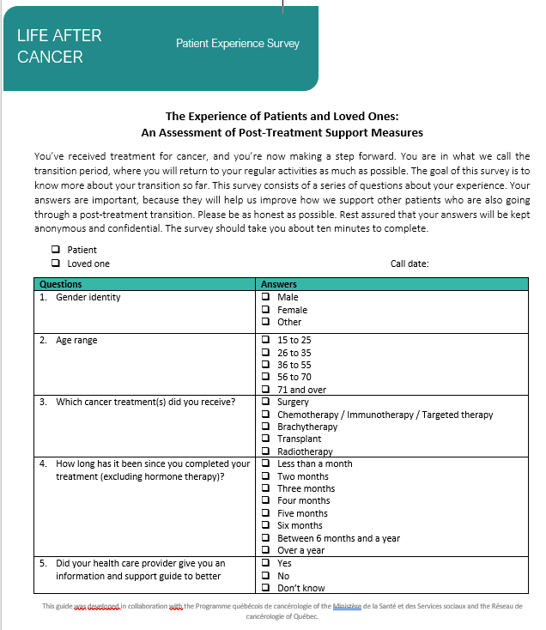
Strategies to assess patient experience
Goal of Step 7: Determine the effectiveness of transition mechanisms by implementing a continuous quality improvement process. | Available tools (click to download)
Proposed strategies
1. Identify methods for assessing the post-treatment patient experience As a team, establish a model for assessing patient experience via focus groups and email or phone surveys Choose a survey format that will generate responses that represent your client base (we recommend using multiple survey modes to ensure your responses are representative) Set up a schedule for a quality feedback loop process in which patient partners can conduct approximately 50 over-the-phone surveys each year with patients who have completed treatment at least three months ago (see project proposal) Give the oncology team a yearly presentation on survey results (from phone calls, emails or focus groups) Come up with an improvement plan with input from professionals and patient partners
Example of patient experience survey:
(Web version: Copy this form to make your own version. No one else will have access to your responses.)
(Paper version)
56

Slide 57
References
Accreditation Canada, 2019. Physical Health Assessment Manual (No. 750-02.001.124-QC.19 V:1(EN)). Accreditation Canada.
Arsenault, D., Roy, M.-C., 2023. Impact de l’activité physique sur les effets indésirables associés au cancer et aux traitements oncologiques chez l’adulte. État des connaissances : Institut national d’excellence en santé et en services sociaux (INESSS), Québec City, QC.
Ashcroft, B., 2013. Throwing light on the consequences of cancer and its treatment. Macmillan Cancer Support.
Azadmanjir, Z., Safdari, R., Ghazisaeidi, M., 2015. From Self-care for Healthy People to Self-management for Cancer Patients with Cancer Portals. Asian Pac. J. Cancer Prev. APJCP 16, 1321–1325. https://doi.org/10.7314/apjcp.2015.16.4.1321
Berkesse, A., Boivin, A., Descôteaux, A., Dumez, V., L’Espérance, A., Karazivan, P., Pomey, M.-P., Skiredj, K., Wong, C., 2022. Ensemble, je vais mieux. Livre blanc sur le partenariat avec les patients et le public Principes de déploiement des fondements du modèle de Montréal. Centre de recherche du CHUM.
Bourmaud, A., Piot De Villars, E., Renault-Teissier, E., 2022. Patient partnership and patient education in oncology. Bull. Cancer (Paris) 109, 588–597. https://doi.org/10.1016/j.bulcan.2021.09.016
Brochu, E., Arsenault, C., 2022. Rapport sur la Transition – La vie après le cancer, L’expérience des patients, des professionnels en cancérologie et des professionnels en première ligne. Survey results. Ministère de la Santé et des Services sociaux.
Canadian Institute of Health Research, 2018. Transitions in care - CIHR [Web Document]. Gov. Can. URL https://cihr-irsc.gc.ca/e/50971.html (accessed 7.12.23).
Canadian Partnership Against Cancer, 2018. Living with cancer: A report on the patient experience (System Performance Reports). Canadian Partnership Against Cancer.
Cancer Care Ontario, 2022. Exercise: For people with cancer. Cancer Care Ont.
Contreras, G., 2020. Survivre à un cancer une fois les traitements terminés : les facteurs associés à une expérience de soins positive chez les patients du Québec. Inst. Stat. Qué., Zoom santé 1–12.
Dubé-Linteau, 2017. Measuring patient experience through surveys: from concepts to best practices (Études et documents). Institut de la statistique du Québec, Québec.
Dulko, D., Pace, C.M., Dittus, K.L., Sprague, B.L., Pollack, L.A., Hawkins, N.A., Geller, B.M., 2013. Barriers and Facilitators to Implementing Cancer Survivorship Care Plans. Oncol. Nurs. Forum 40, 575–580. https://doi.org/10.1188/13.ONF.575-580
Fitch, M., Zomer, S., Lockwood, G., Louzado, C., Shaw Moxam, R., Rahal, R., Green, E., 2019. Experiences of adult cancer survivors in transitions. Support. Care Cancer 27, 2977–2986. https://doi.org/10.1007/s00520-018-4605-3
Gross, O., 2017. L’engagement des patients au service du système de santé, La personne en médecine. Doin, Montrouge.
Health Quality Ontario, 2012. Evidence Informed Improvement Package: Transitions of Care. Health Quality, Toronto.
57

Slide 58
Healthcare Excellence Canada, 2021. Engagement-Capable Environments: Organizational Self-Assessment Tool. Healthcare Excellence Canada.
Hewitt, M.E., Greenfield, S., Stovall, E., National Cancer Policy Board (U.S.) (Eds.), 2006. From Cancer Patient to Cancer Survivor: Lost in Transition. National Academies Press, Washington, D.C.
Kearney, B.Y., Fleischer, B.J., 1979. Development of an Instrument to Measure Exercise of Self-care Agency. Res. Nurs. Health 2, 25–34. https://doi.org/10.1002/nur.4770020105
Macmillan Cancer Support, 2020. What to do after cancer treatment ends: 10 top tips. Macmillan Cancer Support.
Mattison, C., Wilson, M., Gauvin, F., 2018. Optimizing Patient and Family Transitions from Cancer Treatment to Primary- and Community-care Supports in Canada.
Mayer, D.K., Alfano, C.M., 2019. Personalized Risk-Stratified Cancer Follow-Up Care: Its Potential for Healthier Survivors, Happier Clinicians, and Lower Costs. J. Natl. Cancer Inst. 111, 442–448. https://doi.org/10.1093/jnci/djy232
McCabe, M.S., Partridge, A.H., Grunfeld, E., Hudson, M.M., 2013. Risk-Based Health Care, the Cancer Survivor, the Oncologist, and the Primary Care Physician. Semin. Oncol. 40, 804‑812. https://doi.org/10.1053/j.seminoncol.2013.09.004
Model of Survivorship Care Working Group, 2016. Model of Survivorship Care: Critical Components of Cancer Survivorship Care in Australia Position Statement. Clinical Oncology Society of Australia.
National Comprehensive Cancer Network, 2023. NCCN Clinical Practice Guidelines in Oncology for Survivorship. National Comprehensive Cancer Network.
NHS England, 2016. Innovation to implementation: Stratified pathways of care for people living with or beyond cancer – A ‘how to guide.’ NHS England.
NHS England, 2020. Implementing Personalised Stratified Follow Up Pathways [Web Document]. URL: https://www.england.nhs.uk/publication/implementing-personalised-stratified-follow-up-pathways/ (accessed 7.12.23).
Pomey, M.-P., Flora, L., Karazivan, P., Dumez, V., Lebel, P., Vanier, M.-C., Débarges, B., Clavel, N., Jouet, E., 2015. Le « Montreal model » : enjeux du partenariat relationnel entre patients et professionnels de la santé. Sante Publique Vandoeuvre--Nancy Fr. 1 Suppl, 41–50.
Registered Nurses’ Association of Ontario, 2012. Facilitating Client Centred Learning. Registered Nurses’ Association of Ontario, Toronto, Canada.
Registered Nurses’ Association of Ontario, 2014. Care Transitions. Registered Nurses’ Association of Ontario, Toronto.
Russell, S., 2013. Patients’ Experiences: Top heavy with research. Research Matters: Melbourne.
Truant, T.L., Fitch, M.I., O’Leary, C., Stewart, J., 2017. Perspectives mondiales sur la survie au cancer : des dédales de la transition aux voies d’avenir à suivre. Can. Oncol. Nurs. J. Rev. Can. Nurs. Oncol. 27, 295–303.
Truant, T.L., Fitch, M.I., O’Leary, C., Stewart, J., 2017b. Global perspectives on cancer survivorship: From lost in transition to leading into the future. Can. Oncol. Nurs. J. Rev. Can. Nurs. Oncol. 27, 287–294.
Urquhart, R., 2017. Pan-Canadian Framework for Cancer Survivorship Research.
58

Slide 59
APPENDIX 1
Accreditation Canada
59

Slide 60
Données issues du sondage expérience patient
Adapting the Accreditation Canada required organizational practices – Information transfer at care transitions
Accreditation Canada standards (Accreditation Canada 2019) | Proposed tools that relate to the standard
7.1.123 Appropriate follow-up services for the client, where applicable, are coordinated in collaboration with the client, family, other teams, and organizations. Responsibility for the client's care continues until service has ended or the client has been transferred to another team, service, or organization. Follow-up services may include primary care, home and community services, community-based rehabilitation, psychological counselling services, and recommendations for ongoing care. 7.1.124 Responsibility for follow-up care is determined in partnership with the client, family, and primary care provider. Clarity regarding who is responsible for surveillance, other cancer screenings, and preventative health care is important when clients with cancer transition from one service to another. 7.1.131 The client's risk of readmission is assessed, where applicable, and appropriate follow-up is coordinated. | Risk Stratification and Self-Care Capacity Assessment
60

Slide 61
Accreditation Canada standards (Accreditation Canada 2019) | Proposed tools that relate to the standard
7.1.126 The client's physical and psychosocial readiness for transition, including their capacity to self-manage their health, is assessed. This assessment happens as early as possible within the care process. Instances where self-management would benefit the client are determined. Capacity to self-manage is influenced by factors such as access to a support network, community care options, cognitive and physical ability, and literacy level.
End-of-Treatment Preparation Tool
61

Slide 62
Accreditation Canada standards (Accréditation Agrément Canada 2019) | Proposed tools that relate to the standard
7.1.129 Information relevant to the care of the client is communicated effectively during care transitions.
7.1.130 The effectiveness of transitions is evaluated and the information is used to improve transition planning, with input from clients and families.
Pharmaceutical Transfer Plan for IV therapy (FREE after signing up on GEOQ; French only)
Patient Experience Survey
62

Slide 63
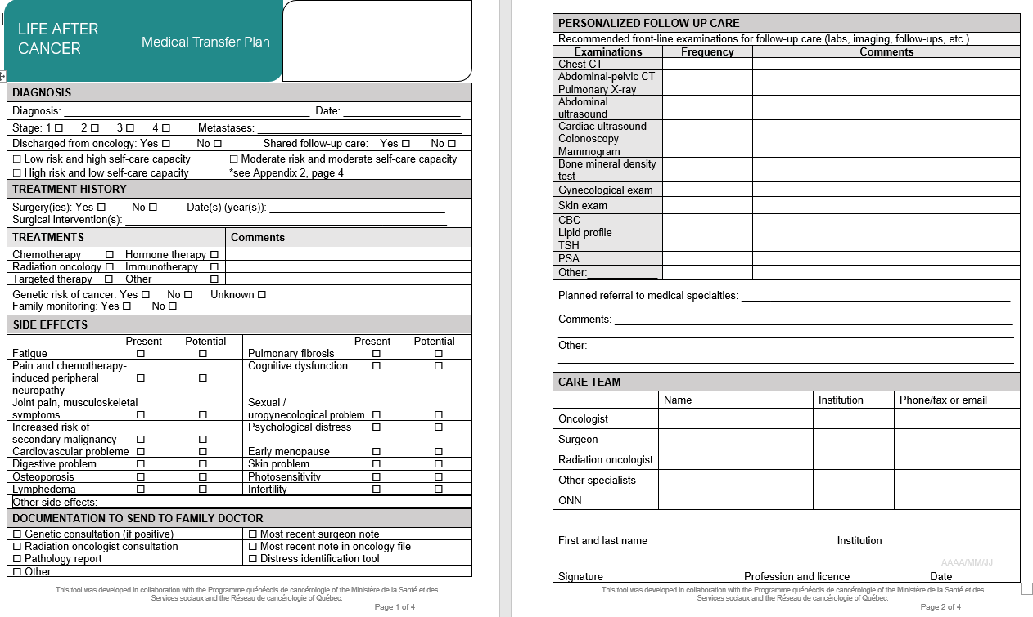
Accreditation Canada standards (Accreditation Canada 2019) | Proposed tools that relate to the standard
7.1.125 A client's wish to end or limit services, transfer to another service, or transition home, is respected. 7.1.127 Clients are empowered to self-manage conditions by receiving education, tools, and resources, where applicable. 7.1.128 Planning for care transitions, including end of service, are identified in the care plan in partnership with the client and family.
7.1.129 Information relevant to the care of the client is communicated effectively during care transitions.
Patient Support Guide
Medical Transfer Plan
63

Slide 64
APPENDIX 2
Clinical tools
64

Slide 65
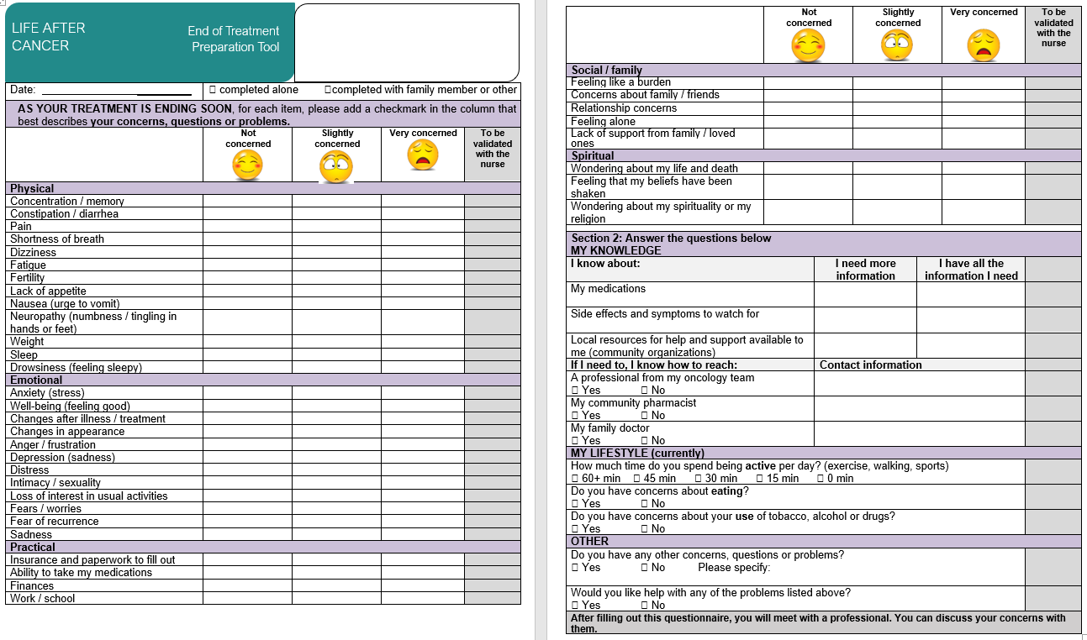
65

Slide 66
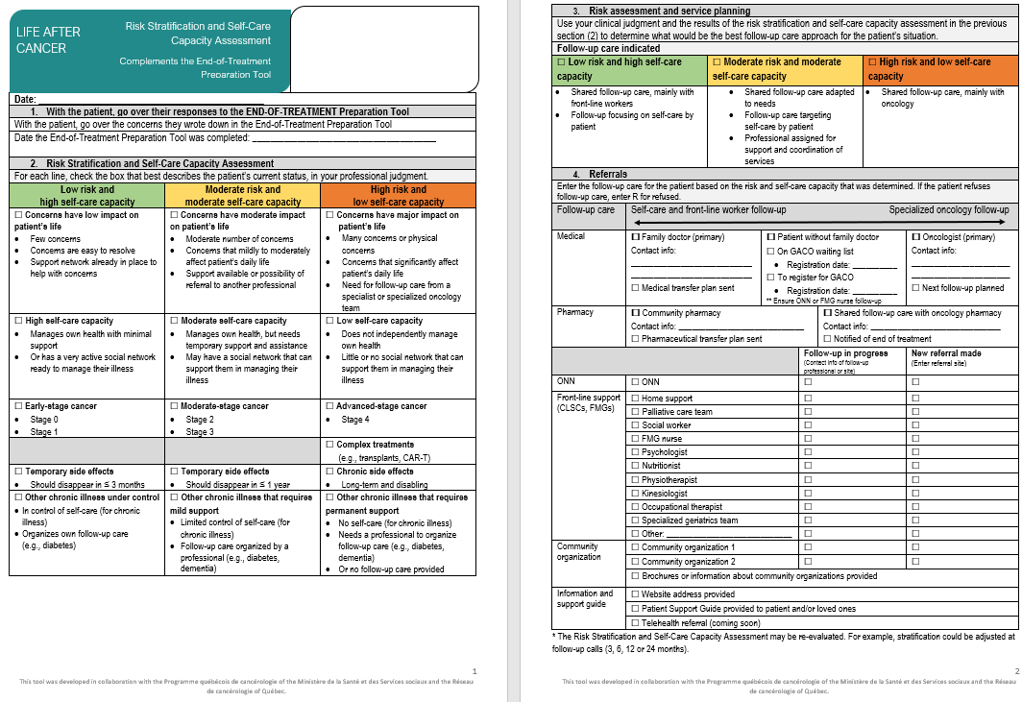
66

Slide 67
67

Slide 68
68

Slide 69
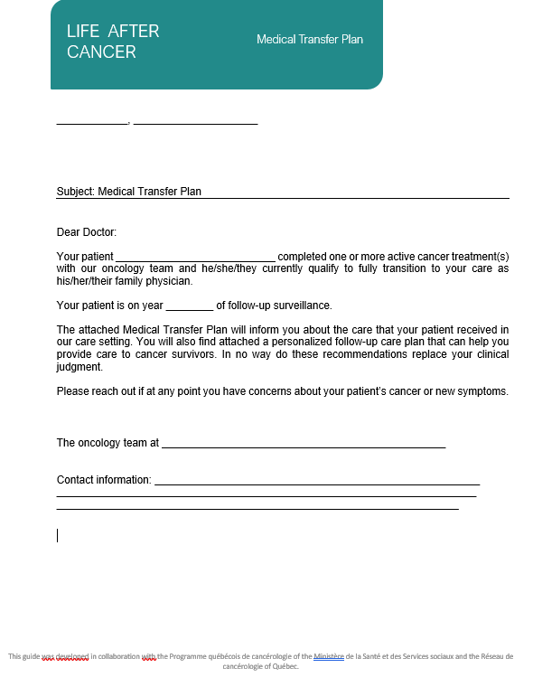
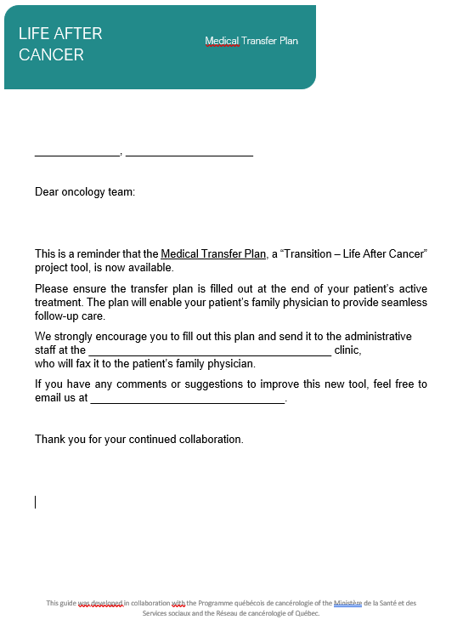
69

Slide 70
APPENDIX 3
Recommendations for improving the clinical tools and toolkit
70

Slide 71
71

